Slide 1
www.verbolia.com

Slide 2
Scalable traffic acquisition platform for ecommerce
Founded 2018

Slide 3
Scalable traffic acquisition platform for ecommerce
40 employees

Slide 4
Scalable traffic acquisition platform for ecommerce
>20.000.000 longtail SEO visits/mo

Slide 5
What Makes Amazon
Stand-out in SEO?

Slide 6
They Have Pages For All Possible Transactional Search Queries

Slide 7
Shampoo - Women shoes - Television
# of monthly searches
Top Tail
(20%)
# of keyword variants

Slide 8
Shampoo - Women shoes - Television
# of monthly searches
Shampoo Nivea - Blue women shoes - Samsung television
Mid Tail
(10%)
# of keyword variants

Slide 9
Shampoo - Women shoes - Television
# of monthly searches
Shampoo Nivea - Blue women shoes - Samsung television
Shampoo Nivea for grey hair - Blue Adidas running shoes for women - 4k samsung led television
Long Tail (70%)
# of keyword variants

Slide 10
Transactional Longtail keywords
Jeans for women

Slide 11
black jeans for women
slimfit mom jeans
Jeans for women
large jeans for women
blue mom jeans
bootcut jeans for women
high waist jeans

Slide 12
stretch black jeans women
large black jeans for women
black jeans for women
slimfit mom jeans
Jeans for women
slimfit high waisted jeans women
large bootcut jeans women
large jeans for women
blue mom jeans
slimfit stretch formal jeans
coated high waist jeans
women black jeans classy
slimfit high waisted jeans women
bootcut jeans for women
high waist jeans
stretch black jeans women
coated high waist jeans

Slide 13
15% - 30%
stretch black jeans women
large black jeans for women
black jeans for women
slimfit mom jeans
100%
slimfit high waisted jeans women
large bootcut jeans women
large jeans for women
blue mom jeans
slimfit stretch formal jeans
coated high waist jeans
women black jeans classy
slimfit high waisted jeans women
bootcut jeans for women
high waist jeans
stretch black jeans women
coated high waist jeans

Slide 14
Longtail SEO for ecommerce…
…for whom?

Slide 15
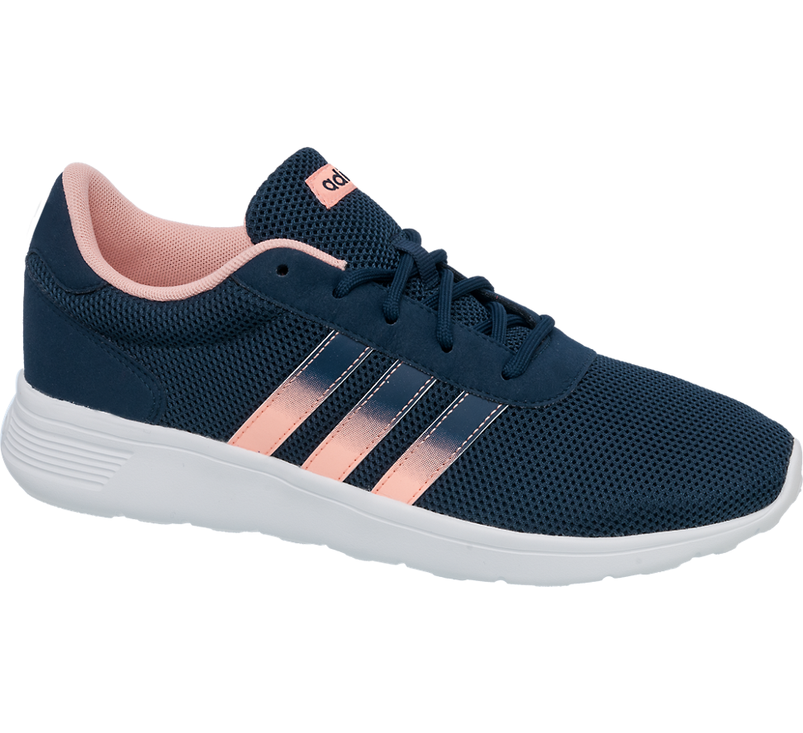
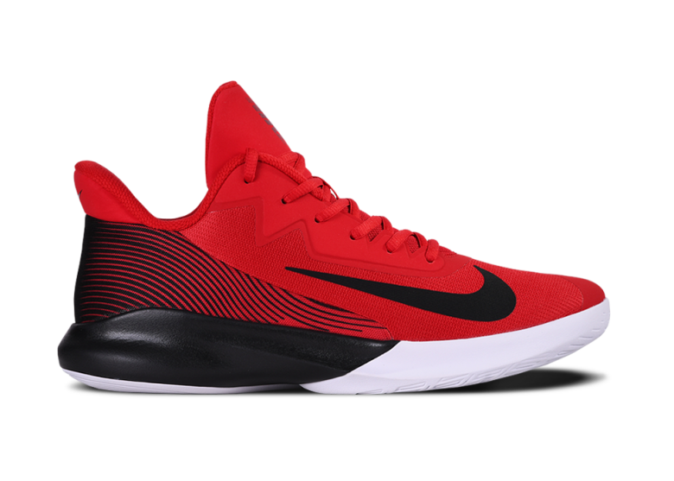
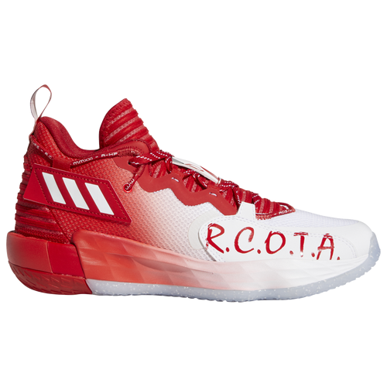
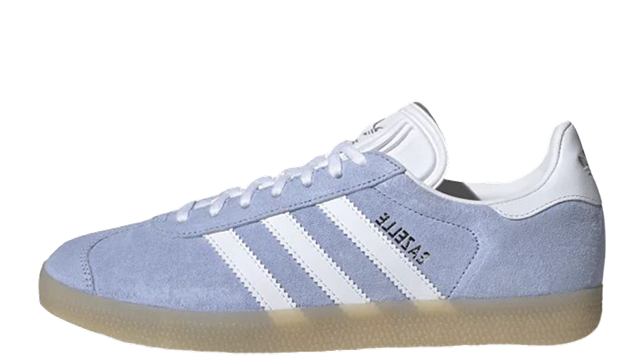
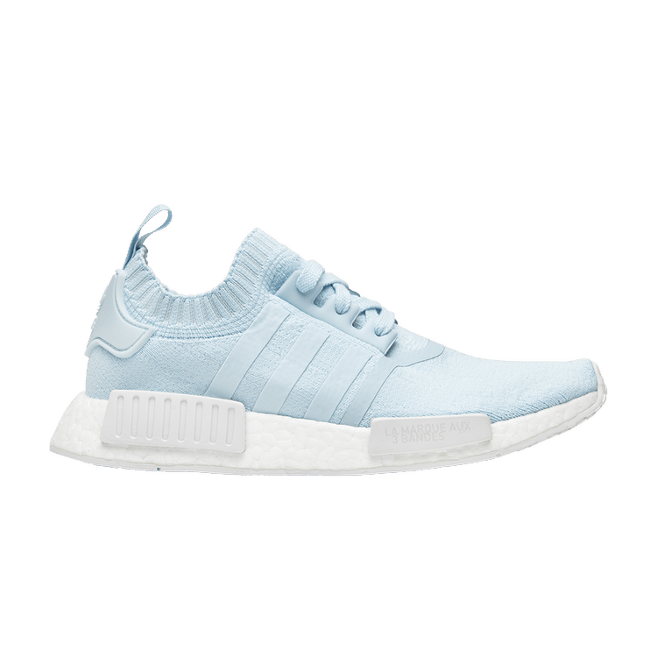
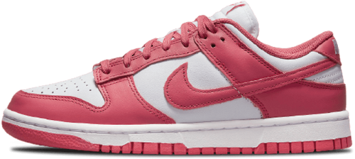
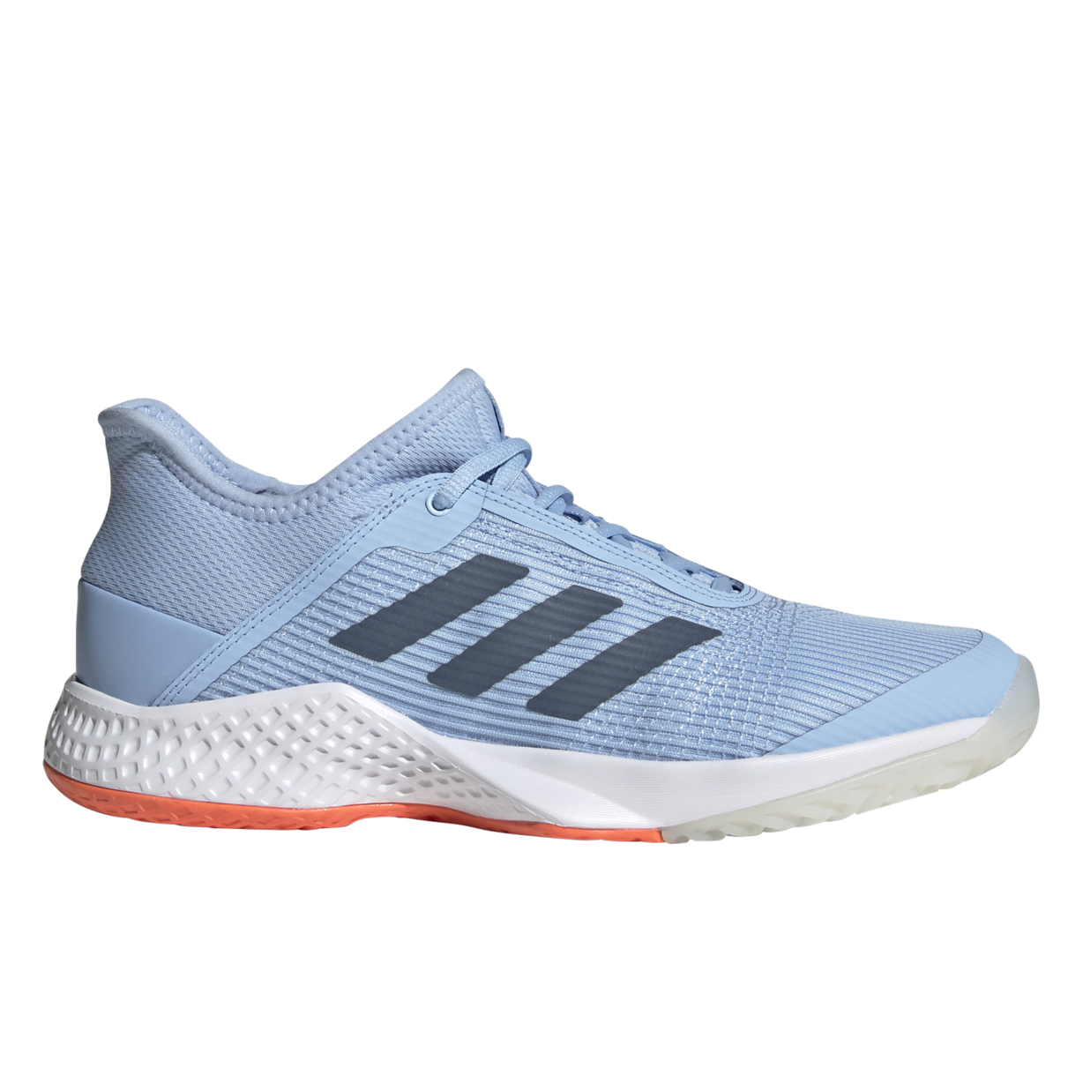
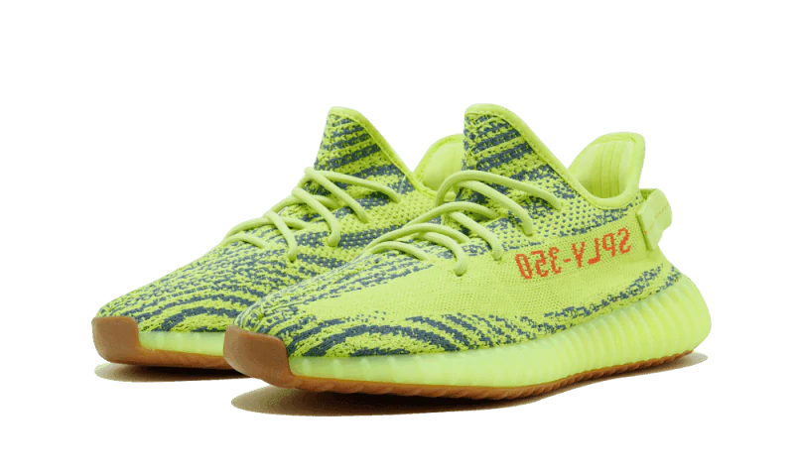
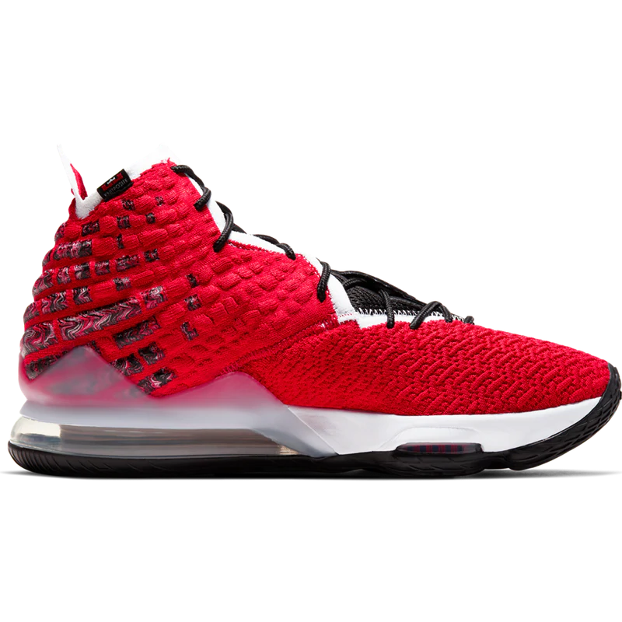
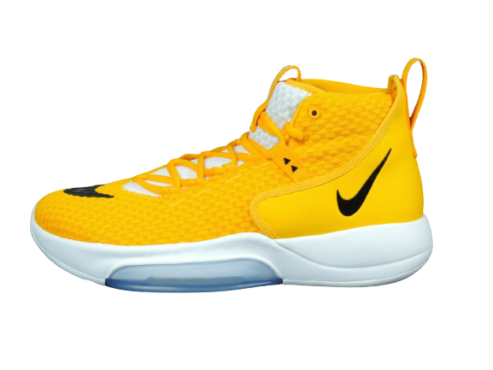
Ecommerce platform with
>3000 products
Adidas Lite Racer
Nike Precision IV
Nike Precision IV
109$
109$
Adidas Prophere 18
109$
Adidas NMD-R1
Adidas Dame 7
Nike Air Jordan 4
109$
109$
109$
109$
Nike Dunk Low
Adidas Lite Racer
109$
Adidas Prophere 18
Adidas Dame 7
Adidas Adizero Club
109$
Adidas Yeezy Boost
109$
Nike Dunk Low
109$
Adidas Yeezy Boost
109$
109$
Adidas Adizero Club
Adidas Adizero Club
109$
109$
Adidas NMD-R1
109$
Nike LeBron 17
109$
109$
Nike Air Jordan 4
Adidas NMD-R1
Nike Precision IV
109$
Nike Air Jordan 4
109$
Nike Zoom
109$
Nike Zoom
109$
109$
109$
Adidas Dame 7
109$
Adidas Prophere 18
Adidas Lite Racer
109$
Nike Dunk Low
Nike LeBron 17
109$
109$
Adidas Yeezy Boost
Nike LeBron 17
109$
109$
109$
Nike Zoom
109$
109$

Slide 16
Already some non-branded traffic
>100k monthly visits

Slide 17
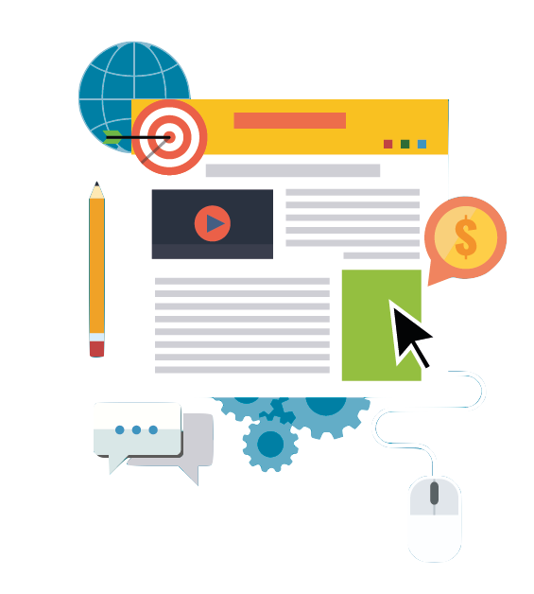
✗ Expensive
✗ Can’t automate
✗ Non-transactional
✗ Poor conversion rate
Blog post?

Slide 18
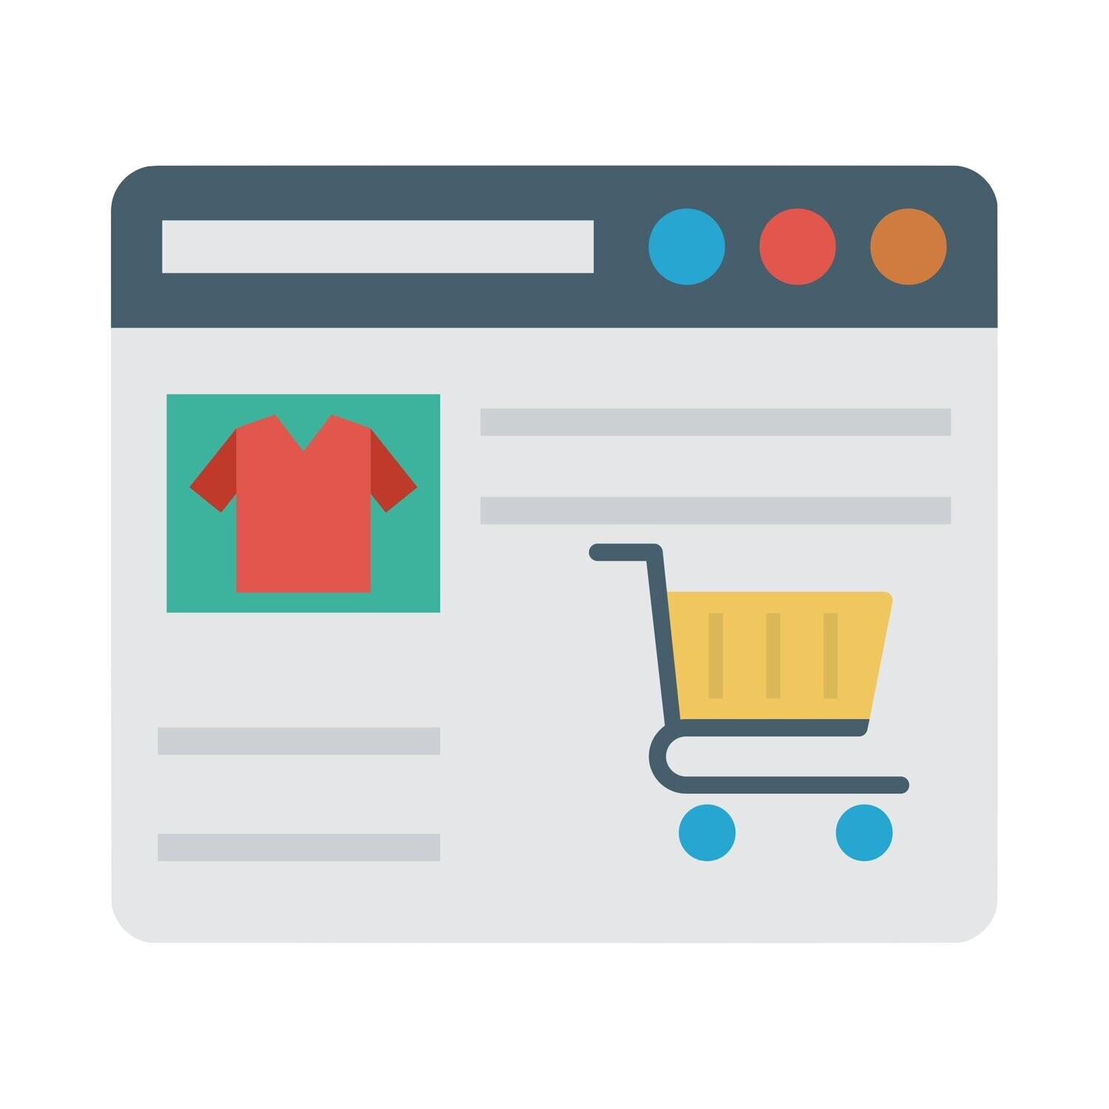
✗ Single product
✗ Can’t automate
✗ What if OoS?
Product Detail Page?

Slide 19
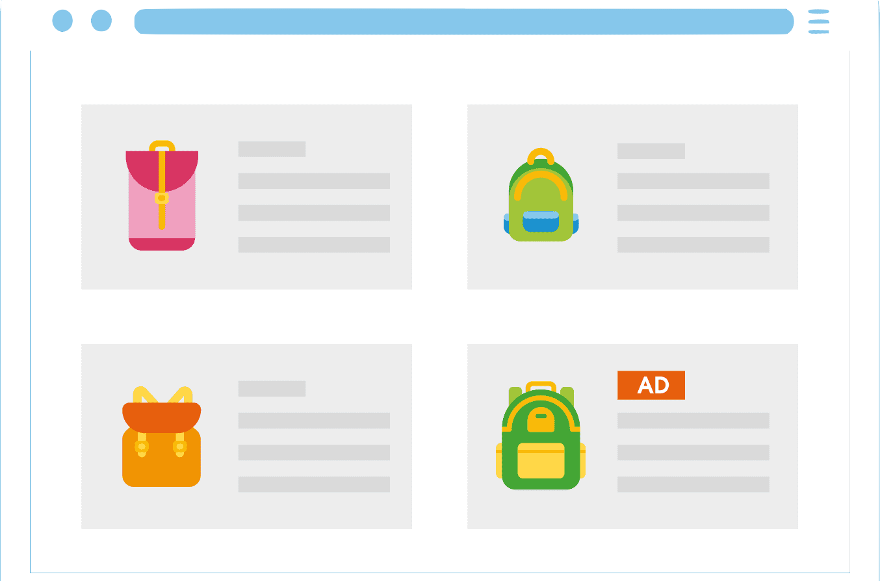
✔ Transactional
✔ High conversion
✔ Automation possible
✔ Multi-product
Product Listing Page?

Slide 20
?

Slide 21
It’s super simple!

Slide 22
1. Find tons of keywords

Slide 23
1. Find tons of keywords
2. Select most relevant keywords

Slide 24
3. Create specific PLP for each keyword
1. Find tons of keywords
2. Select most relevant keywords

Slide 25
3. Create specific PLP for each keyword
1. Find tons of keywords
4. Optimize CWV of each PLP
2. Select most relevant keywords

Slide 26
3. Create specific PLP for each keyword
1. Find tons of keywords
5. Insert relevant content on each PLP
4. Optimize CWV of each PLP
2. Select most relevant keywords

Slide 27
6. Link all PLP
3. Create specific PLP for each keyword
1. Find tons of keywords
5. Insert relevant content on each PLP
4. Optimize CWV of each PLP
2. Select most relevant keywords

Slide 28
6. Link all PLP
3. Create specific PLP for each keyword
7. Monitor crawlability
1. Find tons of keywords
5. Insert relevant content on each PLP
4. Optimize CWV of each PLP
2. Select most relevant keywords

Slide 29
6. Link all PLP
8. Monitor indexation
3. Create specific PLP for each keyword
7. Monitor crawlability
1. Find tons of keywords
5. Insert relevant content on each PLP
4. Optimize CWV of each PLP
2. Select most relevant keywords

Slide 30
6. Link all PLP
8. Monitor indexation
3. Create specific PLP for each keyword
7. Monitor crawlability
1. Find tons of keywords
5. Insert relevant content on each PLP
4. Optimize CWV of each PLP
2. Select most relevant keywords
9. Monitor ranking

Slide 31
6. Link all PLP
8. Monitor indexation
3. Create specific PLP for each keyword
7. Monitor crawlability
10. Monitor visits
1. Find tons of keywords
5. Insert relevant content on each PLP
4. Optimize CWV of each PLP
2. Select most relevant keywords
9. Monitor ranking

Slide 32
6. Link all PLP
8. Monitor indexation
3. Create specific PLP for each keyword
7. Monitor crawlability
10. Monitor visits
1. Find tons of keywords
5. Insert relevant content on each PLP
4. Optimize CWV of each PLP
2. Select most relevant keywords
11. Monitor revenue
9. Monitor ranking

Slide 33
6. Link all PLP
8. Monitor indexation
3. Create specific PLP for each keyword
7. Monitor crawlability
10. Monitor visits
1. Find tons of keywords
12. Aaaand… start over!
5. Insert relevant content on each PLP
4. Optimize CWV of each PLP
2. Select most relevant keywords
11. Monitor revenue
9. Monitor ranking

Slide 34
It’s super simple!

Slide 35
1. Find tons of keywords
Your product catalog
Adidas Lite Racer
Extract n-grams with NLP algorithms
109$
Adidas Dame 7
109$
Adidas Adizero Club
Nike Precision IV
“Nike zoom”
“air jordan 4”
“shoes for women”
“tennis shoes”
“Adidas Yeezy”
“shoes to run”
“amazing shoes”
“running shoes”
109$
109$
Adidas NMD-R1
Adidas Yeezy Boost
109$
109$
Nike LeBron 17
109$
Nike Zoom
109$
Adidas Prophere 18
109$
Nike Dunk Low
109$
Nike Air Jordan 4
109$
10.000 products
50.000 keywords

Slide 36
1. Find tons of keywords
Enrich with
- favorite tools
- internal search data
Combine with all possible attributes (color, size, style, discount,...)
“Nike zoom”
“air jordan 4”
“shoes for women”
“tennis shoes”
“Adidas Yeezy”
“shoes to run”
“amazing shoes”
“running shoes”
“Nike zoom”
“air jordan 4”
“shoes for women”
“tennis shoes”
“Adidas Yeezy”
“shoes to run”
“amazing shoes”
“running shoes”
“cheap shoes”
“shoes boston”
“regular shoes”
“whatever shoes”
“cheap blue shoes”
“cheap green shoes”
“cheap blue shoes for women”
“Nike zoom for women”
“air jordan 4 green”
“wedding shoes for women”
“formal shoes for women”
“black formal shoes for women”
“wedding tennis shoes”
“White Nike zoom for women”
50.000 keywords
100.000 keywords
10.000.000 keywords

Slide 37
2. Select most relevant keywords
Remove
- low quality
- too similar
- no AMS
Check
- matching products?
- no duplicate? (same products)
“cheap blue shoes”
“cheap green shoes”
“cheap blue shoes for women”
“Nike zoom for women”
“air jordan 4 green”
“wedding shoes for women”
“formal shoes for women”
“black formal shoes for women”
“wedding tennis shoes”
“White Nike zoom for women”
“cheap green shoes”
“Nike zoom for women”
“air jordan 4 green”
“wedding shoes for women”
“formal shoes for women”
“black formal shoes for women”
“White Nike zoom for women”
“cheap green shoes”
“Nike zoom for women”
“wedding shoes for women”
“formal shoes for women”
“black formal shoes for women”
10.000.000 keywords
1.000.000 keywords
20.000 keywords

Slide 38
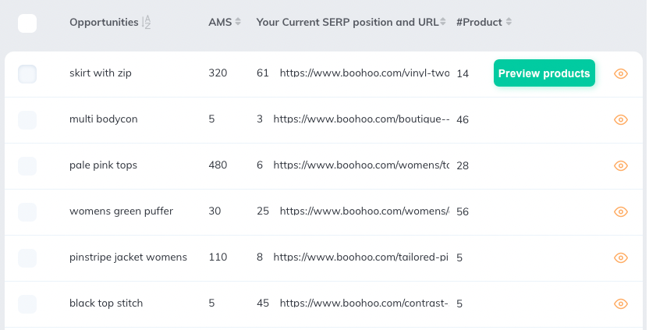
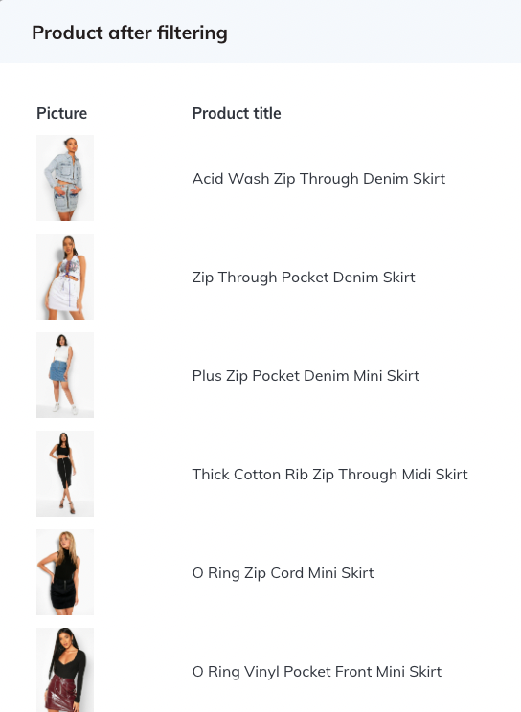
2. Select most relevant keywords
Prevent cannibalization: SERP scraping
“cheap green shoes”
“Nike zoom for women”
“wedding shoes for women”
“formal shoes for women”
“black formal shoes for women”
20.000 keywords
10.000 keywords

Slide 40
Implemented as a State Machine in AWS

Slide 41
?

Slide 42
3. Create specific PLP for each keyword
Your Product Catalog
Blue adidas shoes for women
Adidas Lite Racer
Adidas Lite Racer
Adidas Dame 7
109$
109$
109$
Adidas Adizero Club
Adidas Adizero Club
Nike Precision IV
109$
Red basketball shoes
109$
109$
Adidas NMD-R1
Adidas Dame 7
Adidas NMD-R1
Adidas Yeezy Boost
One keyword
=
One page
109$
109$
109$
109$
Adidas Prophere 18
Nike Precision IV
Nike LeBron 17
109$
109$
109$
Nike Zoom
109$
Nike Dunk Low
Adidas Prophere 18
109$
109$
Nike Dunk Low
Nike LeBron 17
109$
109$
Nike Air Jordan 4
109$

Slide 43
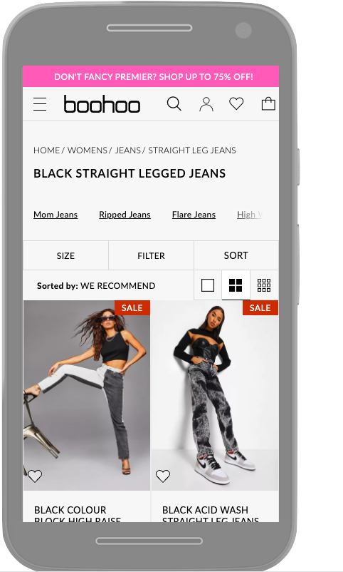
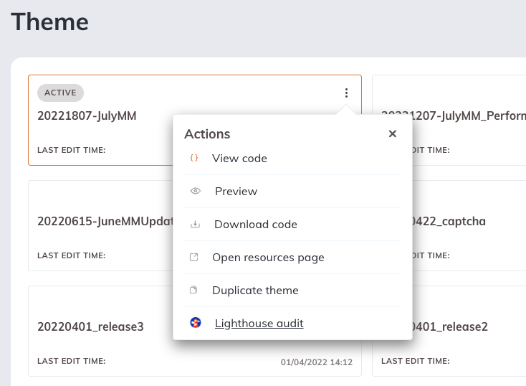
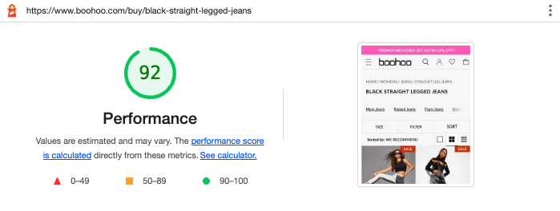
4. Optimize CWV of each PLP
Take it to 90+

Slide 44
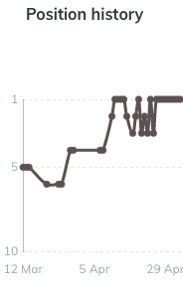
5. Insert relevant content on each PLP
“Blue adidas shoes for women”
check position
Adidas Lite Racer
“Amazing Adidas shoes! Just bought them, can’t stop running anymore”
109$
NLP extraction from:
User reviews
Product Attributes
Product Description
Adidas Adizero Club
- Brand: Adidas
- Gender: Women
- Color: Blue
109$
Adidas NMD-R1
The Adidas NMD-R1 is an all-round shoe for women who like to exercise very…
try another combination
109$

Slide 45
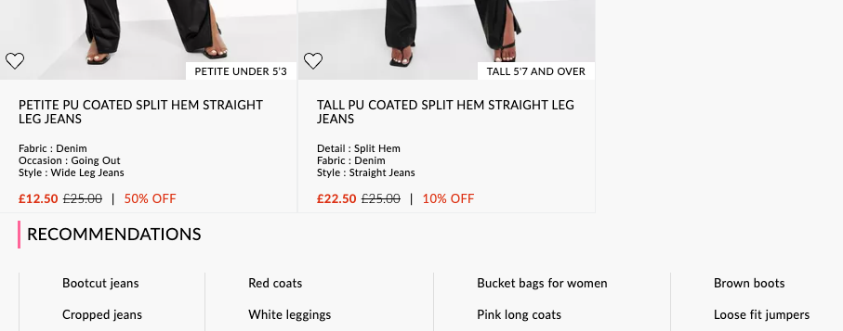
6. Link all PLP
Dynamic linking, based on:
Similarity: Semantic Proximity
Least Crawled: Real-time Log Analysis

Slide 46
7. Monitor crawlability
Check Googlebot visit in logs

Slide 47
8. Monitor indexation
Check indexation in GSC or “site:”

Slide 48
9. Monitor ranking
SERP crawling everyday

Slide 49
10. Monitor visits
GA, GSC, AT,... you name it

Slide 50
11. Monitor revenue
Attribution model:
“user landed on PLP” AND “user purchased within 3d”

Slide 51
6. Link all PLP
8. Monitor indexation
3. Create specific PLP for each keyword
7. Monitor crawlability
10. Monitor visits
1. Find tons of keywords
12. Aaaand… start over!
5. Insert relevant content on each PLP
4. Optimize CWV of each PLP
2. Select most relevant keywords
11. Monitor revenue
9. Monitor ranking

Slide 52
When you get there…
+15% to +30%
of your non-branded SEO traffic

Slide 53
When you get there…
+15% to +30%
of your non-branded SEO traffic
(btw, Verbolia can probably help you)

Slide 54
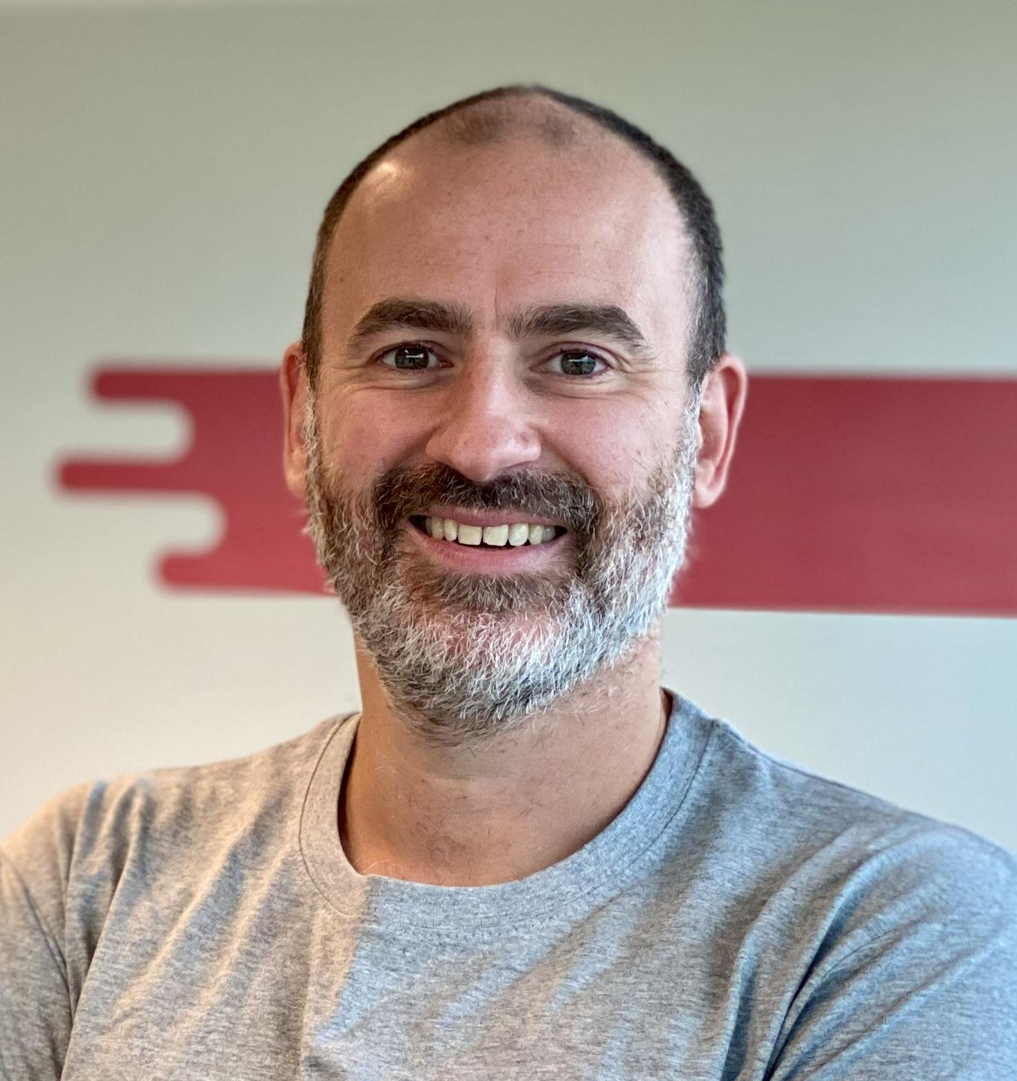
Get in touch!
Pierre-Olivier Danhaive
Co-founder & CEO
pod@verbolia.com
https://www.linkedin.com/in/pierre-olivier-danhaive-468a51/

