Slide 1
Embracing change:
Navigating an ever-evolving commerce landscape, turning opportunities into profit
Notes:
Title Slide

Slide 2
Mel van Lieshout
Country Lead Benelux @ Shopify
Notes:
INTRO
Hi — I’m Mel van Lieshout, Country Lead for the Benelux at Shopify.
I’m delighted to be here at the EU Crossborder Forum, meeting so many inspirational ecommerce leaders and entrepreneurs! I’m excited to have the opportunity to share insights and practical tools that will be helpful for those of you in the audience looking to leverage your creativity to stay adaptable in the world of commerce.

Slide 3
Shopify is the leading multi-channel commerce platform
2006
platform released
>175
countries
~$543B
total sales on Shopify platform
(Dec 31 2021)
Millions
of merchants on Shopify worldwide
~600 million
consumers around the globe have
purchased from a Shopify Merchant
$229.3B
Contribution to GDP globally in 2022, an 8% increase since 2021
5.2M jobs
Supported by Shopify Merchants globally in 2022
$38
the amount merchants make for every $1 Shopify makes
Notes:
At Shopify, by putting retailers on the right side of change, we’ve helped them support 5 million jobs last year. Collectively this would make up the largest workforce in the world. With a GDP contribution of almost 230 billion dollars globally and over 600 million shoppers having bought from one of the merchants on our platform, the Shopify ecosystem is truly a global force.

Slide 4
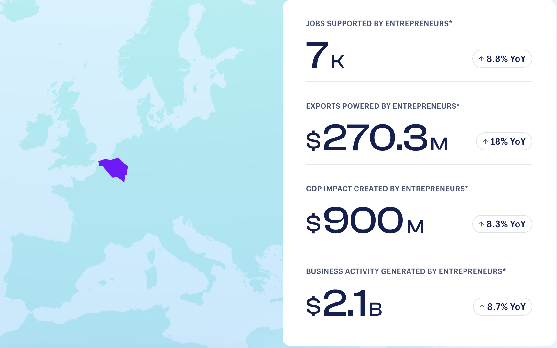
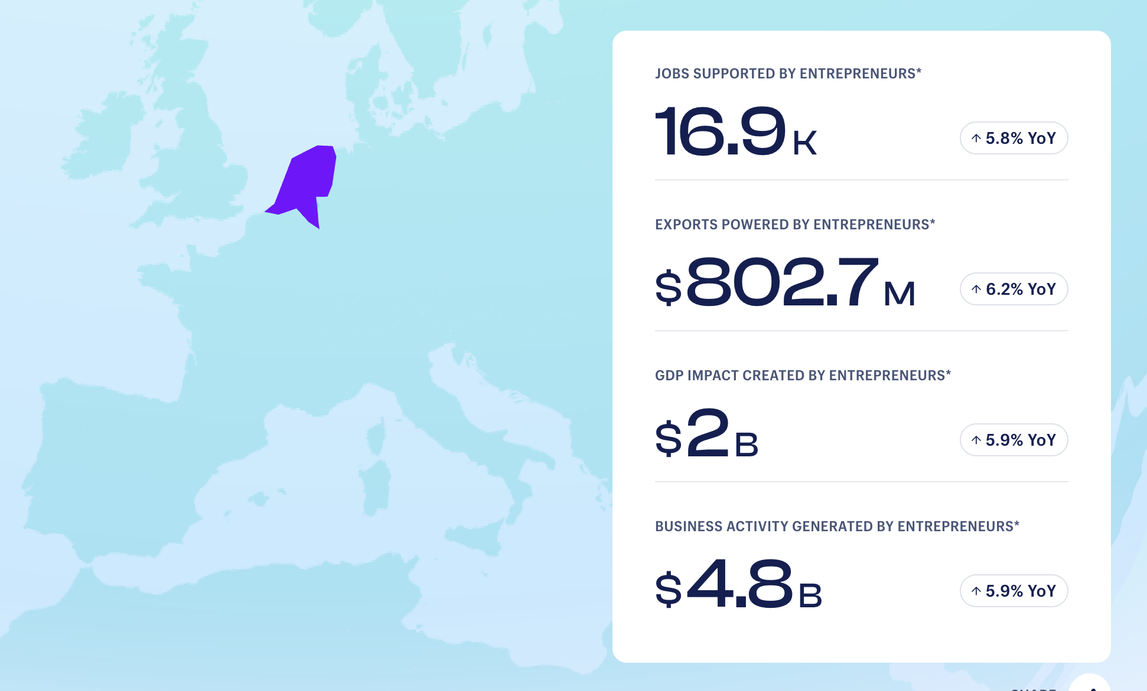
Shopify Index - Focus in Benelux
Notes:
Now, let’s look a little closer at some of these numbers for the Benelux!
Earlier this year, we released the Shopify Entrepreneurship Index: the world’s first home for data and insights on global entrepreneurship across 40 countries. The Shopify Entrepreneurship Index measures the economic impact of entrepreneurs in Shopify’s ecosystem on national economies across business activity, GDP impact, exports and jobs supported.
When looking at the economic impact created by entrepreneurs in the Benelux in 2022, Shopify merchants supported close to 24.000 jobs and powered nearly $3 billion in economic activity. (link here). That puts the Netherlands in the 23rd place of our list, and Belgium on the 25th. So besides the geographical position, both countries are performing fairly similar in our Index.

Slide 5
Shopify Index - Focus in Benelux
Notes:
We’ve also looked at the cross border impact from the Shopify merchants in the Benelux. We’re seeing that the Dutch Shopify merchants are exporting over $800 million in 2022, with a year on year increase of 6.2%. We’re seeing higher year on year numbers in Belgium of 18%, but the actual value of $270 million is far less than its neighbor.
The fact that Belgium is lower has to do with lots of elements, but most and foremost of the digital Commerce maturity. As the Commerce maturity in Belgium is lower, it directly impacts the cross border sales, as it’s both a technical and operational struggle. Merchants tend to lean towards what is more comfortable, in an already challenging environment, and that’s the local market.
While cross border sales is very complex, the technical element is something we’ve been tackling for quite some time and are becoming successful to provide a solution where merchants are more eager to take the leap into new geographies.

Slide 6
$1.38B
Retail
All new POS
Marketing
Marketing Dashboard
R&D spend last 12 months
Surface expansion
Payments/ POS
Multi-currency
Tap & Chip
International expansion
Consumer App
Languages
Local Payments Methods
Facebook Shops
Working capital
Multi-channel
Fulfillment
Payments
Platform/
Payments
on Facebook, Instagram, & Google
Ecosystem
Platform expansion
Locations
Fraud Protect
Shipping
Subscription
Online stores simplified
Retail
Shopify Balance
Inception-today
Notes:
TALK TRACK So I’ve shared some information about the impact our merchants are having across the market. While the majority of you know Shopify by name, it’s good to provide some context on what we do from day-to-day.
First and foremost Shopify is a product company.
Today I’ll be focusing more on the ever-evolving commerce landscape, but from our inception in 2006, we’ve built and shipped enough products for me to talk all day! The main thing to understand is that we are constantly building & innovating. We’ve invested over $1.3BN into R&D on the platform over the past 12 months, and if you take today -12 months, this number actually has ramped up to $1.5BN. So we’re fully invested into our product and determined to have the best product.
An important part of deciding what to build is listening to what the retailers on our platform need to continue to thrive as the world of Commerce evolves.

Slide 7
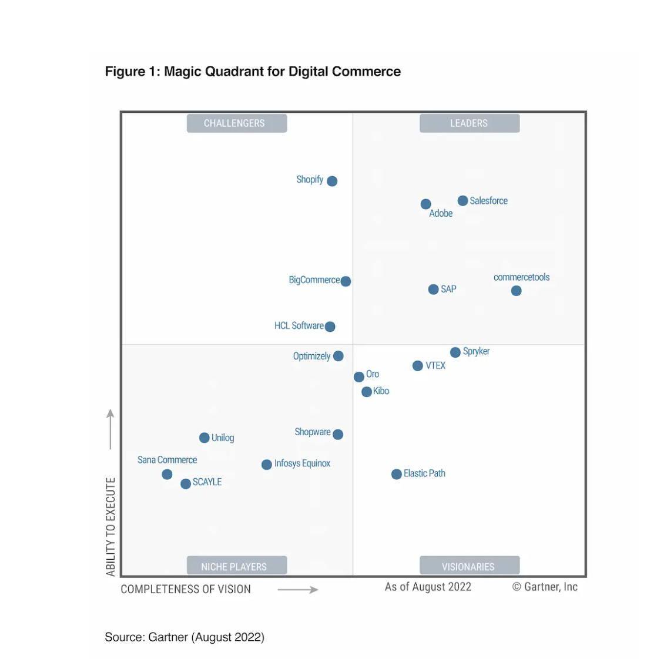
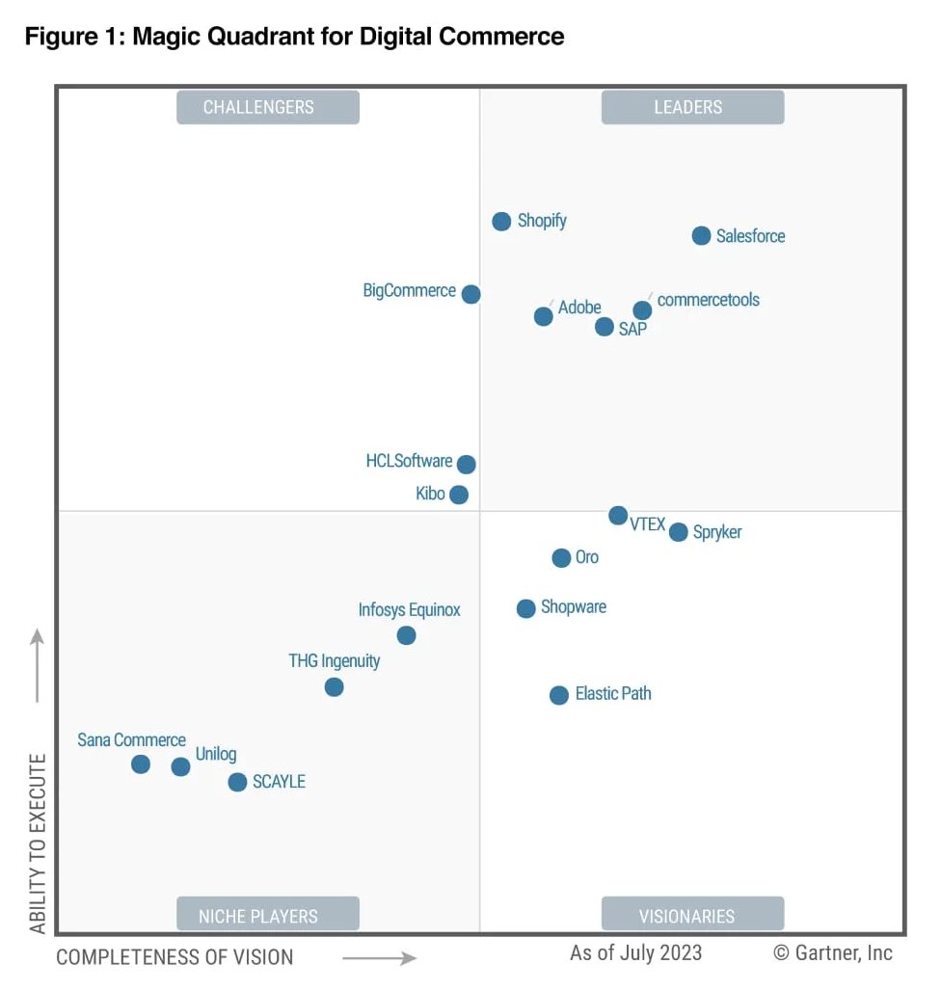
Position by Analysts
2022 > 2023
Moved from Challenger > Leader with the highest ability to execute
Notes:
All these investments are being acknowledged by the market and by external analysts, like Gartner. As we’re positioned the highest related to ability to execute, this will provide an unfair advantage for those using Shopify. New ways of Commerce is not something you need to focus on, it will be enabled and built by us.

Slide 8
CUSTOMERS
More than just a commerce platform… We invest & build for every stage of the journey
Customer acquisition
Find & attract
Marketplaces
B2B
Retail point of sale
Convert & ship
Payments
Shipping
Logistics & fulfilment
Product sourcing
Delight & retain
Capital & lending
International expansion
Notes:
As I take you through the ever evolving commerce landscape, you’ll see that we offer multiple channels for merchants to access so they can sell and market, like social integrations, brick and mortar & B2B.
That’s because Shopify’s mission is to make it easier for our merchants to reach customers on every surface and to help with every aspect of running a business, from internationalisation to retail POS to capital and lending.

Slide 9
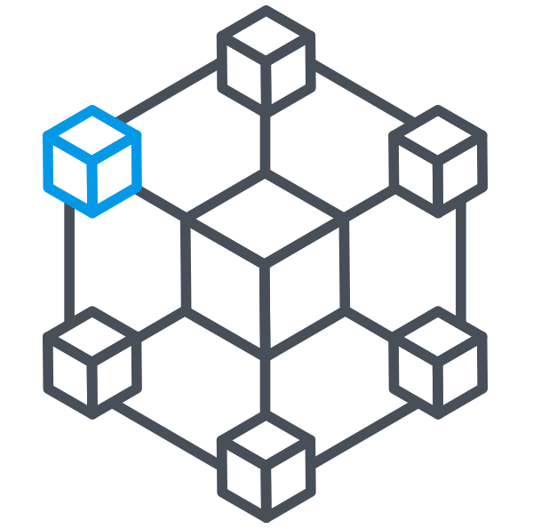
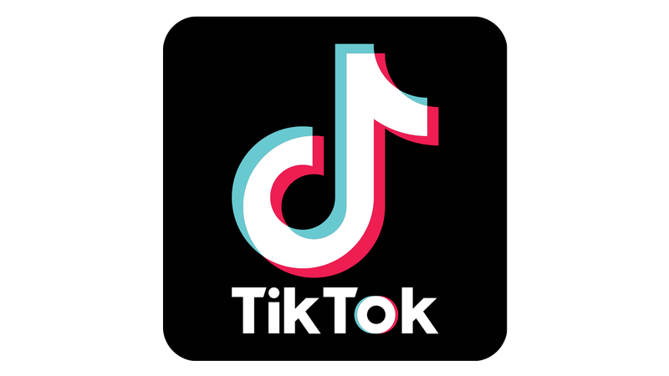
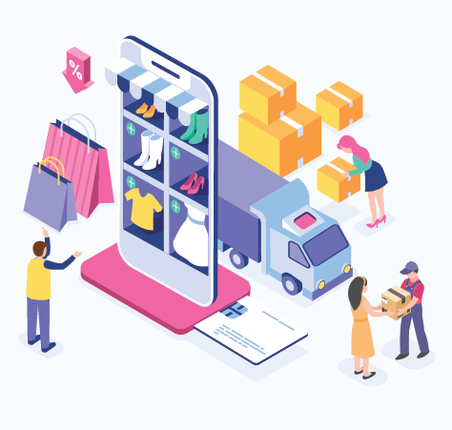
Shopify is putting retailers on the right side of change
Notes:
CONTEXT
As some of you may know, Shopify is no stranger to disruption and change in retail. It’s in our DNA as an entrepreneurship company. And we love change. We thrive on it! What’s exciting is how fast change happens in today’s world. In the space of 5 to 10 years:
No one even thought about TikTok and how it would upend how Gen Z socializes and buys.
No one could have imagined how DTC would shake up the retail industry.
No one could have predicted how web3 would disrupt the foundations of the internet itself, especially with the arrival of ChatGPT.

Slide 10
Shopify provides retailers with the tools to become more profitable
Privacy shifts
Supply chain shortages
Built to last
Ecommerce
Pandemic
Retail everywhere
Customer experience
Evolving consumer expectations
Physical retail
Technology
Advertising shifts
Notes:
{Animated slide: click once for macro trends to appear (white), and then again for the solutions / where merchants need to be present (yellow)}
Shopify has a strong track record in providing retailers with the right tools to stay creative, adapt, innovate and become more profitable. In DTC, for example, we’ve created entirely new category leaders and helped retailers of all sizes adapt to new retail environments. Businesses like Mr Marvis, Cowboy and Gimber are thriving in times of change thanks to Shopify. And we’ve created DTC giants around the world, from Gymshark to Kylie Cosmetics.
So we operate at an incredible scale, helping our merchants adapt to whatever comes next. And this is much needed in light of current events, from the emerging from the pandemic, to the conflict in Europe, the continued stress of the climate crisis and unimaginable natural disasters. As everyone here knows, these events have a colossal impact on populations, consumers, business and retail.
The biggest key to flourishing beyond mere survival in this environment is investing in innovative tools and placing customers at the center of your business model. In fact, research has shown that companies that continue to find creative ways to establish and retain relationships with customers are the ones who flourish during times of uncertainty.
This is particularly non-negotiable in the Netherlands:
Which is the 7th largest e-commerce market in Europe, with 90% of the population shopping online.
In the last decade, the Dutch e-commerce market has grown by over 20 billion euros and shows no signs of stopping.

Slide 11
Many pathways to Connect to Consumer (C2C)
Notes:
INTRODUCING C2C SOLUTION
The reality is that consumers are more discerning with their spend and their loyalty. They’re harder to reach and are spread across so many more surfaces. You now have to work overtime to cultivate audiences and loyalty.
But what if I could tell you there’s a solution for this new world of retail. A radically easier way to win in the new era of commerce by connecting to consumers.
That’s it, in fact: connect to consumers, or C2C. That’s the solution.
If online marketplaces and one-stop stores like eBay and Amazon defined commerce in the 2000s, and DTC brands defined the 2010s, C2C will define the future. Adopting the C2C model is the key to being on the right side of history.
What is C2C? How do you do C2C? What real-world problems will it solve for your business now?
C2C has many pathways to consumers, not just one. It’s where brands are smart about telling their unique story across multiple pathways to cultivate communities and buyers.

Slide 12
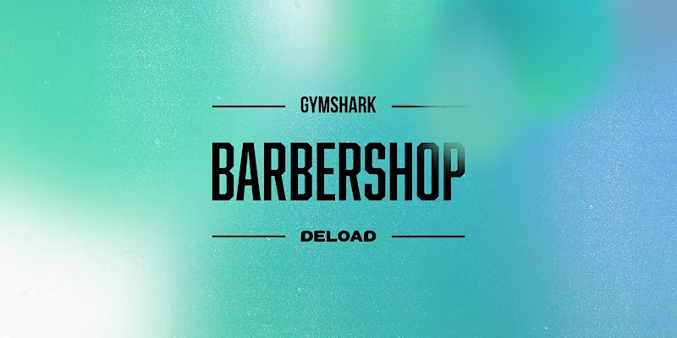
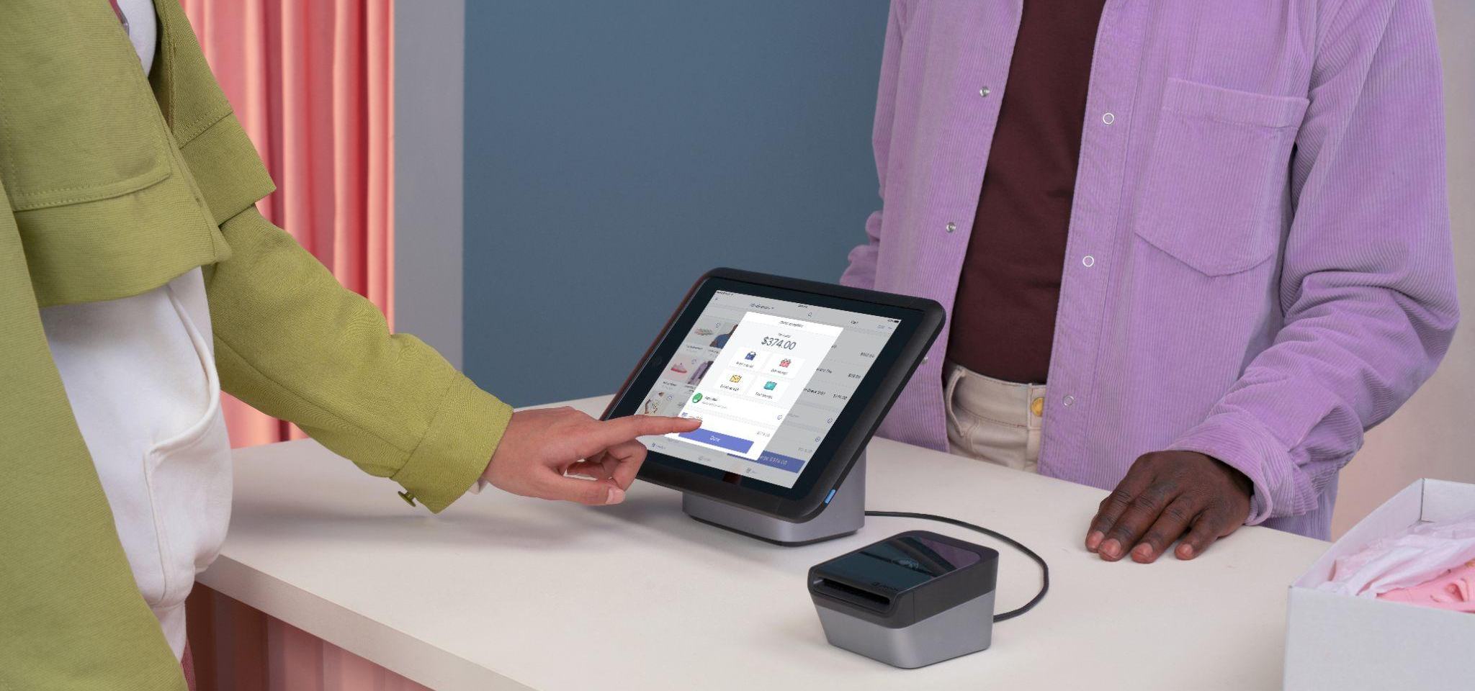
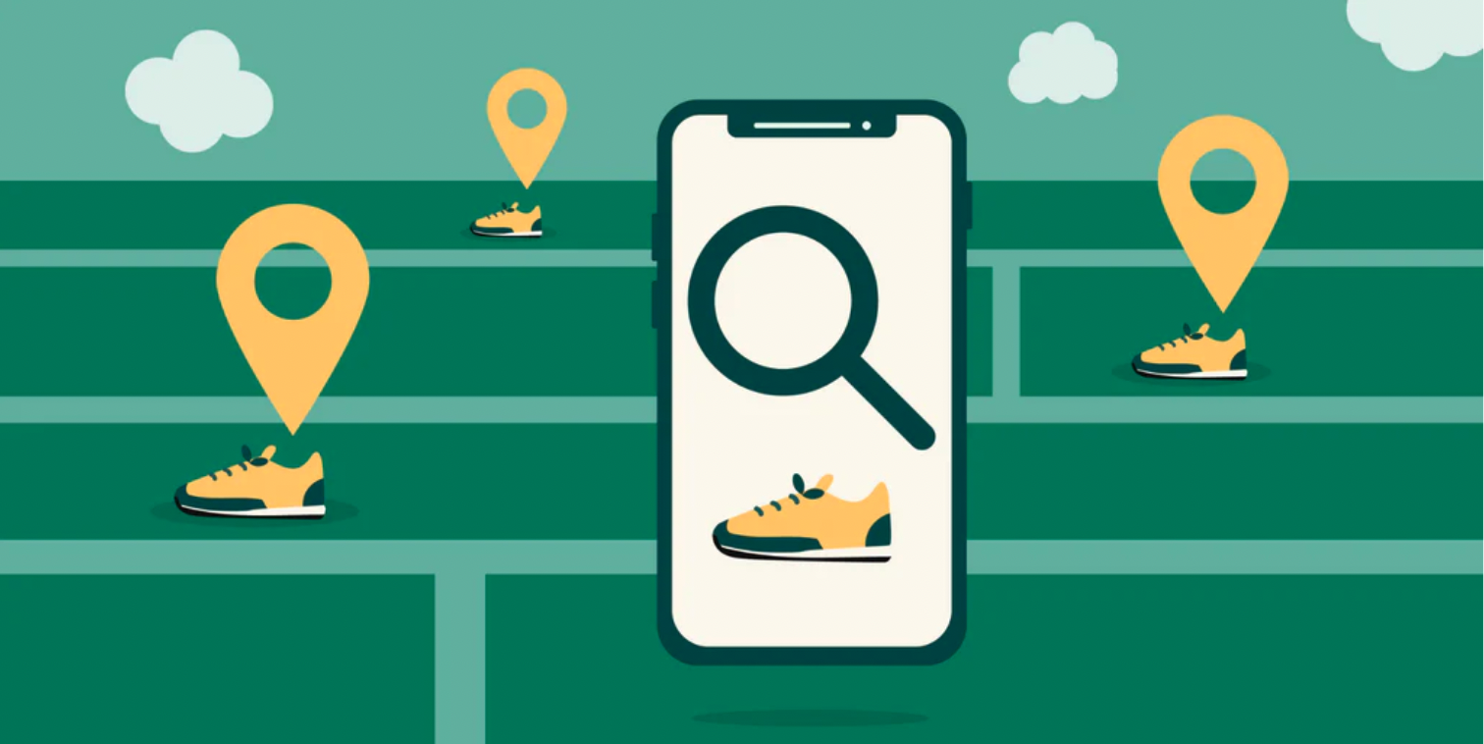
Offline
Notes:
OFFLINE
In the post-pandemic world, offline retail is soaring in popularity. Retailers have had to break back on to the street and capture consumer spend happening in real life.
We see it at Shopify. In fact, in 2022, Q2 offline sales grew 47% year on year.
Physical retail helps drive brand awareness, enhance consumer perceptions, and is an opportunity to provide personal and tailored advice and experiences.
Retail is everywhere - brands are re-imagining the role brick and mortar stores play to unlock their full potential and connect to consumers in a meaningful way. This does not only mean that the POS will play a new role (act as fulfillment centers, showrooms) but the role of employees will change too. Store employees will act more as “experience hosts.” Brands will give them the tools they need to better serve customers and facilitate options like appointment shopping, virtual shopping, live shopping, and live chat.
At Shopify, we facilitate this change by providing a POS solution that seamlessly integrates your online store with up to 1,000 physical locations. Whether it’s your first store, or you’re already in high streets across the country, we are constantly bringing out new features to help you scale and future proof your business.
The most ambitious retailers are effective at breaking down silos between digital and physical storefronts to create a holistic shopping experience based on their customers needs and preferences. Gymshark for example opened a very large flagship store in London last October and incorporated a “Deload” pop-up barbershop, an innovative mental health initiative which encourages young people to focus on their mental as well as their physical wellbeing. It provides content, stories and advice from wellbeing experts and medical professionals. This offers a glimpse into the possibilities of connecting to consumers on a deeper level.

Slide 13
Social Commerce
x5
40%
increase in orders from social media for Shopify merchants (Q2 2021 vs. Q2 2022)
of people aged 18-49 have ordered on social media (as of May 2022)
Notes:
SOCIAL COMMERCE
So off-line is one pathway. Social Commerce is another one you can’t afford to ignore.
A lot of experimentation with the C2C model is happening already on social media. In fact, orders made for Shopify merchants through key partner surfaces like TikTok and Instagram grew 5X over Q2 of last year.
Social media is where the most exciting brands are building and cultivating their communities. It’s where they’re able to connect directly with consumers with unique brand storytelling. But it’s often happening over so many different surfaces and brands just need an easy button to connect and sell anywhere.
Not just on one marketplace. Not just on one channel. Your community is everywhere, so retail should be everywhere too. Shopify is this easy button to connect to consumers everywhere, from YouTube to TikTok.
The western world is following in the footsteps of Asia when it comes to live selling. And there is huge potential there knowing that livestream shopping app installs jumped by 77% in 2022.

Slide 14
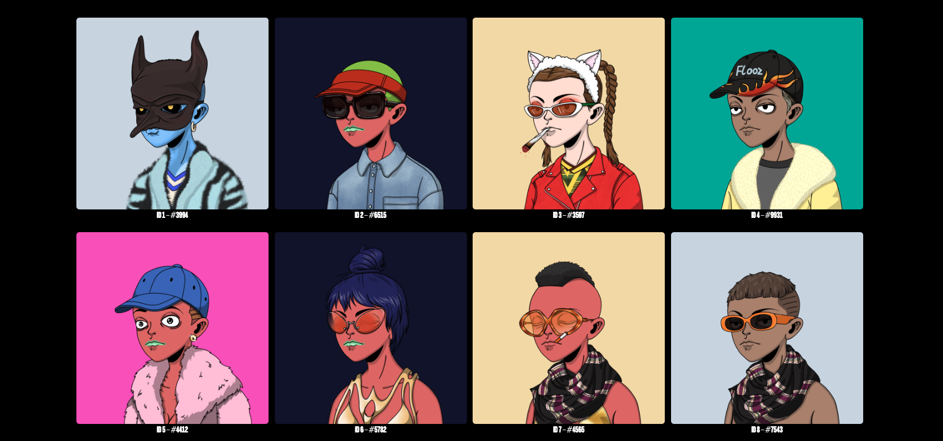
Web3
Notes:
WEB3
A new frontier is Web3. Web3 is creating new opportunities for brands to connect with consumers in a creative way. Consider how a token or NFT in your digital wallet will unlock an exclusive offer online or a VIP experience on the high street. This is what we’re calling tokengated commerce.
It is already hitting the mainstream, with Starbucks rolling out a web3-based rewards program to give customers exclusive perks.
And streetwear retailer Daily Paper has rolled out NFTs for their community to unlock exclusive brand drops and VIP access to events.
This is how tokengated commerce works at Shopify:
A buyer will connect their wallet to a Shopify store to validate they own an NFT that will then unlock exclusive access to merch and other perks. Buyers will then go through the familiar checkout flow to complete their tokengated buying experience.
Buyers can use their NFTs to unlock personalized shopping experiences designed especially for them, even on stores they’ve never shopped at before.
A real advantage with NFTs is that buyers don’t need a customer account. Connecting a wallet means that the store logs into the buyer, rather than the buyer having to login to the store.
What’s super exciting is that tokengated commerce can be multiplayer and collaborative.
NFTs can be from a merchant’s brand, a sub-brand, or even a collab partner. Through collaborative tokengating, merchants can easily partner with other brands without having to share customer lists or data. One brand’s NFTs can unlock another brand’s store.
This is a new way to accelerate “community commerce” - inviting other communities into discovering new brands, do endorsements, etc. (e.g. Patta x Tommy).

Slide 15
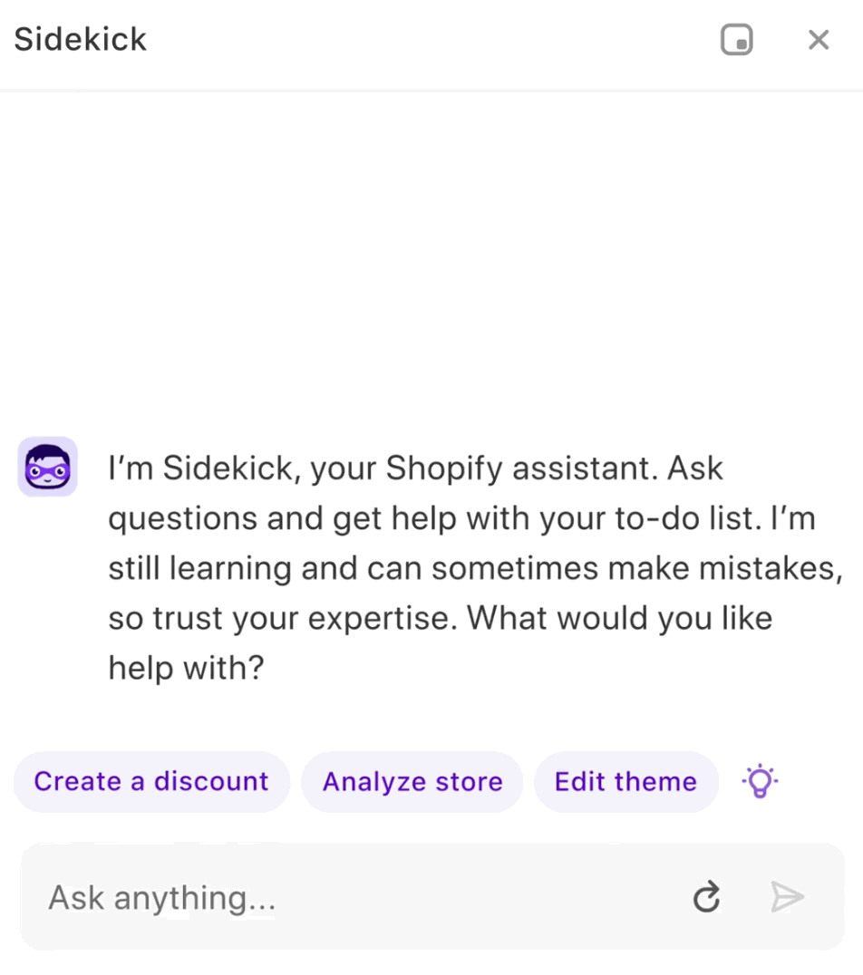
AI
Notes:
AI
You can’t open a news feed or Linkedin feed or you come across something around AI and how it’s massively impacting our lives at this stage, but more importantly the near future.
While it’s in development already for years, with the launch of ChatGPT It instantly became mainstream and people were mind blown by the information they can get by asking a question. In reality this is just the beginning of AI and how it will affect our lives, and eCommerce is a field where AI thrives!
At Shopify we’re having major investments in our AI suite, called Shopify Magic. We’re on the verge of launching Sidekick. This assistant will feel like an additional member of your team. It can provide insights in your data, it can create discount codes and even change the look and feel of your theme.
The possibilities are endless when it comes to Commerce & AI. Some examples we’ve already implemented are:
Creating generative text. AI will generate content that converts. It will generate on-brand, quality content that drives traffic to your store. From headers to product descriptions.
Review, edit, and respond to live chat inquiries instantly with smart replies in Shopify Inbox.
Publish personalized FAQs and responses with Shopify Inbox.
Generate compelling subject lines, create engaging email content, and find send times with highest impact using Shopify Email.

Slide 16
Being creative to sell better
50 flash sales each year
$1m sales in the first minute
Notes:
BEING CREATIVE TO SELL BETTER
For merchants, being creative in the way they connect with their customers can also mean updating their product offering quickly, or even the way they sell. One great example to do this are Flash Sales, which creates excitement and a deeper connection to the brand.
Two examples:
In Q1 of this year we welcomed the iconic streetwear brand Supreme to Shopify. Supreme is one of the world's biggest flash sale retailers, hosting more than 50 flash sales each year that are live for no more than a few minutes. Supreme needed the ideal platform to accommodate this kind of adaptability and scale.
Another great example is Kim Kardashian’s SKIMS shapewear and clothing brand, which has a cult following. They sell out drops weekly. The brand releases a limited number of products per drop to create FOMO in buyers—and it works. Some of the collection’s most expensive pieces always sold out in mere seconds. In November 2021, SKIMS’ collaboration with Fendi made over $1 million in one minute during its first drop.
This is what all merchants should aim for. They should innovate in the way they sell, and choose solutions that provide speed and the ability to stay creative and absorb constant change.

Slide 17
Selling Internationally
$28B
28%
+50%
in cross-border sales in 2022
of sales from international buyers in 2022
Of B2C crossborder turnover between 2020 and 2022
Notes:
SELLING INTERNATIONALLY
During and post pandemic, merchants have had to quickly get accustomed to selling internationally to reach larger audiences.
In 2022, Shopify enabled approximately $28 billion in cross-border sales, capitalizing on the surge of international interest, with nearly 28% of all traffic to Shopify stores coming from buyers outside of the merchant's home country.
It is imperative that merchants get comfortable with selling abroad and find the best ways to do so in seamless ways.

Slide 18
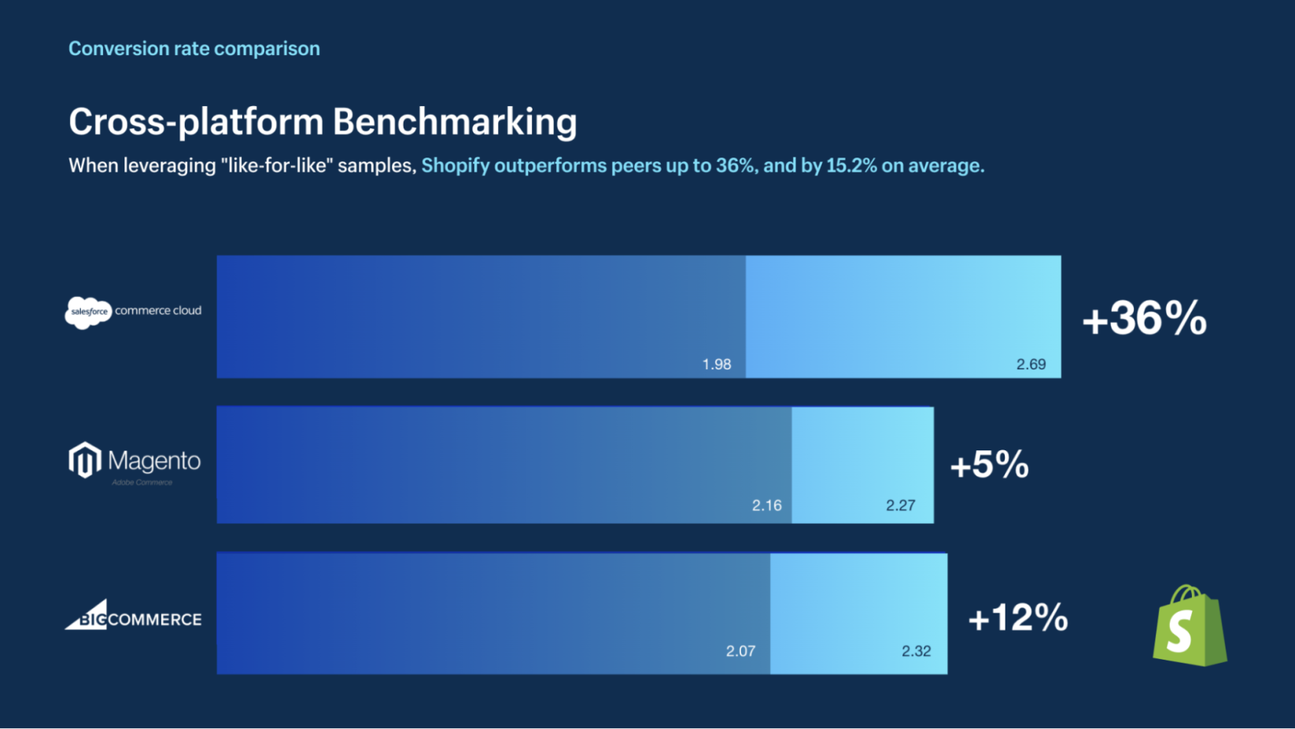
Conversion
4.53%
77%
Of total conversion rate on all devices
Of checkouts happen on mobile
Notes:
CONVERSION
Ultimately, building a great relationship with your consumers is only effective if it also translates as part of the conversion stage.
When shopping, time savings and convenience is a top priority which means merchants need to ensure convenience is at the forefront of their strategy and address any pain points in the consumer journey, particularly through smooth check-outs.
Looking at a local case, Club Brugge is experiencing great conversion rates when they moved to Shopify last year. With a 4.53% conversions rate on all devices, and where 77% of all checkouts happen on mobile.
And when it comes to conversion, Shopify gives retailers the cheat code to convert customers faster than ever.
Earlier this year the Big3 global consulting firms executed this study where Shopify outperformed peers up to 36%, and by 15.2% on average.
In other words; You’re simply losing money by not using Shopify’s checkout.

Slide 19
Customer Loyalty
22x
higher worth of loyal customers
40%
60%
Global
of loyal customer buy products even if cheaper options exist
of customers tell others about brands they’re loyal to
launched their new loyalty app
Notes:
CUSTOMER LOYALTY
Loyal customers are worth far more than short-term sales. In fact, a 2021 study estimated that loyalty increases a customer’s worth by 22 times. It costs less to sell to loyal customers because they’re more likely to buy, with the probability of a sale jumping from 5–20% for a new customer to 60–70% for a returning one.
Strong customer relationships also make price increases more tenable. Almost 40% of loyal customers will buy the brand’s product even if cheaper options exist, and 60% of customers tell others about brands they’re loyal to.
As an example, Toteme, a Swedish brand, launched their own app - which they call ” A TOTEME concierge in your pocket”! Members can access discounts, exclusive features and a portfolio of "off-menu" services.

Slide 20
Connection is key. Thank you so much for your attention. Any questions? Please join us at our booth
Notes:
CONCLUSION
Your consumers are more discerning with their spend and their loyalties. Brand loyalty can no longer be assumed.
They’re harder to reach and are spread across so many more surfaces. You now have to work overtime to cultivate audiences and meet them where they are.
It’s no longer enough to just rely on the web store, a retail location or some paid marketing. Brands must up their game to find audiences, convert shoppers and tell their stories, across every channel.
We are evolving from a one dimensional, transactional relationship with shoppers, and embracing new ways to “Connect to Consumers”. Thank you so much for listening today!

Slide 21
Notes:
Closing slide

