Slide 1
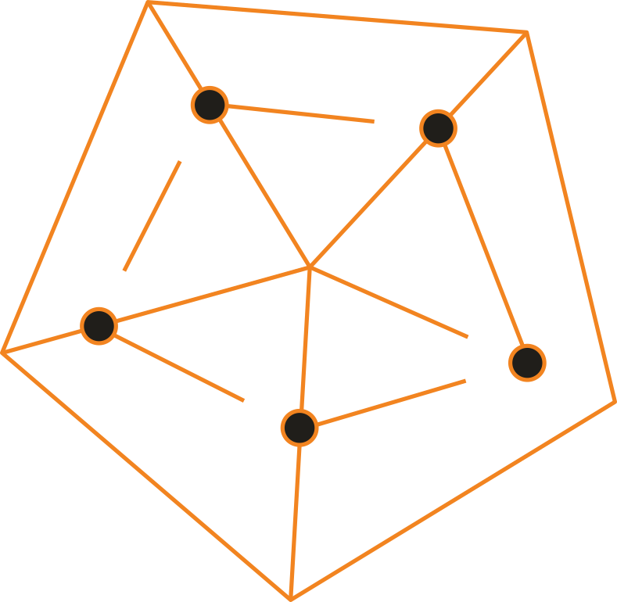




Start to E-commerce
Greet Dekocker
Managing Director SafeShops.be

Slide 2


Voorwoord
Greet Dekocker
Managing Director
SafeShops.be
Who’s BeCommerce/SafeShops?
Belgian E-commerce federation.
Stimulate E-commerce Growth in Belgium.
How?
On a Sustainable, Reliable, Secure way.

Slide 3





Status (Belgian)
e-commerce

Slide 4
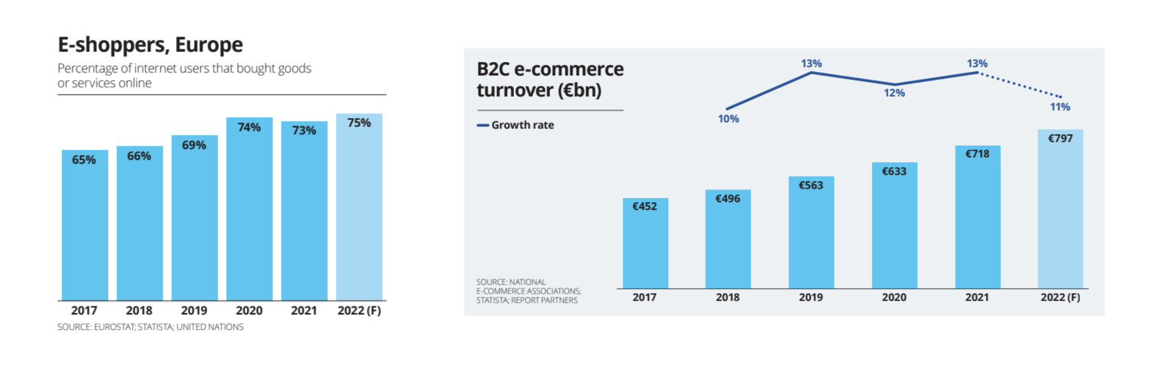

Slide 5




Belgian e-commerce 2021 vs. 2022*
Volume
Who
Transactions
12,1 billion
8,4 million shoppers
168 million
11,7 billion
56K traders
150 million
14,7 billion
8,5 million shoppers
170 million
13,8 billion
57K traders
165 million
2021
2022
*Figures from the E-commerce Barometer compared with Market Monitor figures. The BeCommerce Market Monitor is a large-scale survey, conducted by GfK, that maps the entire online market.

Slide 6

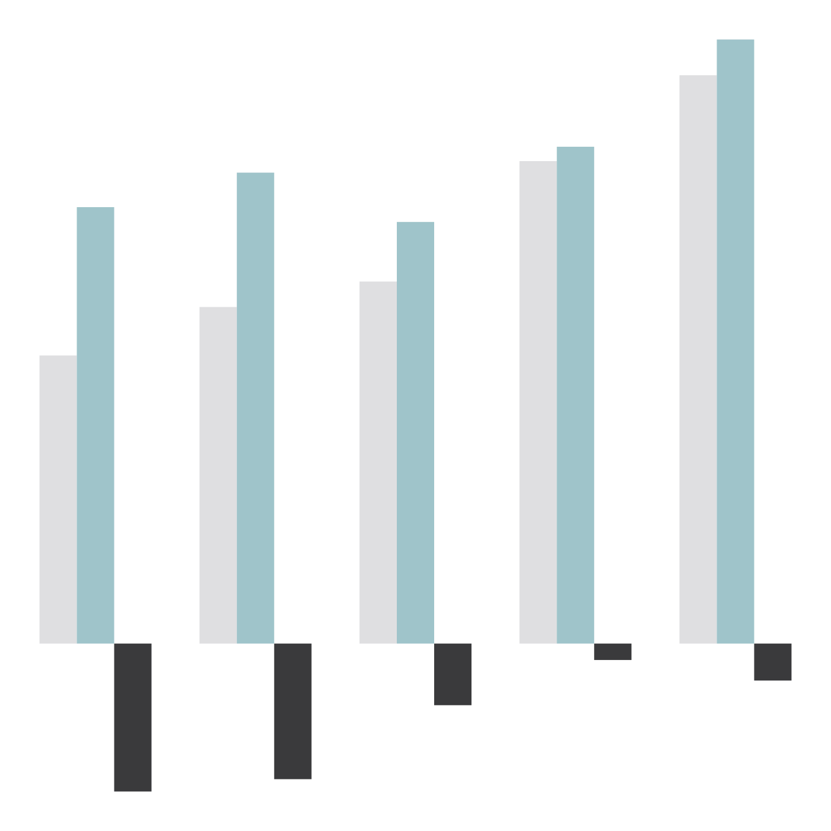

Belgian E-commerce Trends
168
170
166
€ 14,70
Number of transactions
(in million)
150
Volume
(in billion)
€ 13,83
€ 12,09
127
€ 11,46
€ 11,74
113
€ 10,62
€ 10,26
108
97
€ 8,81
85
€ 8,19
€ 7,01
70
2018
2019
2020
2021
2022
2018
2019
2020
2021
-0,4
2022
-0,9
-1,5
-3,6
-3,3
Ecommerce Barometer
Market Monitor
Ecommerce Barometer
Market Monitor
Handelsbalans
*Figures from the E-commerce Barometer compared with Market Monitor figures. The BeCommerce Market Monitor is a large-scale survey, conducted by GfK, that maps the entire online market.

Slide 7
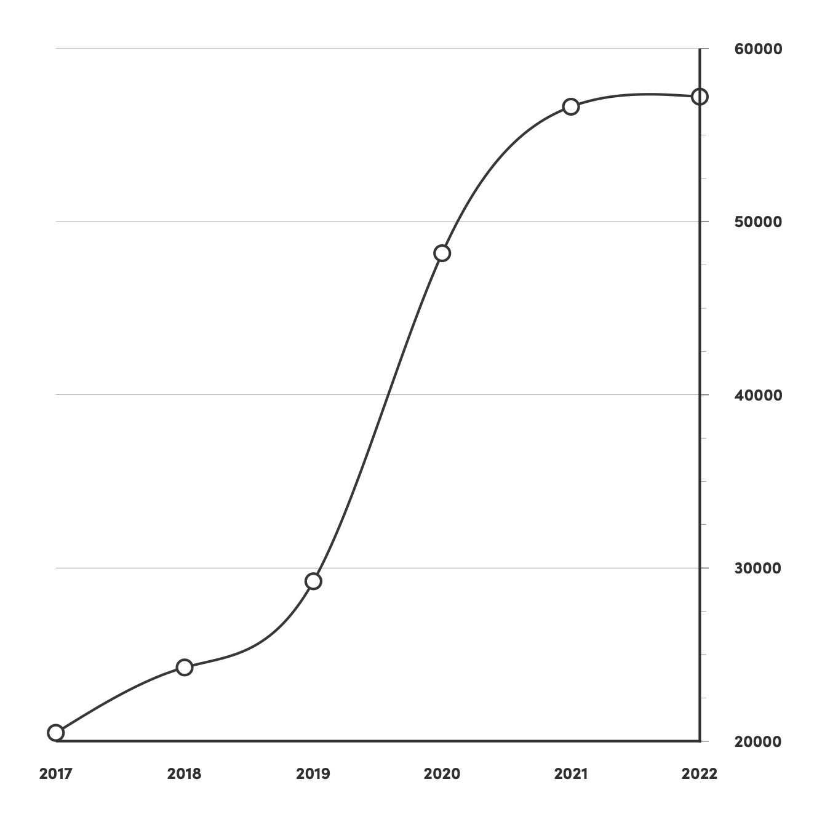

Number of webshops stabilizes
+1%
57.221
+18%
56,642
+65%
48,181
+21%
29,231
+18%
24,254
+27%
20,479
Number of e-merchants

Slide 8



SME’s take a chunk of the big players
897,076,685€
2.,173,117,437€
2,973,304,069€
7,788,154,455€
Volume
Micro 6,49%
Small 15,71%
Medium 21,50%
Large 56,31%

Slide 9


POWERPLAY

Slide 10
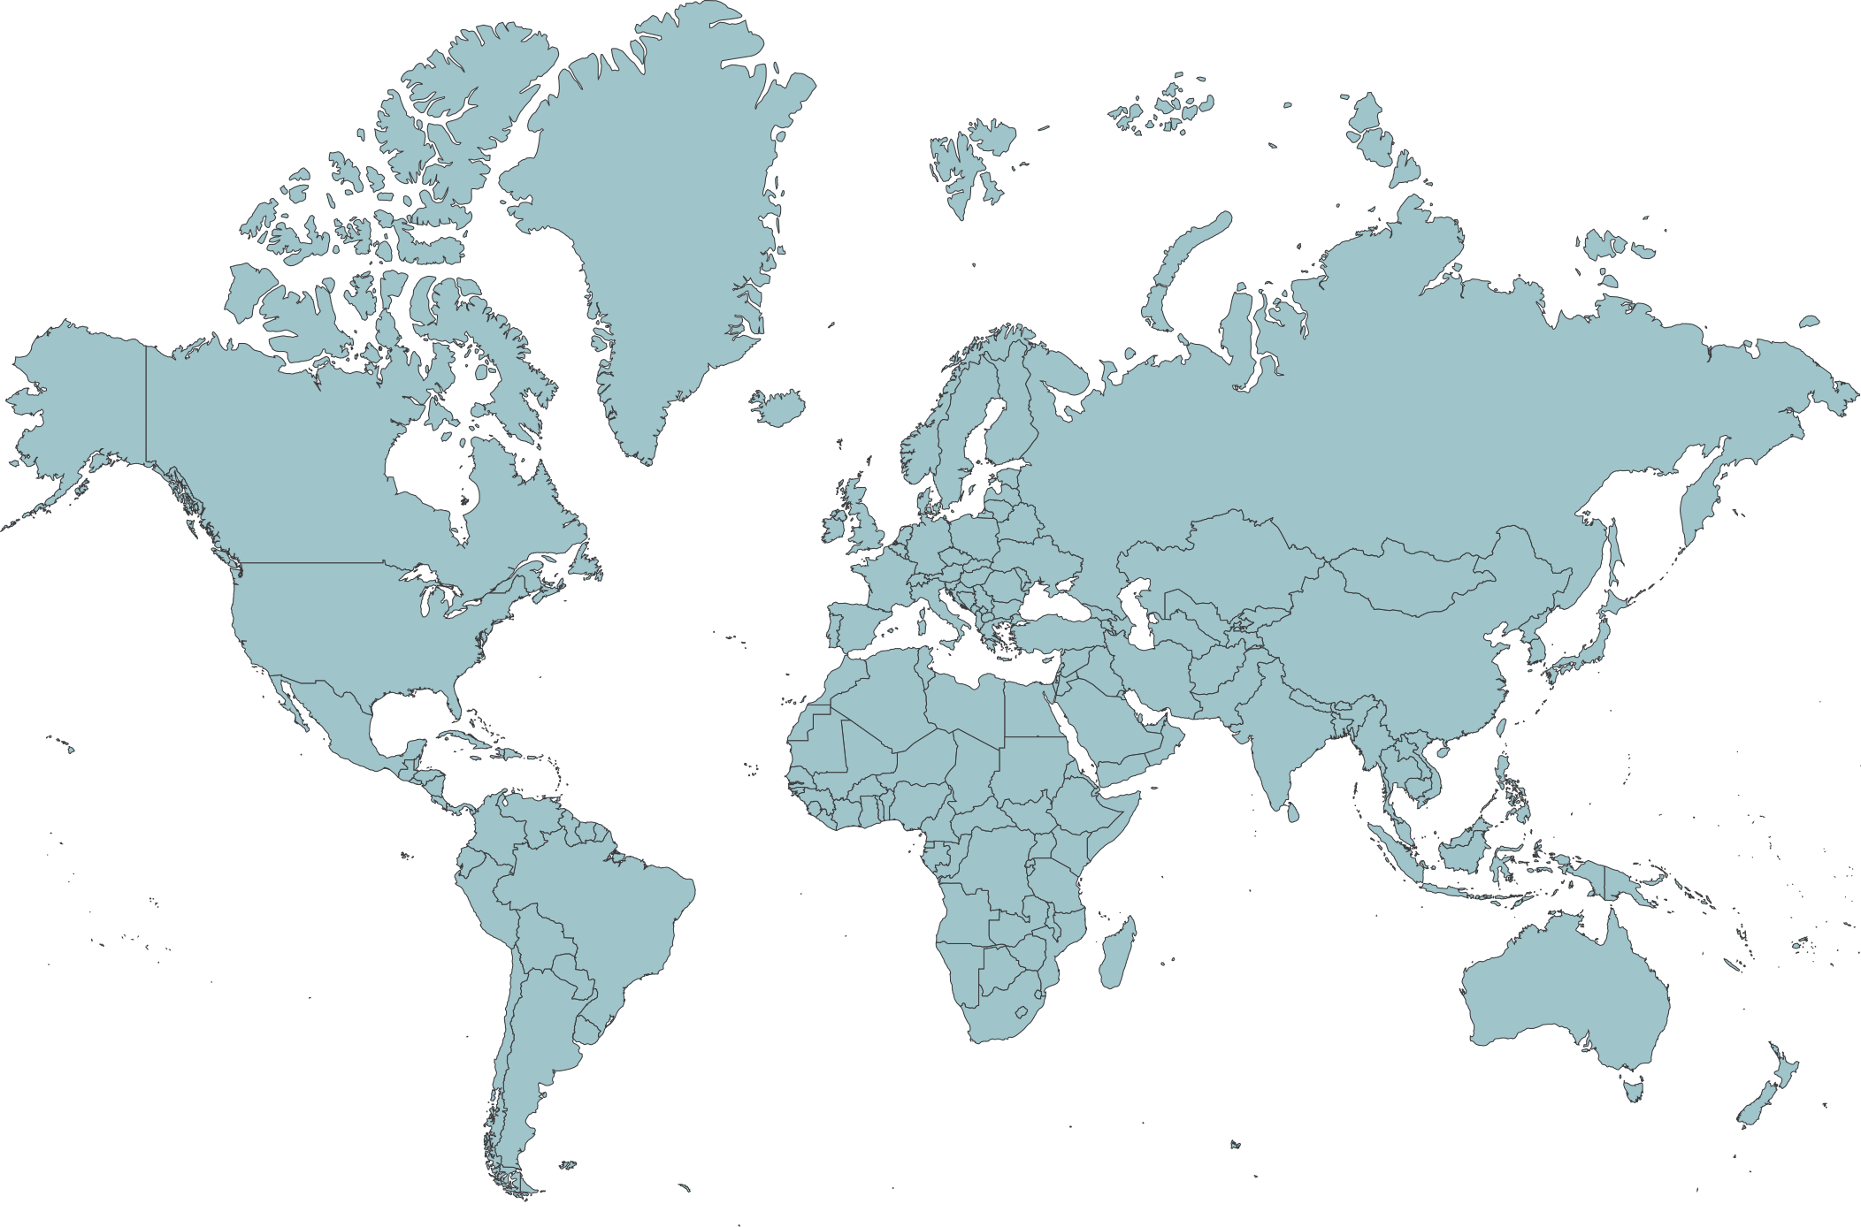

Technology Players
Meta/Google/…
Niche Marketplaces
Bol.com, Decathlon, Fonq,
C-discount,…
Global Marketplaces
Amazon/AliExpress/Ebay…
Webshops /Retail
B2C/ B2B / D2C

Slide 11


MARKET PLACE
WEBSHOP
+ Marketing
+ Export
+ Service
- Dependable
- Comparison of prices
- Commission
+ Own brand experience
+ Ownership DB clients
+ Higher margins
- Technical impact

Slide 12
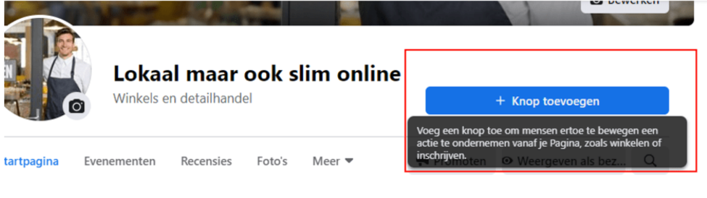
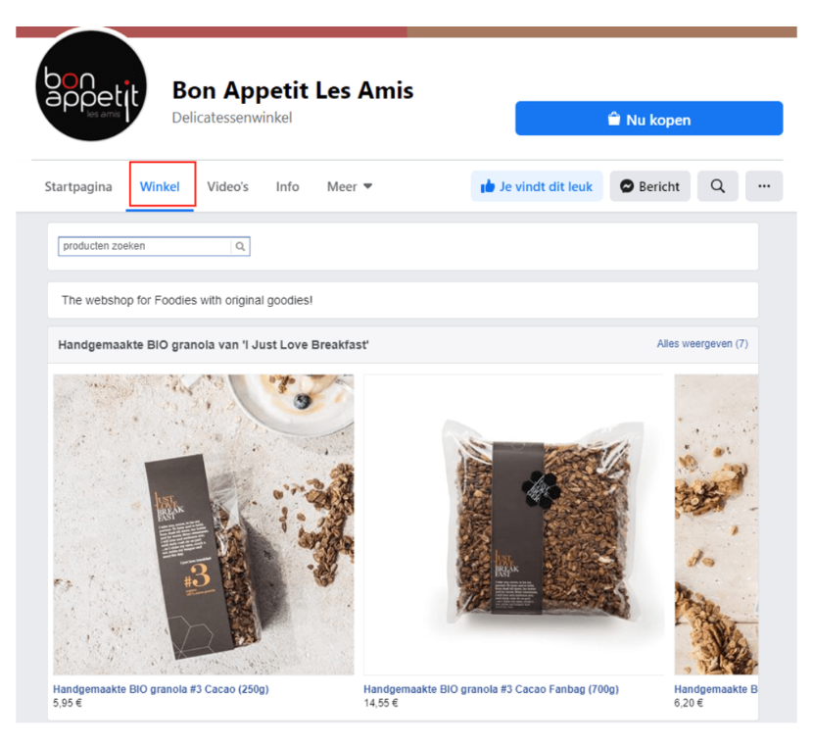

Sell through Social Media?
https://www.safeshops.be/nl/verkopen-via-facebook-instagram/

Slide 13
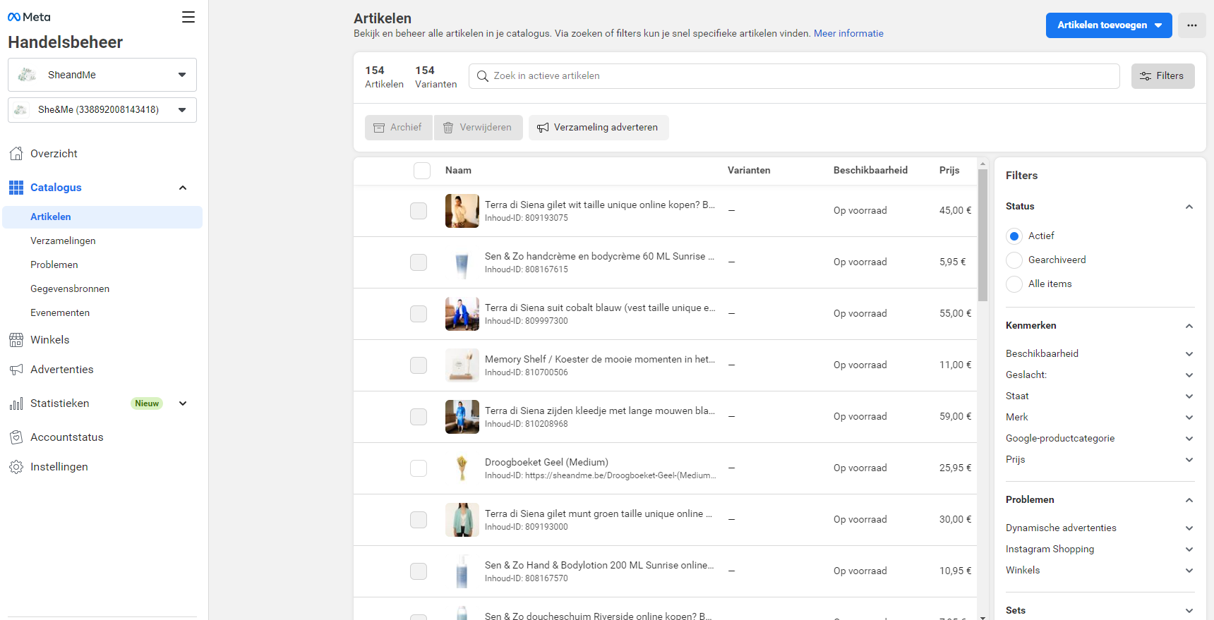
Sell through Social Media?
https://www.safeshops.be/nl/verkopen-via-facebook-instagram/
Via het Meta handelsbeheer kan je zowel IG als FB aansturen, zorg voor een koppeling met je webshop!

Slide 14

CREATE
TRUST

Slide 15


Trustlabels
47% of Belgian Consumers thinks labels are important

Slide 16
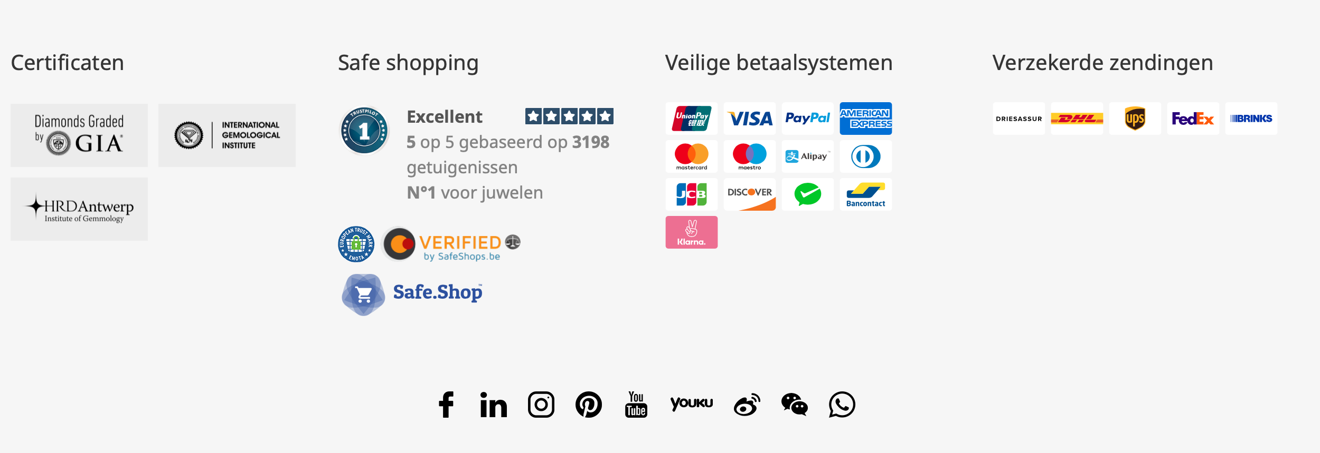

Slide 17
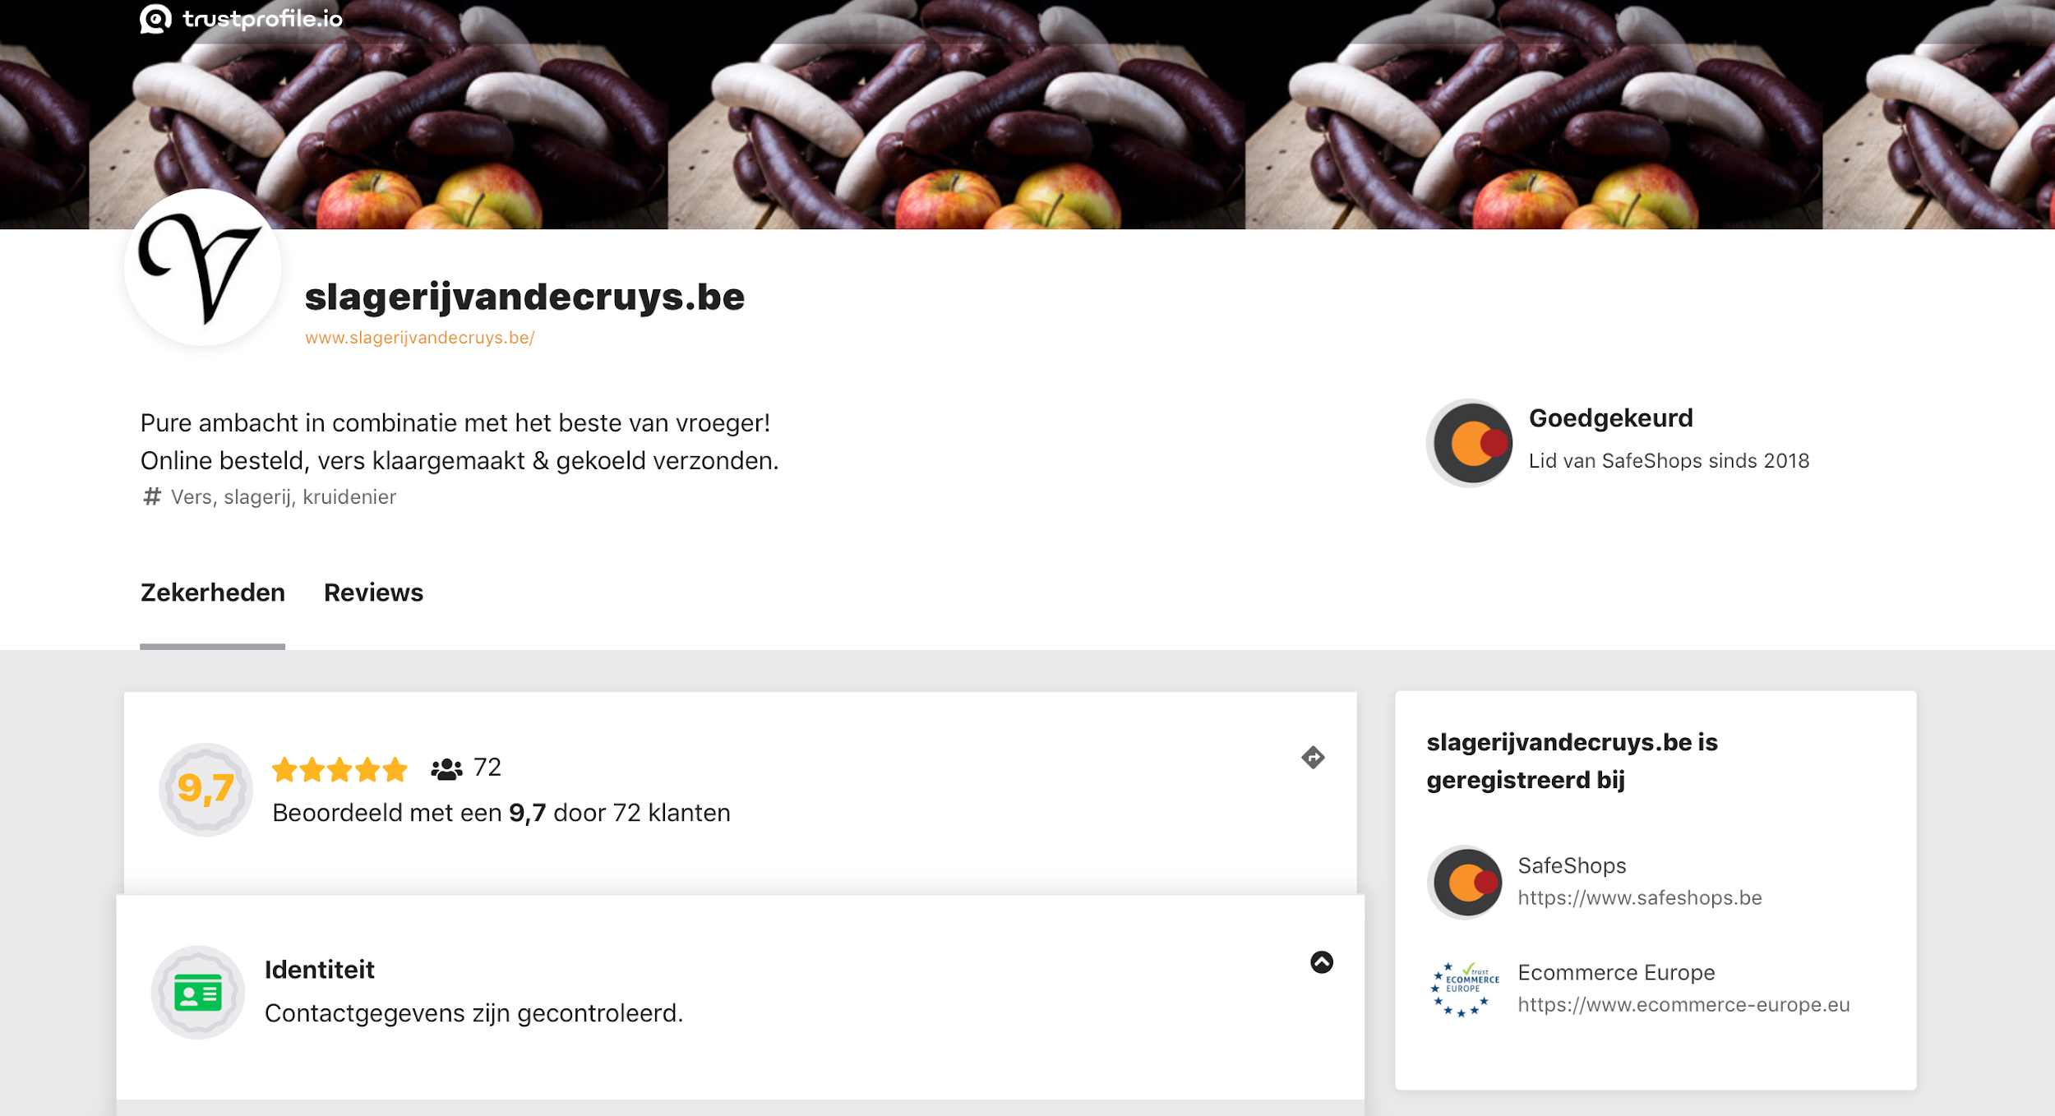
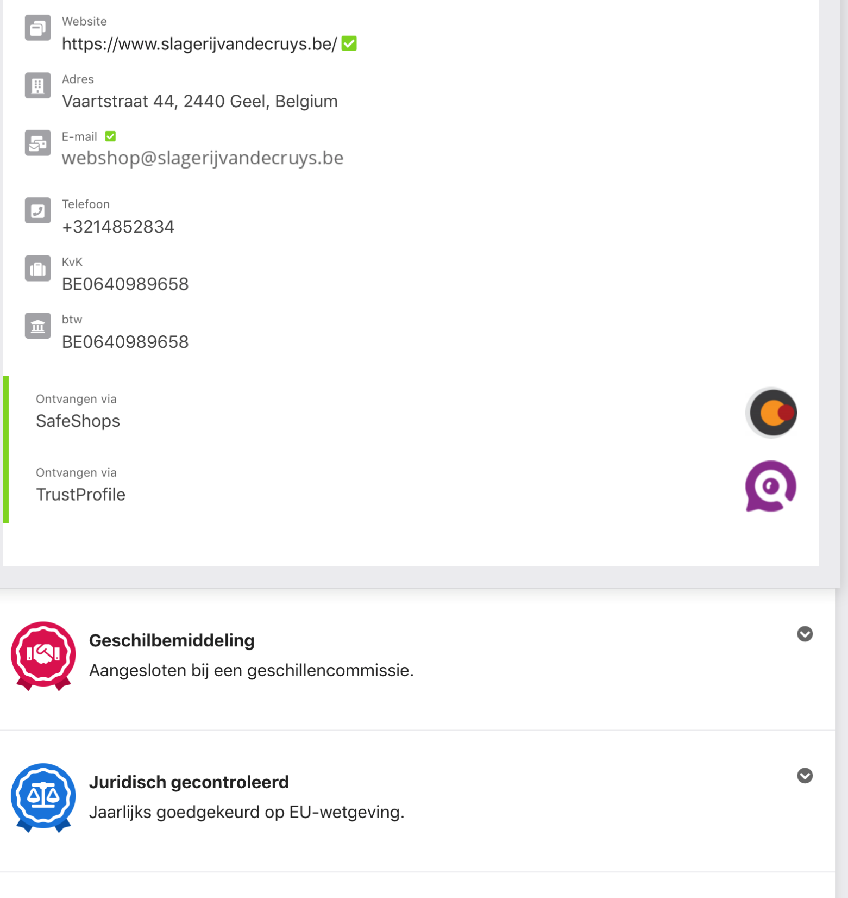

Slide 18
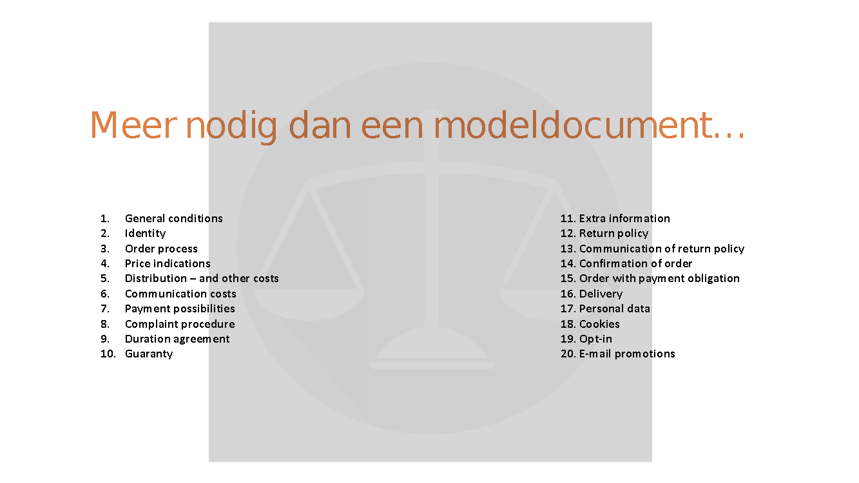

Slide 19



Consumer Reviews
46% always reads some reviews

Slide 20
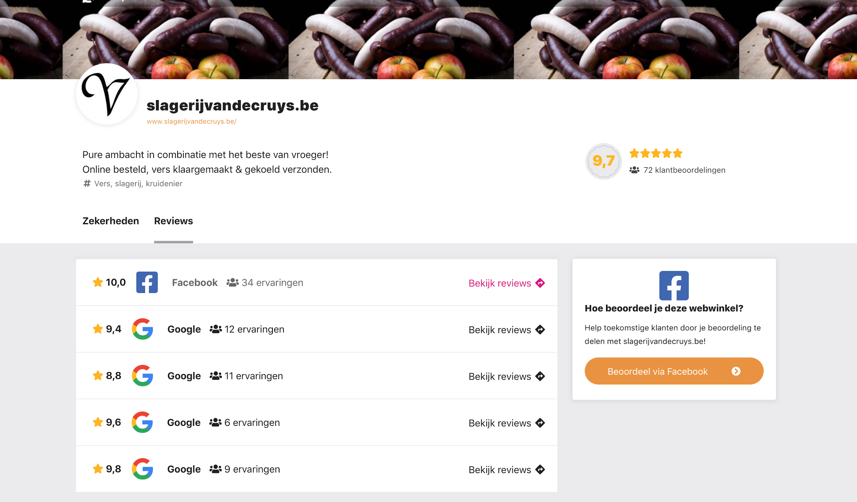

Slide 21


FULLFILMENT

Slide 22






FULLFILMENT
  Opslag (schaalbaar)
  Picking
  Verpakking (Brandimpact, duurzaamheid, bescherming, retour…)
  Handeling (label kleven/vouwen)
  Intern /extern?
  Retour

Slide 23
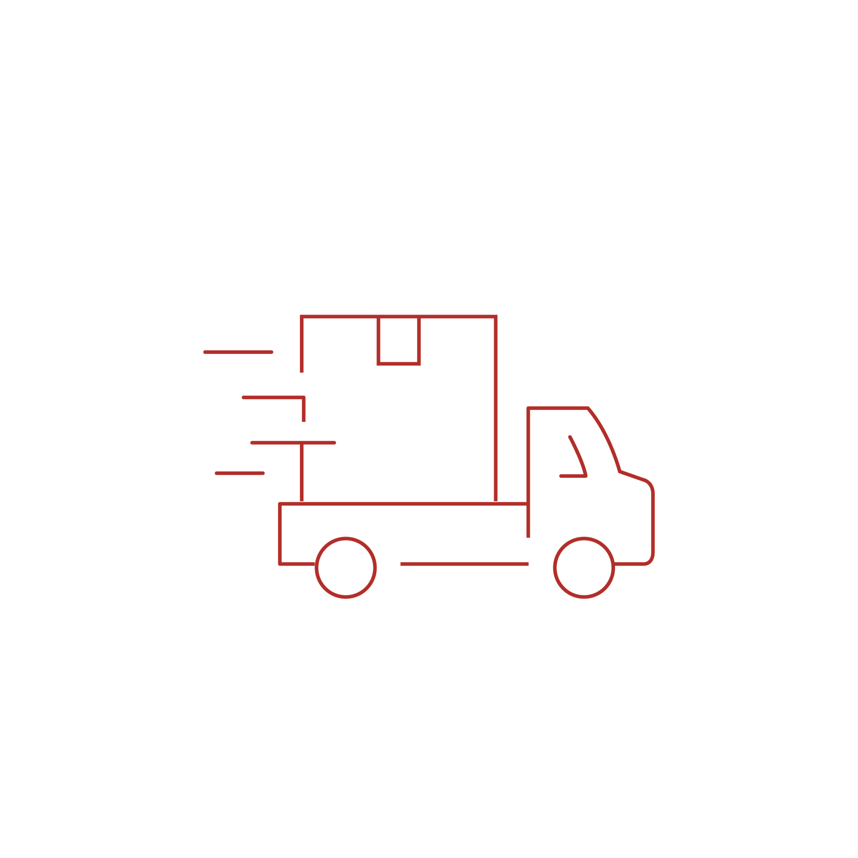
DELIVERY

Slide 24

Ideal web shop – Most important elements
04
1
In general Dutch speaking people attach more importance to each of these elements.
General expectations for web shops
“Must have”
Reliability of delivery is more important than speed of delivery.
*
Transparency (pricing, costs & personal data), logistics & payment are the most important elements of a good web shop
*
Logistics
Customer service
Payments
Concept
Sustainability
Safety
Potential differentiators
Q3.1 Which of the following elements are important to you when discerning between good and bad webshops? Top 2 (important to very important)
Base: Total sample 2022 (N=1015)

Slide 25
DELIVERY
Convenience
Speed
Late cut-off time
Information
Sustainable

Slide 26
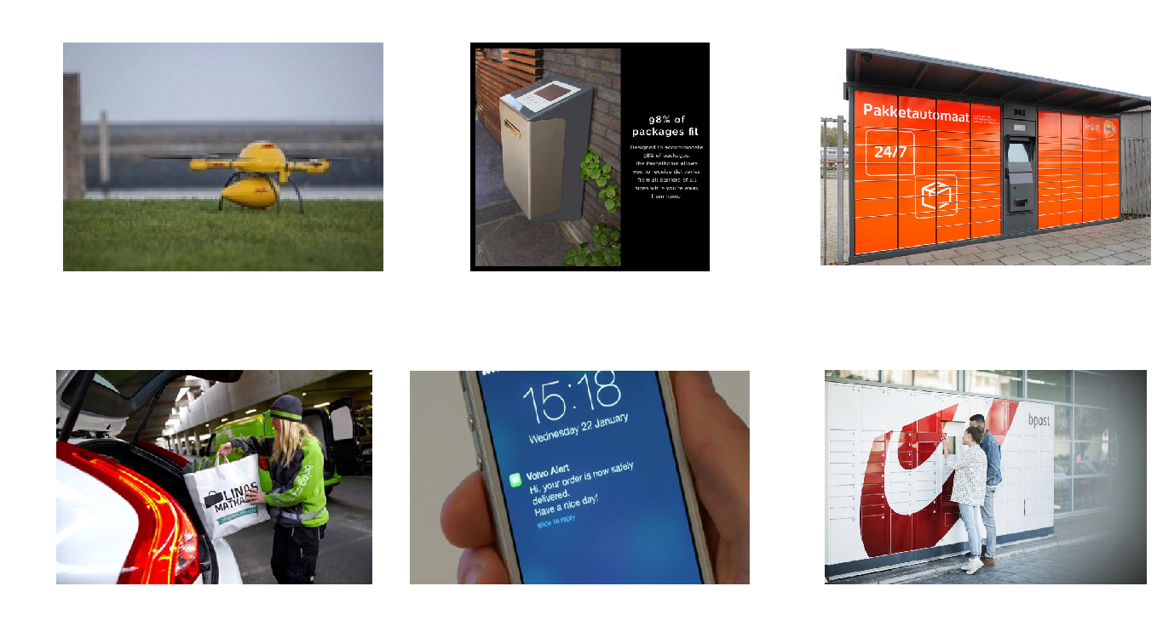
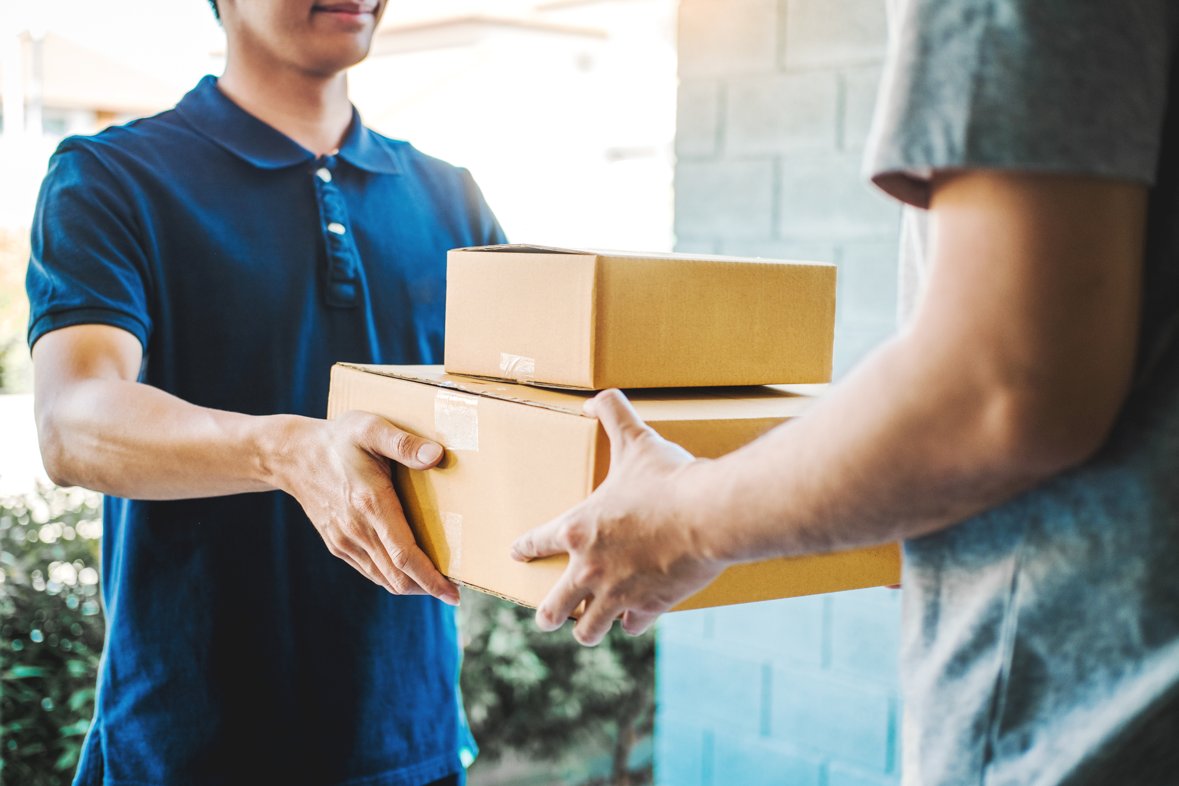

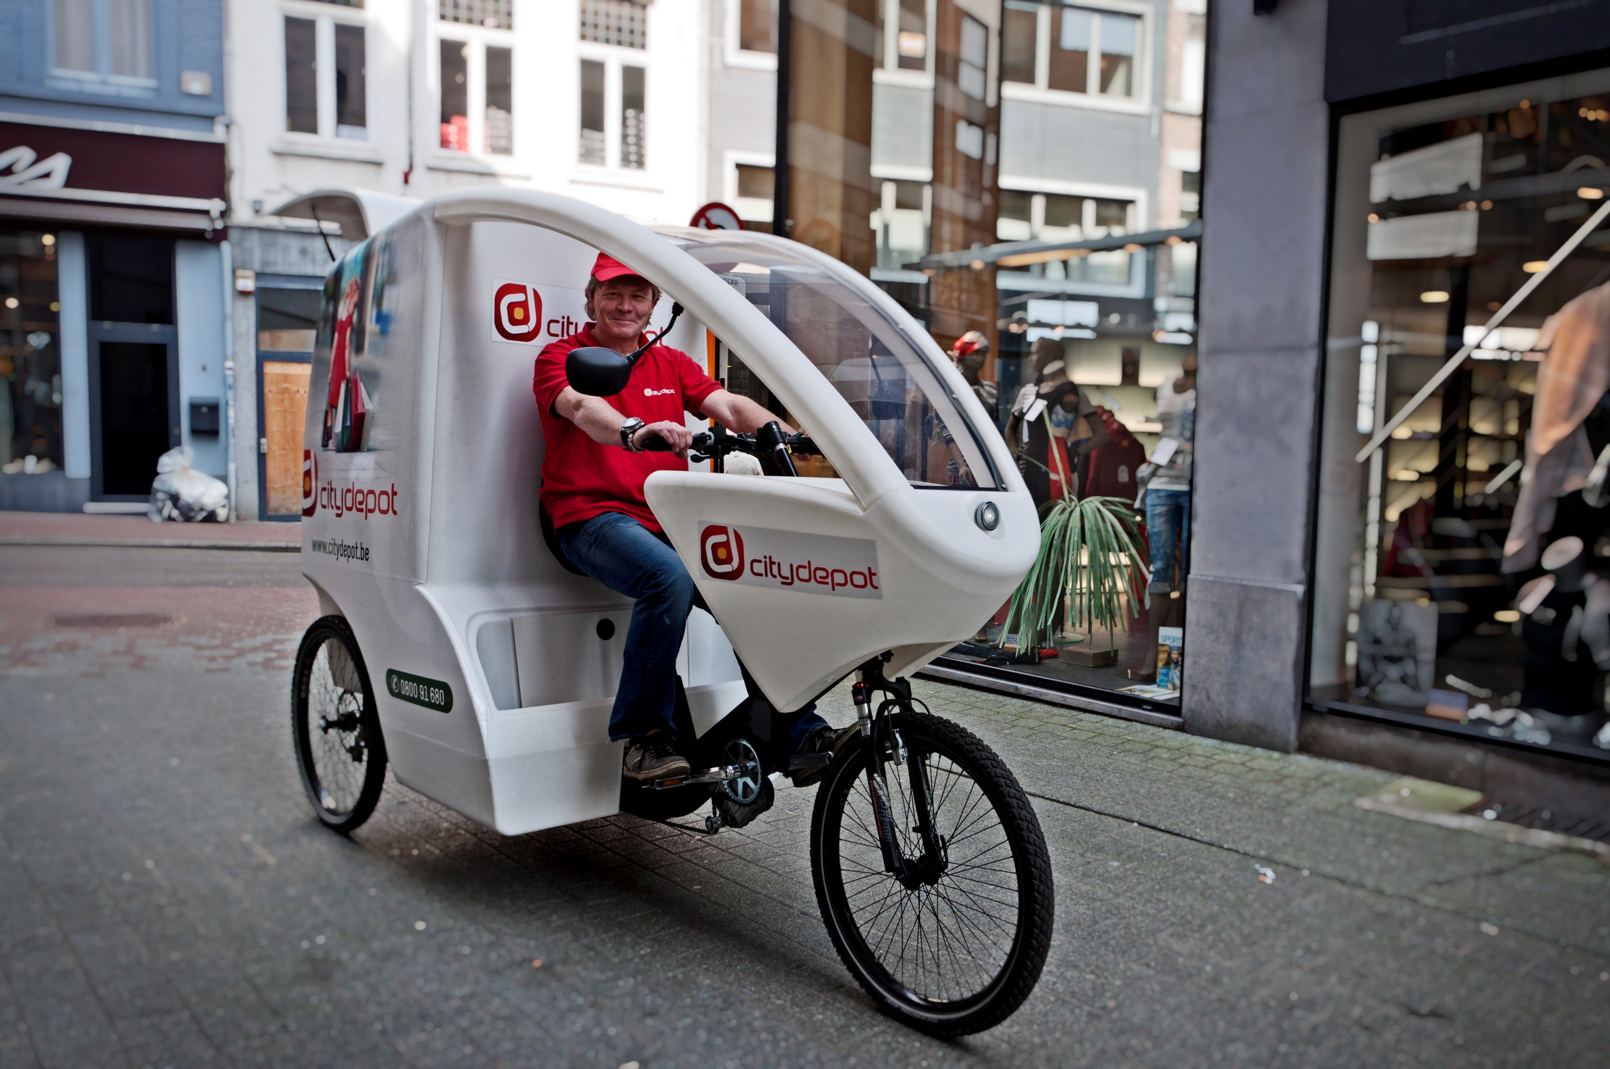
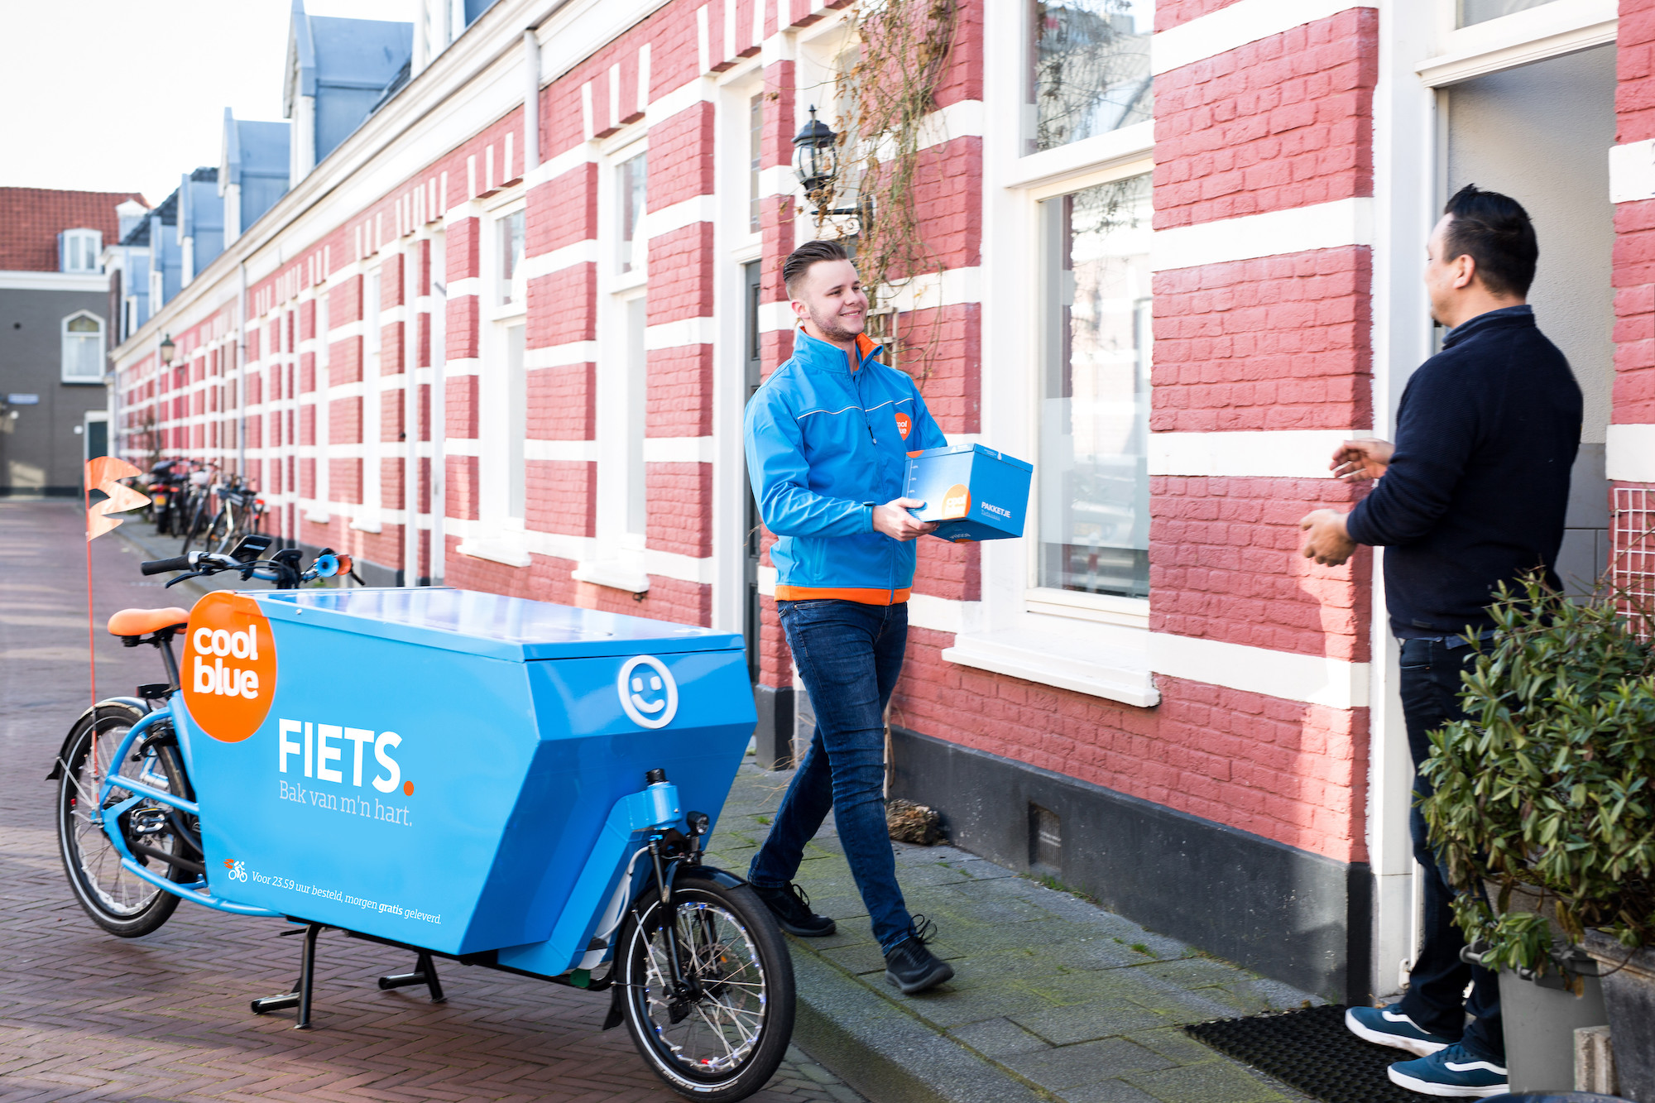


Slide 27
Sending – with who?
  www.safeshops.be/nl/overzicht-verzenddiensten-voor-webshops
  Start to send?
    bpost, Postnl, Dpd, GLS…
  Productafhankelijk:
    Large goods: (postnl@home / dynalogic (bpost)/ BD Logistics…)
    Perishable goods: Dynalogics /Dpd fresh/BD fresh…
  Technical
    Integration with own webshop
  Number of orders
    Sending tool : Sendcloud, myparcel…
  Speed (Express /Same day Delivery)
    DHL Express/ UPS/ Trans Force Logistisc/
  Location
    Internationale specialisation (Asendia: fr/swiss // DHL: Duitsland // UPS/ DHl: worldwide…)
  Sustainable
    Bike (bvb. Cargovelo,..)
    Budbee: sustainable evening delivery (timeframe)
    Ciy distribution (Citydepot)
    Ecozone bpost

Slide 28

Return to sender
Standaard 14 dagen
Uitzonderingen op bedenktermijn (food / op maat / software/…)
Langere retourperiodes
Kostprijs. Voor consument?
Terug in stock (kwaliteitscontrole/ lost/ Recupel/ 2ekans)
=> Download Study ‘return to sender’ – safeshops kenniscentrum

Slide 29

MONEY

Slide 30

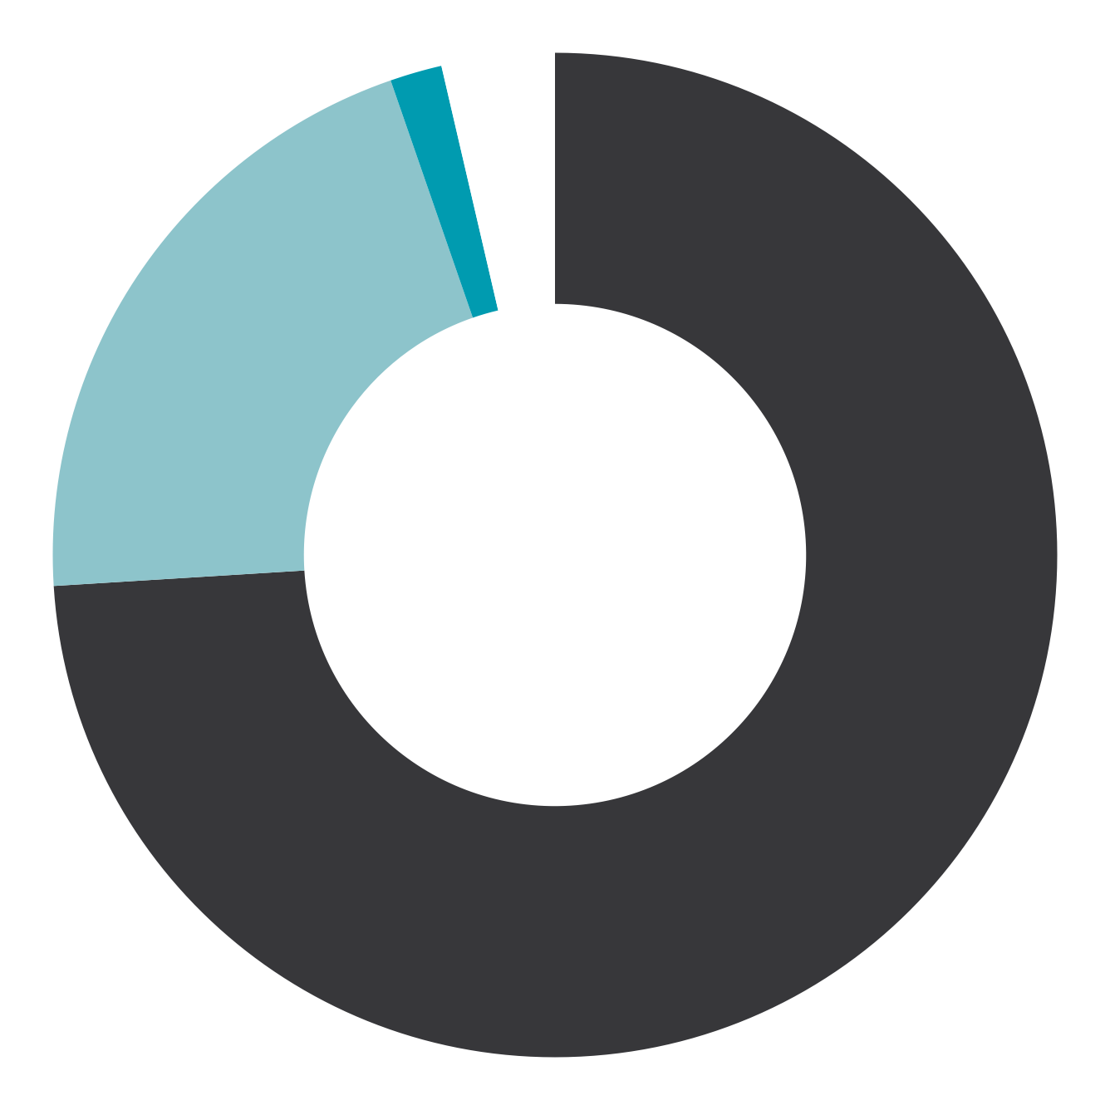

Bancontact favourite paying method of Belgian Consumer
Bancontact
64.87%
1.69%
3.67%
20.88%
74,75%
Paying Methods *
Direct Debet
Credit cards
Classic
New & Special
*zie appendix

Slide 31

SUSTAINABILITY

Slide 32
A few numbers on (Belgian) sustainability efforts
73% of webshops finds it important to strive for sustainability
86% of webshops bundles their shipments in 1 package,
77% uses durable/limited padding materials and
68% offers pick-up points
83% tries to avoid return through better product information
42% of consumers: good webshop → sustainability

Slide 33
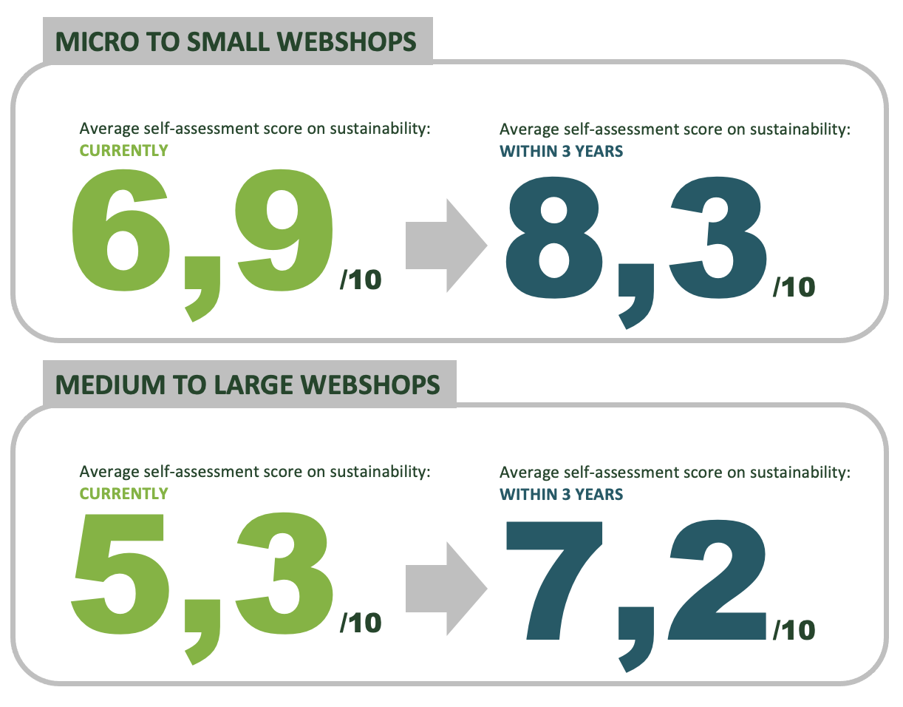

Slide 34

LEGAL

Slide 35
Packaging & Packaging Waste Regulation (PPWR)
European Legislation
Ecodesign for Sustainable Products
Geoblocking
DMA/DSA
Green Claims
Waste Framework

Slide 36
Main Points
DMA/DSA
  Breaking monopolies
  Fair Competition
  Consumer Protection
  …
Geoblocking
  No more discrimination based on location
  E.g. Ban on price discrimination, ban on refusal of certain payment methods
  ex.: Disneyland Paris tickets cheaper for French consumers
PPWR
  Void space limit: 40%
  Extended Producer Responsibility
  Reusable packaging
  …
VAT
  EU: in member state of delivery
  Outside of EU always VAT
  One Stop Shop: Declaration in own country

Slide 37
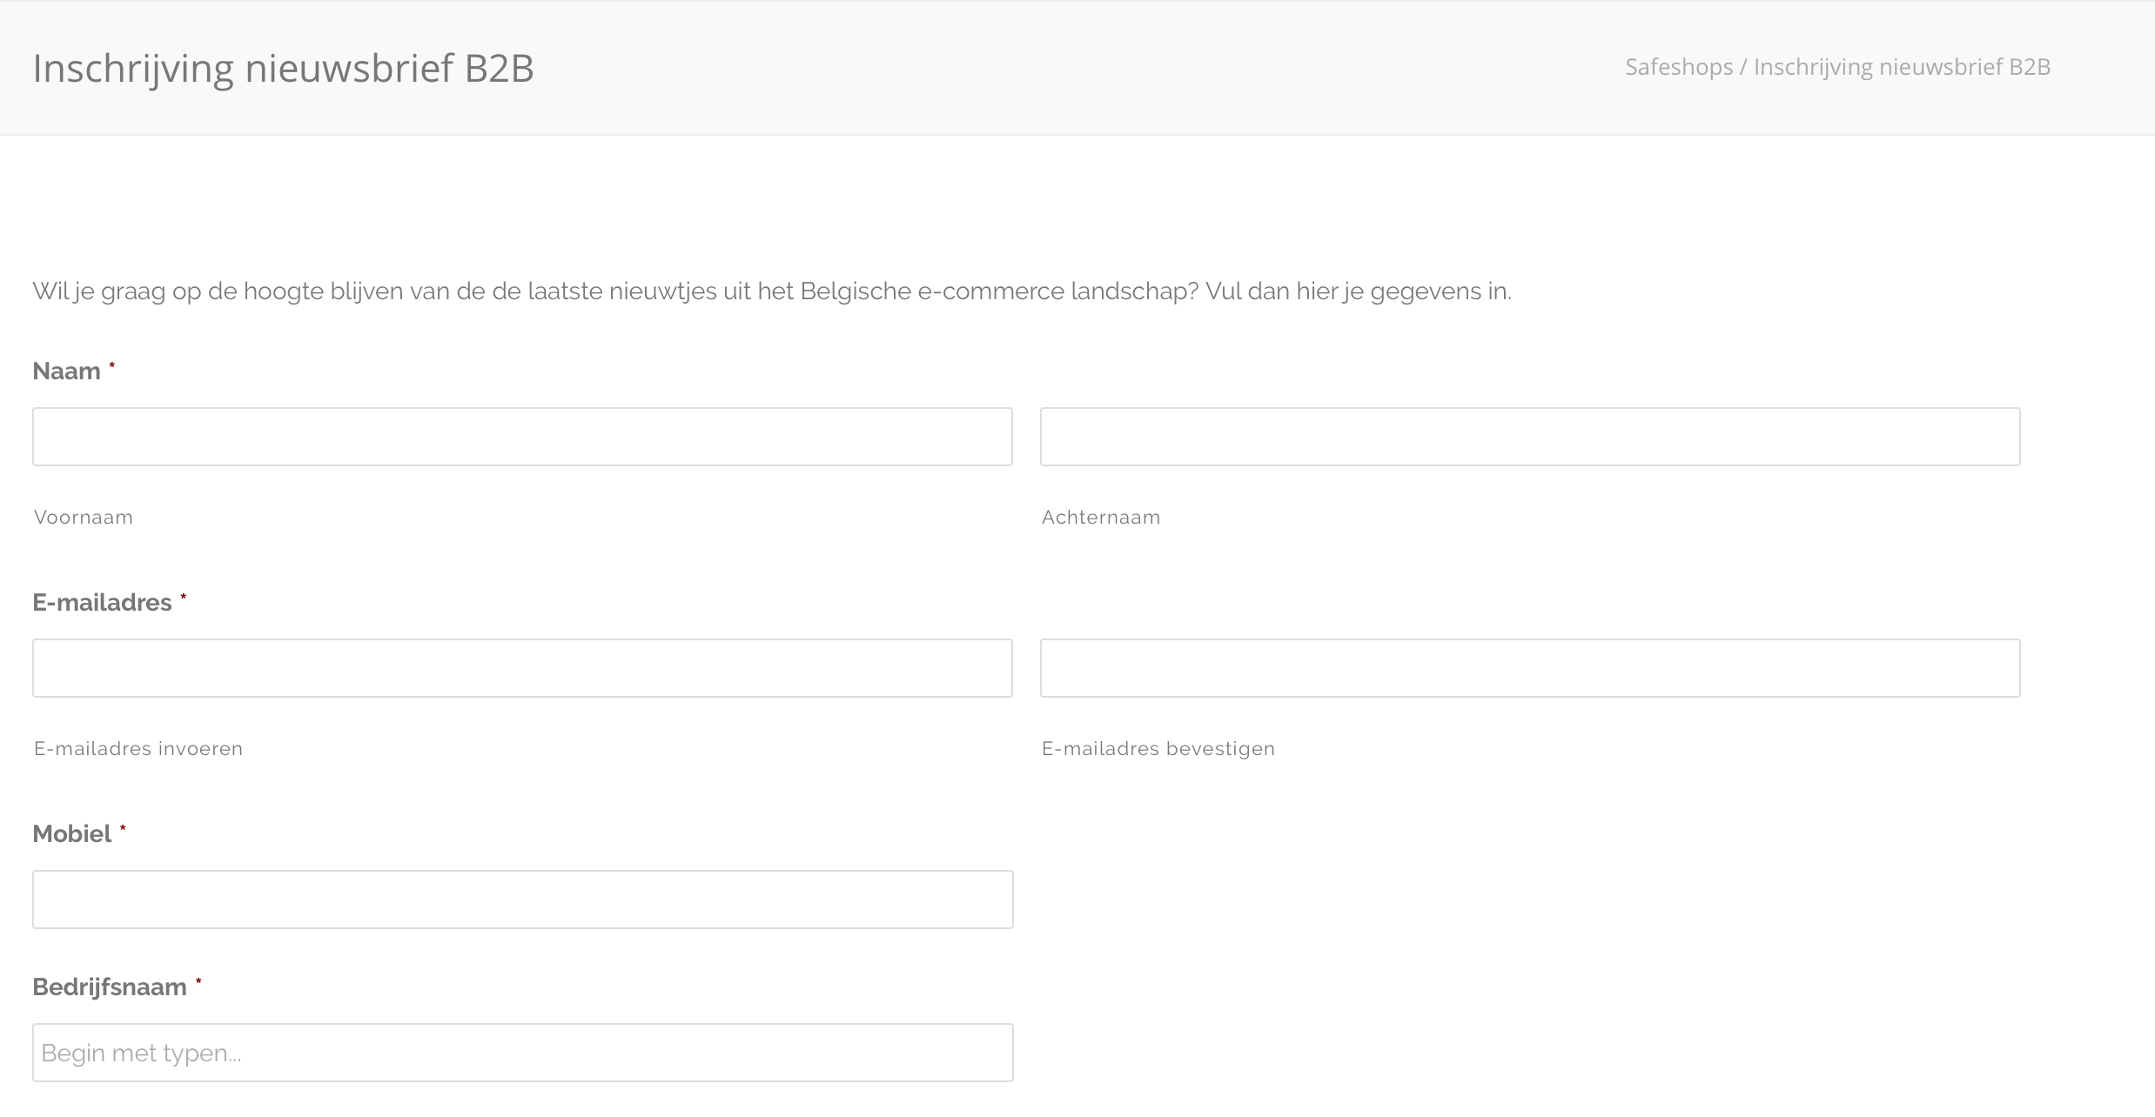

Slide 38

Greet Dekocker
Managing Director
SafeShops.be
Thanks
@2GREET
GREET DEKOCKER
INFO@SAFESHOPS.BE

