Slide 2



Miroslava Biresova
Miroslava Biresova
Welcome
Miroslava Biresova
Senior Sales Manager Czech Market
Miroslava.biresova@kaufland-ecommerce.com
Eleni Dingiludis
        International Sales Manager
        Eleni.dingiludis@kaufland-ecommerce.com
2

Slide 3




01
Cross-border e-commerce and marketplaces
02
Kaufland Global Marketplace – Overview
03
How it works
04
Tips and tricks

Slide 4



Relevance of cross-border e-commerce
Cross-border e-commerce and marketplaces
Selling internationally increases revenue by 10 – 15%
Breaking down barriers between countries
Diversification of the business
Cross-Border Top Categories
Source: Market Analysis Report / grandviewresearch.com 2022,
Nederlandse webwinkels verkopen voor miljarden over de grens / unifiedarts.de 2022
Notes:
The relevance of cross border in ecommerce is becoming increasingly relevant for online sellers.
There is a clear growth trend in cross-border trade in Europe, e.g. in the EU, B2C e-commerce increased by 20% from 2020 to 2021 (€171 billion) and is expected to increase again by 30% in 2022 (to €220 billion).
This is of course due to the increasing popularity of the internet, improvements in payment systems,and of course the impact of the pandemic etc. to name a few.
By entering into international selling, sellers have the opportunity to reach new target groups and new customers, and thus to Increase turnover: when a company starts selling internationally, its turnover increases by an average of 10 to 15%.
The development of Cross Border Ecommerce breaks down barriers between countries, promotes the development of international selling and thus offers you, as a seller, the opportunity to build diversified economic and trade relations.
But what role do marketplaces play here? I would like to discuss a few current trends that I have brought with me and will show you on the next slide.

Slide 5



Sellers rely on established marketplaces as a strategy for profitable growth
Cross-border e-commerce and marketplaces
Marketplaces as the new normal¹
+46%
seller growth on marketplaces
+29%
sales share of marketplaces as a sales channel for sellers
57%
of consumers shop on marketplaces “very frequently” to “exclusively”
25%
growth of marketplaces compared to total e-commerce CAGR of 12%
¹ Vergleich von 2020 zu 2021 (Enterprise Marketplace Index 2022 von Mirakl)
Notes:
Various forecasts show that marketplaces will continue to grow for the reasons mentioned. They usually offer an unlimited portfolio and also a large number of products that are not available in brick-and-mortar stores.
This means that even now, with the right strategy, you can expect an increase in sales. Even if growth in 2021 was exceptionally high, the sales figures for online retail in 2022 will still exceed those of 2020.
https://www.e-commerce-magazin.de/weihnachtsgeschaeft-2022-das-comeback-der-preissucher/
https://www.bevh.org/presse/zahl-der-woche/details/party-isch-over.html
And according to the BEVH, the decline was generally the smallest for marketplaces (-9.5%).
https://www.bevh.org/presse/pressemitteilungen/details/umsaetze-im-e-commerce-weiter-ruecklaeufig.html
To give you an idea of the dimension, you can see more on the slide: sellers shifted their budgets to online at the latest via the pandemic and were unable to meet the sharp increase in demand.
While more than 40% of the top online shops (EHI survey 22) already rely on marketplaces in their e-commerce strategy, the MP activities of sellers as a whole increased by 46% from 2020 to 2022. (which have increased their assortment by 29 % and the selection by 38 %) // In the past two years, the number of marketplace sellers more than doubled (In our case, also a strong increase).
Even after a few years in marketplace operation, sellers continue to post impressive 29% marketplace share growth. For this growth, sellers have successfully and comprehensively fulfilled the wishes of customers - namely assortment diversity and choice - on their marketplaces. It is therefore not surprising that 57% of consumers purchase their desired products exclusively or very frequently on marketplaces.
And also with a view to turnover, the marketplace share of sellers continues to make up a relevant and steadily growing share (+29%).
​https://www.bevh.org/presse/pressemitteilungen/details/umsaetze-im-e-commerce-weiter-ruecklaeufig.html
In 2021, growth in e-commerce almost came to a standstill. In the fourth quarter, it was in the single-digit range and was quantified at just 12% for the year as a whole. In parallel, sales on the same site in enterprise marketplaces increased by a full 25% - twice as much as e-commerce. Even more impressive is the growth of enterprise marketplaces over the past two years, where they achieved a compound annual growth rate (CAGR) of 49.7% (Q4 2021 vs. Q4 2019), while e-commerce as a whole posted a CAGR of 22.2% over the same period.
Conclusion: The reliable marketplace model not only offers customers the security of finding their products, but also provides sellers with a platform through which profitable growth can be expected.
Marketplaces are expected to continue to grow at 15% per annum in the West and by 2025 will be as large as direct online retail in established categories (which account for 45-50% of online spending) (DIE MARKTPLATZWELT Q1 2022).

Slide 6










Germany: A market with high purchasing power
Cross-border e-commerce and marketplaces
Germany shows the strongest demand in Europe in these categories
83% value a lot of product information
Furniture
Beauty, Health, Personal and Household care
88% value free shipping
Toys, Hobby and DIY
13% of online shoppers buy cross-border
Online Fashion
Germans prefer to shop on online marketplaces
Media
Online food and beverages
6
Source: eCommerce Market Data Analysis & Forecast/ Statista 2022
Statista 2022
Internetworld 2022
Bewusst online shoppen während der Inflation? / Inriver 2022
Ecommerce trends in Germany 2022
Notes:
However, let's start with our marketplace in Germany. To get a better understanding of the potential in the market, it is interesting to take a closer look at German customers.
A good thing is that Germany showed in 2022 the strongest demand in whole Europe for many categories and 17% of German online shoppers buy their products cross-border.
Another advantage for you is that German buyers prefer the convenience of buying everything in one place, so 80% of German online shoppers buy at marketplaces. This number is higher than the global average of 60%. Why is that so? The Germans favor the quick search, the wide assortment, and the secure and established processes. That’s probably also the reason why Germans like to shop on established platforms that they know quite well. So for an international seller, you can more easily reach the German customers if you position yourself at a marketplace. What else should you pay attention to?
60% of the Germans value free shipping and another 54% value speed of delivery: but globally, consumers expect to receive their order in less than three days (2.85). While in Spain and the US, customers are expecting faster delivery since last year, in the UK, Netherlands, Germany and France, consumers are expecting deliveries to take longer. So if you are having longer delivery times from the netherlands, it should not be a problem for the German customers.
What you should pay attention to are your product information: 40% of German online shoppers value to receive a lot of product information when shopping online. But I will go into this topic in more detail later.

Slide 7





Here’s what matters – important points to kick off international success
Cross-border e-commerce and marketplaces
Market & competitors
  Market size and potential for growth
  Market penetration and competition
  Product range opportunities
  Logistics, infrastructure
Customers & target group
  Language, translations
  Expectations and customer behaviour
  Reach target group
Legal & accounting
  Tax rates and limits
  Currency
  Customs (import/export)
  Local legal requirements
Service infrastructure
  Marketing and relevant channels
  Payment provider, payment methods
  Customer communication
Notes:
But we also all know that entering foreign markets is not a foregone conclusion.
There are many checklists for international selling. I have brought you a few things here that I think should be taken into account:
First of all : What does the market look like/ What is the competitive situation?
In order to get an idea of what the market looks like, you should first take a closer look at the market. By looking at market size and growth potential.
Then the topic of market penetration and product range opportunities. Which products are generally in demand, how does the competition look and do I as a seller have chances with my articles.
And also logistics conditions, which of course have an impact on pricing.
You need to familiarise yourself with the local shipping service providers and the country-specific prices for shipping and return shipping in case of a return.
Then next: customers & target group
First important point: the language - be it for account management as such, product data and of course customer service Then expectations / customer behaviour
What makes the local customer tick? Insights into customer expectations and behaviour are important.
And how do I reach my target group, how can I optimally promote my products - which search engines or price comparators are relevant?
Then there is the topic of law and accounting.
Every country has a different set-up and its own regulations.
This means you have to deal with tax rates and borders (easier via OSS, but you still have to inform yourself) e.g. VAT liability: when selling to another EU country or warehouse abroad, other tax rates e.g. for books.
Conversion of foreign currencies or customs and import regulations: EU country or non-EU country? Non-EU country, possibly import VAT (e.g. Brexit-UK)
And last but not least, the service provider infrastructure:
- In addition to the logistics already mentioned, you should also look at how things look on the provider side, e.g. with translations, which tax and payment providers there are or which software interfaces are available.

Slide 8

Marketplaces simplify international expansion
Cross-border e-commerce and marketplaces
Market & competitors
  Established market share and position of the marketplace
  Data on product ranges and logistics
Customers & target group
  Wide reach, pre-existing customer base
  Data on country-specific customer behaviour and demand
Legal and accounting
  Fulfilment of all legal requirements during registration as a seller
  Additional services regarding tax obligations and other legal topics
  Multi-channel marketing via country-specific, relevant channels
  Established payment processes, cooperation with payment providers
  Customer service in local language + support with translations
Service infrastructure
Notes:
Marketplaces support with the different hurdles:
Regarding market and competitors, market penetration can be simplified not only by the established market share and the position on the market.
Our data on product ranges and logistics also provide a good basis for facilitating an international expansion.
Then next: customers & target group
Our high reach via search engines and price comparators used locally and our pre-existing customer base increases the chance to reach specific target groups.
Apart from that our country-specific data on customer behavior and demand also facilitates contact with customers.
Then the topic of law & accounting:
By registering as a seller with us, you will be asked for all legal requirements to enable international expansion so you don't have to gather everything yourself. If questions arise, we provide additional services by specialists in the area of tax obligations and other legal topics.
And finally, the service provider infrastructure:
You can benefit from our existing infrastructure. This includes Multi-channel marketing via country-specific, relevant channels. We already created an established payment processes in cooperation with many different kinds of payment providers to meet all customer requirements. Further, we offer customer service in the local languages and we support you with translations.

Slide 9
01
Cross-border e-commerce and marketplaces
02
Kaufland Global Marketplace – Overview
03
How it works
04
Tips and tricks

Slide 10



Kaufland.de at a glance: This is what we have already achieved with the German marketplace
Kaufland Global Marketplace – Overview
€1 billion+
GMV¹
32 million+
website visitors per month
45 million+
products
10,000+
sellers
Ranked 3rd
most popular shopping app in Germany‘s Google Play Store²
340+ points
in German Google’s visibility index³
5,000+
categories
¹ Kaufland 2020
² https://de.statista.com/statistik/daten/studie/688703/umfrage/beliebteste-shopping-apps-im-google-play-store-nach-downloads-in- deutschland/
³Sistrix 2022
Notes:
I want to start off with some key figures and what we have achieved with our German marketplace Kaufland.de so far. We are happy that we have achieved over 1 billion € GMV on our marketplace in 2020, and we continue to grow.
This growth is also emphasized by our large, generalist assortment of over 45 million articles.
These are placed in over 5,000 categories, which are divided into different upper categories, such as electronics, furniture, fashion or sports.
We currently work with more than 9,000 sellers who can present their offers to around 32 million website visitors every month.
Lastly, I would like to emphasize our high amount of more than 340 points in the Google visibility index.

Slide 11
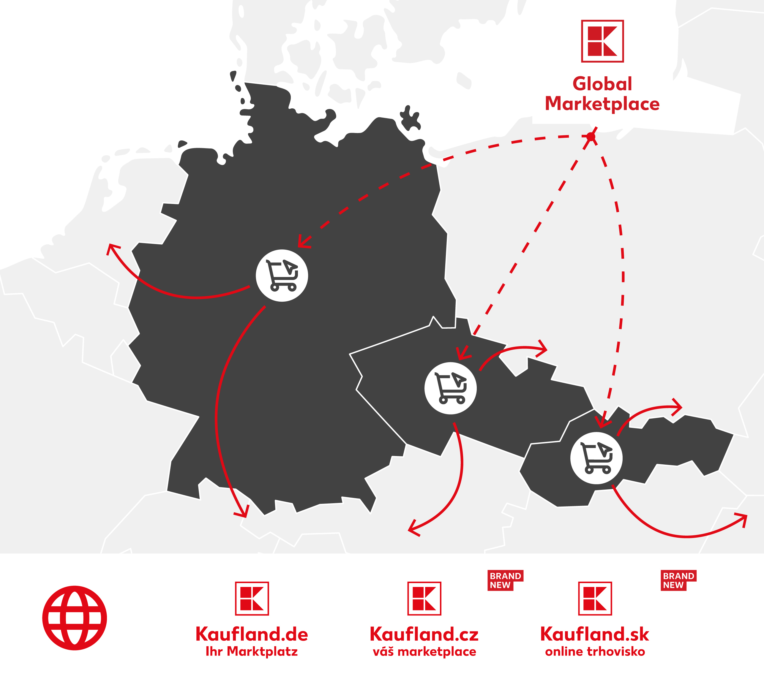
In addition to Kaufland.de, you can now sell on our new marketplaces in Slovakia and in the Czech Republic
Kaufland Global Marketplace – Overview
Kaufland Global Marketplace
An all-in-one solution made up of several online marketplaces
Kaufland.de is paving the way with around 32 million website visitors per month. In addition to the Kaufland.sk marketplace in Slovakia, the Kaufland.cz marketplace has now also been successfully launched in the Czech Republic.
Just one registration
Kaufland Global Marketplace enables you to sell on a variety of Kaufland marketplaces with just one registration.
Simplified international selling
Our multi-marketplace technology allows you to manage all your offers, orders and product data from one place. We also support you with additional services that you need as a global player.
Notes:
It is for this purpose that we have founded our new umbrella brand Kaufland Global Marketplace, which is an all-in-one solution made up of several Kaufland marketplaces. The German marketplace Kaufland.de is the trailblazer, of course. In its footsteps we opened already the new marketplaces Kaufland.sk and Kaufland.cz. ​
Kaufland Global Marketplace enables you to sell on several Kaufland marketplaces with just one registration and one seller portal. It allows you to manage your offers, orders and product data. ​
We also support you with additional services that you need as a global player, for example product data translations. ​
With the popularity of the Kaufland brand in several countries, combined with the transparent and fair conditions you already know from Kaufland.de, we’ll be by your side to help you expand to international markets and increase your reach and target groups.

Slide 12

Czech Republic and Slovakia: Strong growth forecasts in e-commerce show the countries' enormous potential
Kaufland Global Marketplace – Overview
Sales in 2021
5 billion
USD
  Further Key Insights
  Price level of private consumer spending only slightly below Germany
  Good performance of both countries in the Logistic Performance Index
9.6%
annual sales
growth by 2025
(CAGR 2022-2025)
CZECH REPUBLIC
65%
user growth projected
by 2025
SLOVAKIA
57%
user growth projected
by 2025
13.6%
annual sales
growth by 2025
(CAGR 2022-2025)
Sales in 2021
1 billion
USD
    Rapid increase in sales growth
Quellen: Statista, E-Commerce- Markt Tschechien/ Slowakei 2021
European Ecommerce Overview Czech/ Slovakia 2022
https://marketplaceworld.de/ueberblick-ueber-tschechischen-und-slowakischen-e-commerce-markt/
Quellen: European Ecommerce Overview: Slovakia 2022 / ecommercegermany.com,
European Ecommerce Overview: the Czech Republic 2022 / ecommercegermany.com,
Vergleichende Preisniveaus 2022, Europa.eu,
Logistics Performance Score 2018
12
Notes:
Not only the German marketplace, but also the Czech and Slovakian ones hold great potential
As part of our internationalisation into the two countries, we have of course also looked at the data and I would like to share these insights with you.
The e-commerce market in these two countries has experienced rapid sales growth in recent years - and the trend is still rising.
1. the population of the Czech Republic is 10.7 million, that of Slovakia 5.45 million.
2. the turnover in the e-commerce market in 2021 was 5 billion US dollars in the Czech Republic and 1 billion US dollars in Slovakia.
Special effect Corona: Sales in the Czech Republic grew by 26 % and in Slovakia by a full 29 % (2021).
The annual growth forecasts are 9.6% in Czech Republic and 13.6% in Slovakia.
By 2025, the Czech e-commerce market is expected to reach a user penetration of 65%, with Slovakian penetration rising to 57%.
Further Key Insights here are:
- The price level of private consumer spending is only slightly lower than in Germany (Eurostat 2020: D - 106.3 / CZ - 74.6 / SK 81.1 = slightly lower).
Both countries have a good performance in the Logistic Performance Index which is divided into six categories: customs (efficiency of the authority), infrastructure, international shipping, logistics performance, traceability and punctuality. The scores of the individual categories are aggregated by means of a weighted average to a total figure that results in a ranking of the countries examined.
Thus, not bad basic conditions.

Slide 13





The Kaufland brand - one of the leading retailers in the Czech Republic and in Slovakia
Kaufland Global Marketplace – Overview
Slovakia
Czech Republic
77
Kaufland stores
142
Kaufland stores
16,1 %
Market share
13,7 %
Market share
#3
in food retail
#1
in food retail
Slovakia – Country Commercial Guide/ trade.gov 2019
Umsatzanteil bezogen auf den Gesamtumsatz des Einzelhandels des Landes, Statista.com, marketresearch.com, lloydsbanktrade.com 2019
Nach Umsatz, Statista.com, lloydsbanktrade.com 2019
European Ecommerce Overview: Slovakia 2022 / ecommercegermany.com,
European Ecommerce Overview: the Czech Republic 2022 / ecommercegermany.com

Slide 14


An international expansion can be a challenge at first – we support you in various aspects
Kaufland Global Marketplace – Overview
Access to 32 million customers
(on Kaufland.de alone)
All-in-one solution to manage multiple Kaufland marketplaces
Multiple connection options and easy listing via GTIN (EAN)
Automatic translations for product data in German, Czech and Slovak
Multi-channel marketing across all relevant channels
Automatic translations for customer communication in all languages
Personal, multilingual seller support and 1st level customer service in local language
All relevant payment methods for our customers included
Notes:
To summarize the advantages of selling via Kaufland Global Marketplace:
I would like to particularly emphasize the multi-marketplace technology, which allows easy international selling in 3 different countries via the Seller Portal. ​
But multi-channel marketing via all relevant channels in the respective countries is also included. For example, in the Czech Republic a major search engine is not Google, but Sesznam, through which we will then of course also promote your products in these countries - of course also included for you. ​
Just like the relevant payment methods in all three countries. ​
Perhaps a brief word on conditions: With the Early-Bird offer, you pay no basic fees and no commissions for the first 6 months anyway. But even after that you sell with us at fair and transparent conditions, because you pay the monthly fee only for one marketplace and can sell on all 3. And the commissions are the same as currently on Kaufland.de. Here, of course, our goal is the greatest possible transparency and simplicity for you. ​
Finally, I would like to highlight the personal seller support and customer service from our side, which is available in different languages to support you on Kaufland.de but of course also on our new marketplaces in the best possible way. ​

Slide 15
01
Cross-border e-commerce and marketplaces
02
Kaufland Global Marketplace – Overview
03
How it works
04
Tips and tricks

Slide 16












We support you holistically – selling with Kaufland Global Marketplace is easy
How it works
Registration as a seller
Sales channel onboarding
Listing via EAN
Shipping to customers
Payout revenue release*
Seller account
activation
Automated marketing
Payment
process
Dispatch information
1st level customer
+ seller support
*The payment service provider cflox settles the respective seller balances on a daily basis. In particular due to the consumer's right of revocation in the distance selling business as well as different delivery periods, the funds received on the clearing account of the sellers set up for this purpose will, however, only be made available for payment to the respective seller with a time delay of at least 14 days, but no later than 42 days, after the conclusion of the purchase contract.
Notes:
If you say now, that this sounds interesting for you and you would like to sell with us, I will now introduce you to the process of listing and selling on our marketplace. Here, you can see the complete process and who is responsible for each step in the selling process. The grey arrow in the top is the seller and the red arrow in the bottom is Kaufland.
First of all, you need to register as a seller on our marketplace.
When you have submitted your registration, we will check your provided information and activate the account.
With this, you will get access to our seller portal and you can start with the setup and the Onboarding of your desired Sales Channels. This includes e.g. the legal texts or the shipping settings.
As part of the Onboarding, you also start with the listing of your products via EAN codes. I will show you the listing options that you have on the following slide.
Once your products are live, we advertise your offers which are in the BuyBox on our external marketing channels to generate the most traffic for you. I will also go into more detail on this topic later on.
When customers order a product from you, they pay to Kaufland marketplace – because we handle the payment processing for you. So we offer the customers all typical payment methods, like payment on account, credit card or PayPal and the customers pay directly to us – you as a seller don’t need to worry about payment methods or money from customers.
In a next step, we provide you with the order and shipping information.
Now it’s your turn to ship the respective articles from your warehouse to the customer’s address. Here, the shipping provider and the conditions can be chosen by yourself.
In a final step, you will receive your sales revenue from us. Your revenue will automatically be credited to your Kaufland seller account after the revocation period of 14 days. You can then pay out the money from your account to your bank account at any time.
In general, we support you throughout the whole process with our seller support and our first level customer service. In terms seller support, we have colleagues who are available by mail and by phone 5 days a week to help you with your listings, your account and so on. And on the other side, we have a customer service who supports you with all first level requests from our joint customers.

Slide 17
Our conditions are fair and transparent – there are no hidden costs
How to start
Monthly fees
Variable fees
Basic fee
€ 39.95
Per month, plus VAT^{1,2}
CATEGORIES | COMMISSION³
Computers, consumer electronics, household appliances, tyres, complete wheels | 7%
Fragrances, tools & garden tools | 10%
Computer accessories, electronic accessories, kitchen & household, personal care & health, toys, office supplies, fan articles, bicycles & e-bikes, sports & outdoor (without camping, gym equipment & standup paddle boards), watches, food, tobacco products, garden & leisure, furniture & living, lamps & lights, sex toys, clothing, table tennis tables, party decorations, handicraft supplies, protection & safety, baby & baby accessories, esoterics, cars & motorbikes (without tyres, rims, complete wheels), other | 13%
Media | 13% + 0.70€ / Item sold
Pet supplies, camping, gym equipment & stand-up paddle boards | 15%
Jewelry | 16%
Basic fee + Shop Link
€ 49.90
Per month, plus VAT^{1,2}
¹ Can be cancelled/switched at any time.
² If a seller with Kaufland Global Marketplace sells on several Kaufland sales channels, they only pay the monthly basic fee for one sales channel. The use of the other sales channels is included in this basic fee.
³ The commission is calculated on your sales price including taxes and shipping costs.
⁴ For further information on the terms and conditions, please check: https://www.kaufland.de/becomeaseller
Notes:
Lastly, what does it cost you to start and sell on Kaufland.de?
We are working with a combination of a monthly fee and a sales commission.
The monthly fee is roughly 40€ for the basic subscription and it includes our services, like the unlimited listing, our automated marketing, our personal support and also the payment processing by us.
Next to that, we have the sales commission which is category-based. Overall, it is in the range of 7% to 16%. Most categories are in the category of 13%, as you can see here on the slide. For example, we charge 7% for computer electronics and 13% for furniture. Of course, this commission is only charged for successful sales, so not in case of cancellations or returns.
I believe our conditions are very competitive and transparent. And also, there is no contract period or cancellation period, so if you notice that Kaufland.de might not be the right sales channel for you, you can end our cooperation at any time.
What I would like to emphasize here as well is our Early Bird Offer for our new marketplace Kaufland.cz. So, if you are selling in Germany already and you want to extend your business to the Czech Republic, you can enjoy no commissions in the first six months and a Sponsored Product Ads Budget of 1.200€ on our new marketplace.

Slide 18
01
Cross-border e-commerce and marketplaces
02
Kaufland Global Marketplace – Overview
03
How it works
04
Tips and tricks

Slide 19
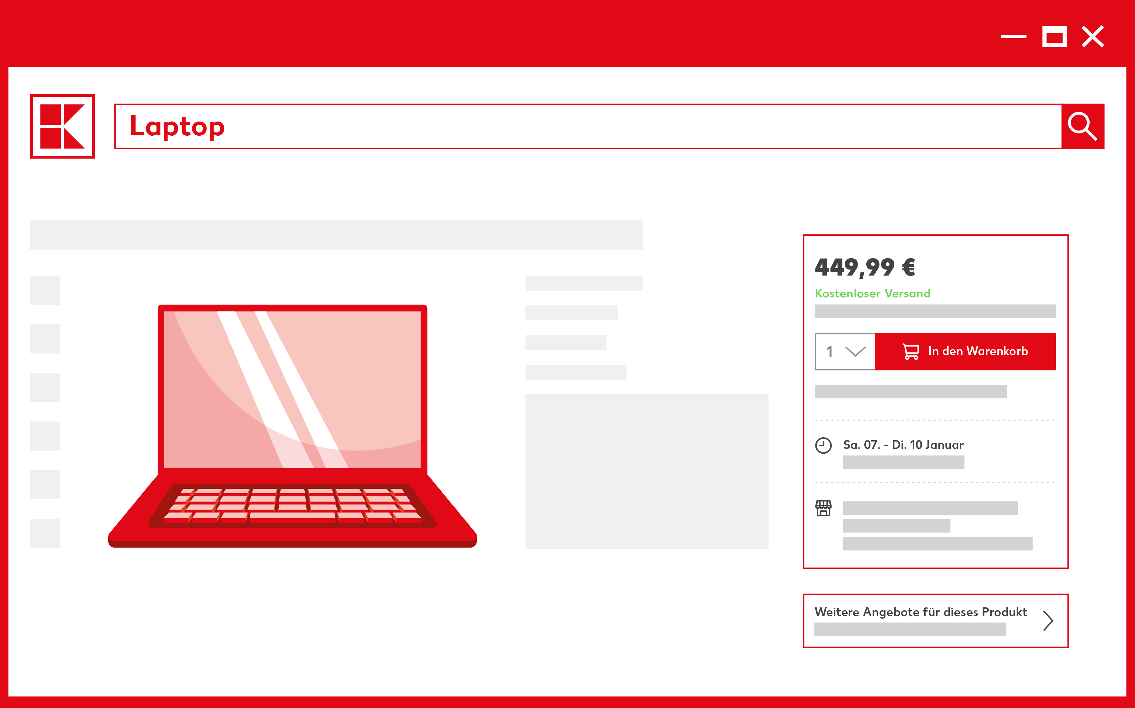

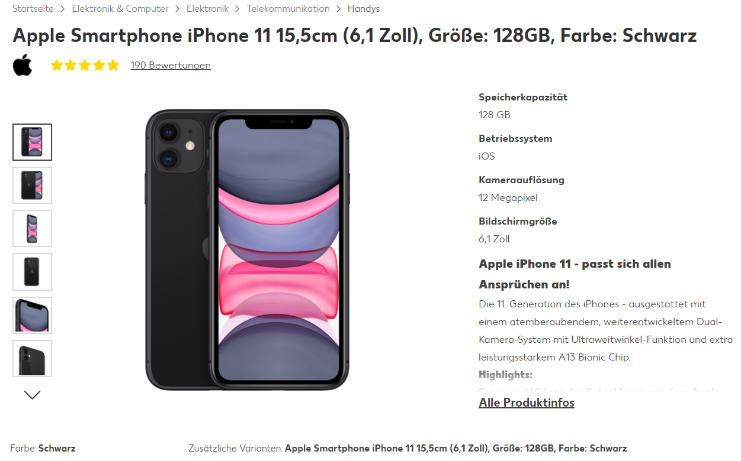



Informative & fully maintained attributes ensure high attractiveness and visibility
Tips and tricks
Product data
  Complete attributes and meaningful content
  Freestanding pictures (white, no logo or similar)
Check category
  Keywords in short description and title
Product detail page is a central location for customer purchase decisions
Notes:
But how do you sell successfully after you have registered? For this we first look at the product data.
It is important to know here that we distinguish between offer and product data. Offer data are EAN, price, quantity and delivery time.Product data are then title, description, picture, attributes.
With regard to product data, it is important that it is meaningful and fully maintained because as already mentioned 40% of German online shoppers value to receive a lot of product information when shopping online. (Statista 2021)
Means as also shown here:
Correct category entry
Meaningful title
Detailed images with a white background and cut out without logos and watermarks, so that they can also be displayed in GS.
Make sure that the cover picture is in the first place.
Meaningful description with promotional body text and bullet points for technical details
Maintenance of all relevant attributes - also important here for all legal aspects. Relevant attributes such as, for example, an EU data sheet must be displayed for a hoover, otherwise the articles are considered invalid by us and the end customer does not get to see them.
What do your customers enter in search to find your products?
- Additional key words have a positive effect on the search algorithm and increase organic visibility.
- The key words are not displayed to customers on the product detail page
- Put on the customer glasses - use various synonyms, product details, spelling variants and abbreviations
If they take these things to heart, then they are already well positioned on the product data side.

Slide 20




Competitive prices and short delivery times bring you maximum reach
Tips and tricks
Offer data
List your entire product range
Competitive delivery times and prices
Check your inventory
  Low-price automatic
Das beste Angebot wird dem Kunden über die Buybox angezeigt
Notes:
Next to the list of the full assortment you see on the left again the PDP this time with focus on the Buybox. Because...
As a marketplace, we enable several sellers to offer deals for the same product and show the customer the most attractive or best offer via the buybox - the so-called shopping cart field. But what factors make up the algorithm? First of all, your prices and the delivery time are decisive here.
While the total price consists of the product price, including VAT and shipping costs, we understand delivery time as the period between the customer's order and the receipt of the product by the customer. (54% germans value speed of delivery Statista 2021) A combination of Best Total Price/Best Delivery Time results in the best offer, which is then also displayed in the Buybox. All other offers land under "More offers for this product" under the Buxbox.
Ensure stock so that your products are also available for the customer.
Via the price floor automatic, we provide you with a tool that helps you find the best offer. You enter your minimum price and the tool dynamically calculates the prices between the specified price and the lowest price so that your offer can be displayed in the Buybox. The competition as well as shipping costs and delivery time are taken into account.

Slide 21

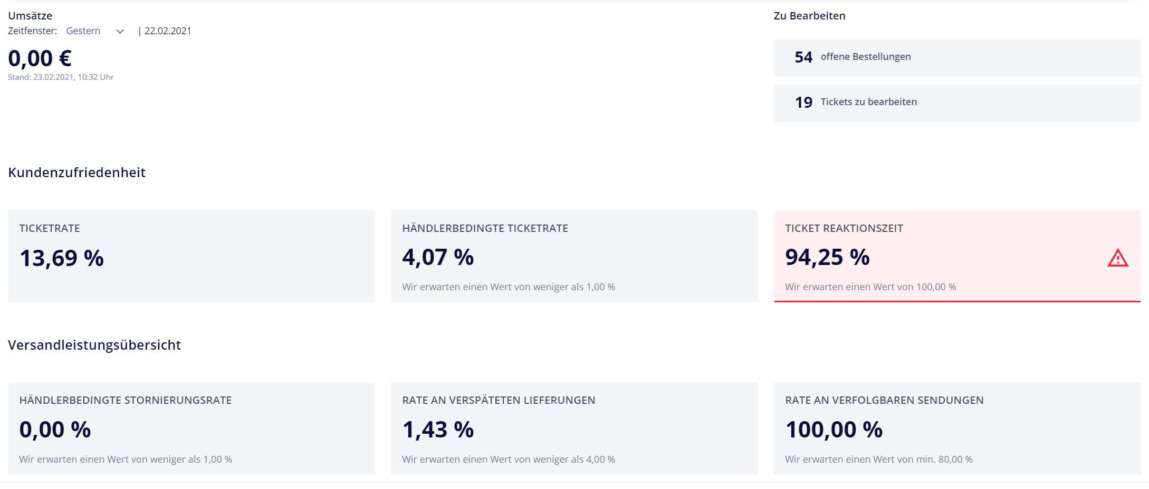



Good customer service is essential to achieve a high repurchase rate
Tips and tricks
Service performance
  Compliance with delivery time
  48h response time (weekdays)
Low seller-related ticket rate
  Seller-related cancellation rate
All important key figures at a glance on the dashboard in the Seller Portal
Notes:
In order to offer the best possible customer service, it is possible to track your own service performance in our Seller Portal and thus identify possible need for improvement.
We divide this into Customer Satisfaction and Shipping Performance.
You can greatly influence the Customer Satisfaction by simply paying attention to a few things:
Make sure to response to tickets within 48 hours
and keep the seller-related ticket rate low. The cause of a seller-related ticket is often avoidable as there are reasons like e.g. incomplete delivery, not received delivery, incorrect products, defects and delayed inventory.
The Shipping performance can also be greatly impacted by a few factors:
- Once the customer has been promised a certain delivery time, it is important to keep to it. You can reduce customer enquiries by accurately calculated delivery windows
- Keep the seller related cancellation rate low. This can be managed by e.g. paying attention on your stock/ increasind frequency of inventory uploads, or check that your prices and the product data are indicated correctly

Slide 22
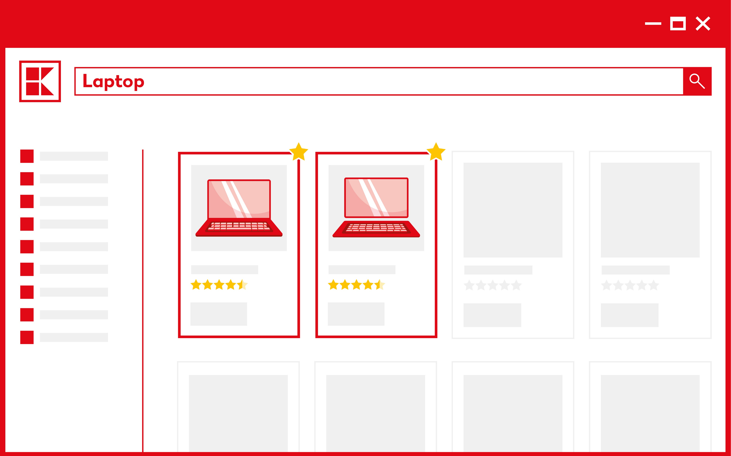



Increase visibility and sales via the multitude of advertising options
Tips and Tricks
Advertising opportunities
  Automated marketing
  Sponsored Product Ads
Inclusion in Sparfuchswoche distribution list
  Participation in seasonal campaigns
Highlight products based on performance with Sponsored Product Ads
Notes:
And last but not least lets take a look on our marketing options.
We offer a few marketing options which are included in the monthly subscription.
There is the automated marketing which means that we automatically advertise all your products which are in the BuyBox via external marketing channels. So, these measure are already included in your monthly subscription. In more detail, we carry out search engine advertisement and search engine optimization for you, we have display ads with your offers and we list your products on price comparison portals like idealo.de or billiger.de.
Besides that, you can also participate in our seasonal campaigns which take place at regular intervals seasonally or occasion-related (for example Christmas, Black Week..) or the Sparfuchswoche (which means something like smart spending week). This campaign takes place monthly and is promoted through multiple channels, and you as a seller have the opportunity to participate for free. All you have to do is send us some attractive article suggestions, and then we will determine whether we will include your discounted offers in this campaign.
In addition to these services, there are of course other marketing options which are optional, and which can be booked on request like our SPA.
Paid top placement for items
Auction Principle: The highest bidder pays the price of the second-highest bid
Performance-based advertising tool: Costs only incurred when the ad is clicked

Slide 23





Register now with voucher code EUCE2023 and pay no monthly fee for the first 3 months
Q & A
Miroslava Biresova
Senior Sales Manager Czech Market
Miroslava.biresova@kaufland-ecommerce.com
3 months without monthly basic fee¹
Voucher code:
EUCE2023
https://www.kaufland.de/becomeaseller
Eleni Dingiludis
        International Sales Manager
        Eleni.dingiludis@kaufland-ecommerce.com
¹ The voucher code must be entered in the registration process and will be automatically credited to the seller for the first three months. This code is valid until 31st December 2023.

