Slide 1






The Evolution of Retail Sourcing: Leveraging Innovative Solutions for Competitive Advantage
Clayton Kilkenny
Retail Director
RangeMe Europe
Antoine Walravens
Director Merchandising, Space & Assortment Strategy Ahold Delhaize
Notes:
Short intro speakers.

Slide 2

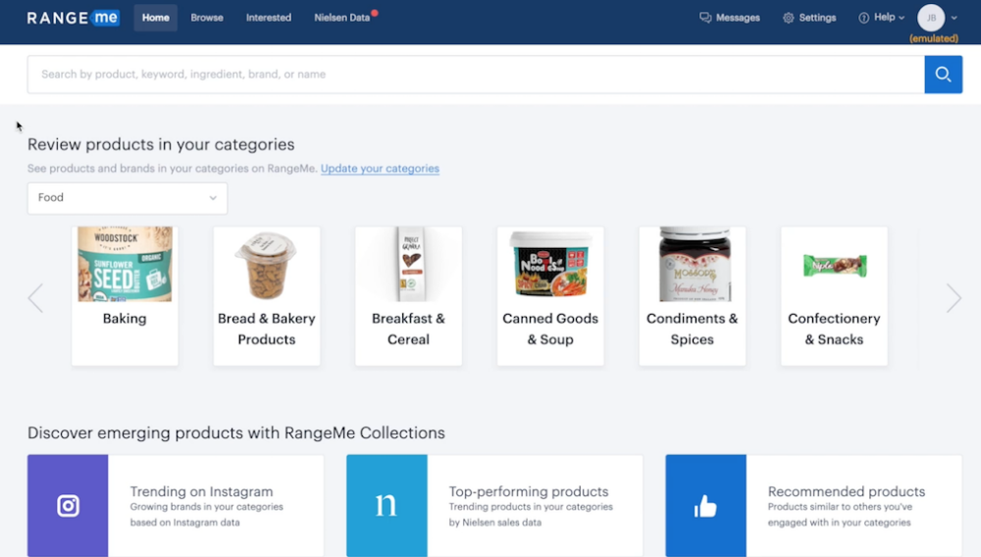
Introduction RangeMe
Inspiring retail to discover what’s next…
RangeMe is the leading product discovery and sourcing platform where retailers discover, connect, and grow their business.
Buyers and sellers connect directly on RangeMe to start conversations, request samples, and discuss next steps.

Slide 3

Agenda
Introduction
Traditional sourcing
Digital sourcing
Business cases
Closing remarks

Slide 4
1. Traditional sourcing

Slide 5

Fragmented, outdated, and inefficient processes
Phone
Search
Forms
Email
Trade shows
Store tour
Social
Sell sheet
Distributors
Brokers
Notes:
Downsides of traditional sourcing:
Many disparate channels, hard to aggregate data.
Difficult to share data/findings with colleagues.
Loss of knowledge/info in case of job rotations.

Slide 6

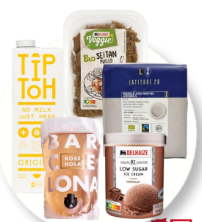












Delhaize’s experience with traditional sourcing
827
20.000
1.800
5.000
827 stores
4 store formats
SM-AD-Proxy-Shop & Go
E-Commerce
~20.000 references
Several brands
~1.800 new products/year
Exclusivity & Innovation
~5.000 emails/year
Email, pdf, pwp,…

Slide 7
2. Digital sourcing

Slide 8





Delhaize’s needs and objectives around digital sourcing
Delhaize Sourcing strategy:
Local sourcing
Digital Sourcing
“RangeMe”
Category/sourcing Managers
Healthy products via Nutriscore
Harmonization between country
Affordability for our customers
Targeted suppliers' approach
Specify our needs
Standardization of requests
Central platform
Reach directly the right contact
Innovation/Exclusivity

Slide 9

RangeMe - retail sourcing platform for consumer products
FMCG Product
Sourcing
Trending
Products
High Tech
& Touch
Zero cost
Team of 300 professionals
USA, CAN, UK, EU, AUS and NZ
Over 210.000 active consumer product companies with
2 Million SKUs in Food, Beverage, Healthcare, Beauty, Petcare and Household items.
Highly effective in sourcing trending categories:
Private Label
Localization
Natural & Wellness
Sustainable packaging
Hygienic packaging
Environmentally friendly
Supplier Diversity
Ecomm
Award winning technology
White-glove service running category specific campaigns to meet business objectives
Free for
Retail Partners
Notes:
Advantages of digital sourcing:
Funneling all new sourcing information to one place.
Supplier submissions an be shared.
Info can be retained in case of job rotations.
Information is actionable via simple communication tools.

Slide 10
3. Business cases

Slide 11
















Examples RangeMe retail partnerships
European Retail
Partners

Slide 12
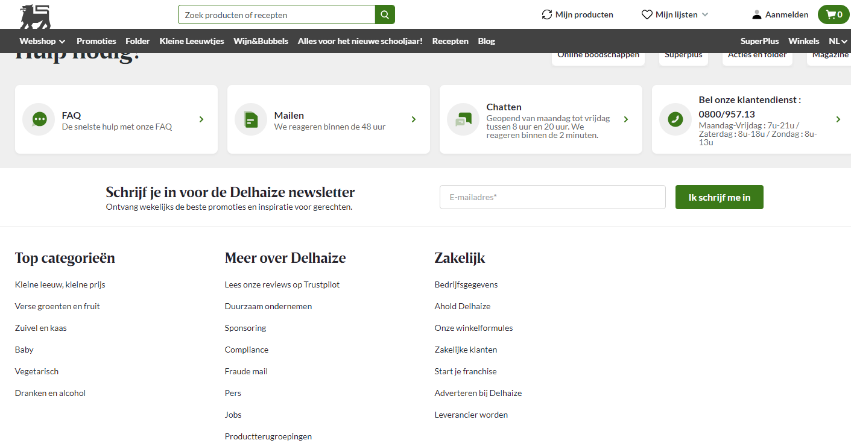
Supplier Submission Management on Delhaize’s website …

Slide 13
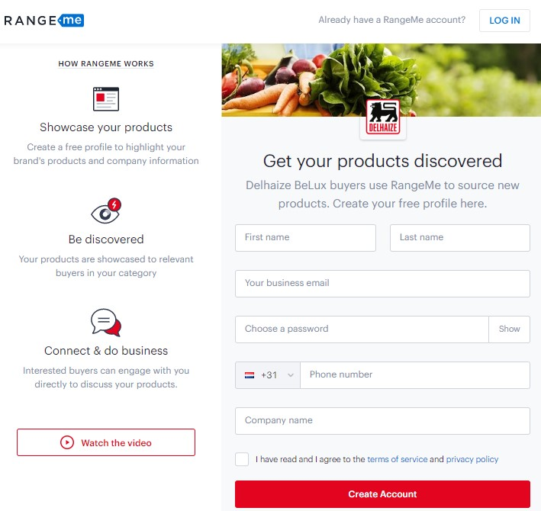
… carries prospecting suppliers to a customized
landing page
Notes:
Audrey

Slide 14




Delhaize’s expectations and experiences around RangeMe
One channel of communicaton
Speed up innovation & reduce time to market
Time efficiency for category manager
New way of working since July:
47 new suppliers' requests received
532 new products submitted
3 rounds of training
Press/Media communication
Redirection on webpage
Win-Win
Suppliers-Retailers

Slide 15

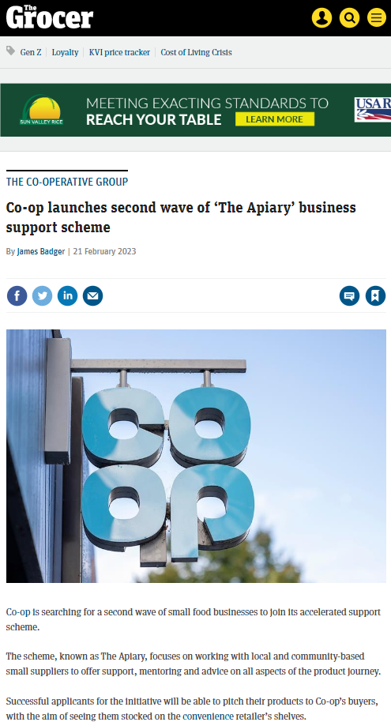


Co-op’s small supplier support scheme
451 Supplier Entries
Co-op Apiary Programme
30 Suppliers invited to first round
The scheme, known as The Apiary, focuses on working with local and community-based small suppliers to offer support, mentoring and advice on all aspects of the product journey.
Successful applicants for the initiative will be able to pitch their products to Co-op’s buyers, with the aim of seeing them stocked on the convenience retailer’s shelves.
18 Suppliers shortlisted to second round
“This is an exciting time for our Apiary programme – the search is now on for the next group of businesses to join our accelerator scheme in 2023,”
Co-op Head of Category
Rebecca Oliver-Mooney
Notes:
8 made it to shelf.

Slide 16





Belgian trade organizations taking the lead in …
Joining forces with Belgian trade organisations to expose Belgian businesses to international opportunities through RangeMe
Notes:
Trade organization: FEVIA, AWEX, HUB Brussels, FIT/Flanders Investment & Trade.

Slide 17
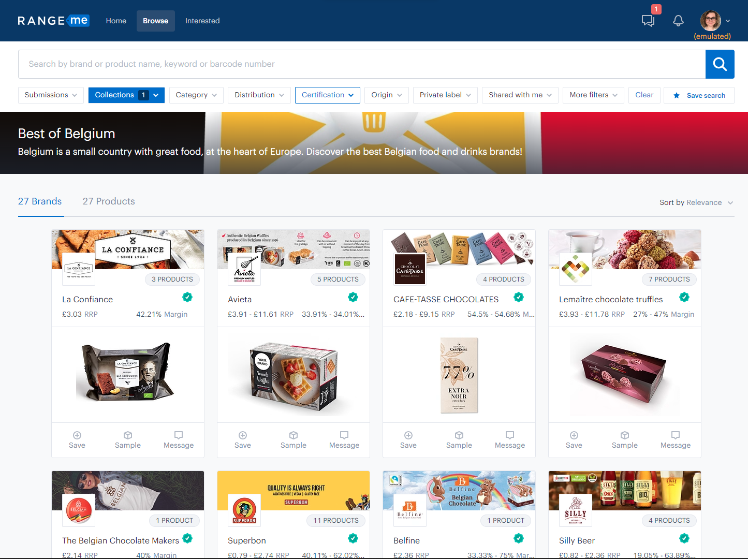
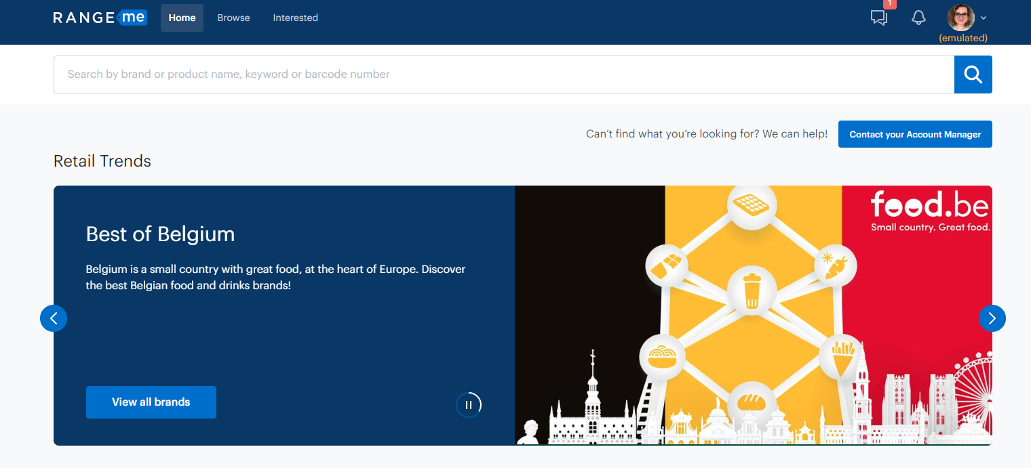
… coordinating a Belgian Pavilion for their members

Slide 18
4. Closing remarks

Slide 19
Closing remarks
Cost effective way of scaling up digital approach to sourcing/selling.
Network effect of all industry players working with one platform – win/win for buyers and suppliers.
Digital tools and solutions a valuable addition to the traditional sourcing/selling methods.

Slide 20

Thank you

