Slide 1


DHL EXPRESS
E-COMMERCE SOLUTIONS
Realizing your global e-commerce potential
DHL Express - Excellence. Simply delivered.
Notes:
Koen: Goedemiddag en welkom, we hopen dat het goed gaat met iedereen en we zijn enthousiast om het komende half uur onze e-Commerce inzichten met jullie te delen. Vandaag bekijken we hoe merken en bedrijven kunnen profiteren van grensoverschrijdende trends en het aangepast consumentengedrag om u te helpen uw online activiteiten van uw bedrijf naar een hoger niveau te tillen. En we zitten op de Export beurs dus de nadruk ligt op globalisering en hoe je best inzet op de internationale markt

Slide 2




THE ultimate
B2C OPPORTUNITY
WHEN THE WORLD BECOMES YOUR PLAYGROUND
DHL Express. Excellence. Simply Delivered.

Slide 3

GLOBAL E-COMMERCE TRENDS
2.1
815
99,9985%
billion
shoppers online by 2021*
billion €
spent on cross-border
purchases by 2020***
Of the world’s population lives outside of Belgium
5.3
CONSUMER BEHAVIOUR
HAS CHANGED:
They expect everything ‘on demand’,
any time, any place and to buy anywhere
81%
Global eCommerce sales rose by 81% in May 2020 compared to May 2019****
trillion €
estimated global e-commerce sales by 2022**
Sources:
*Statista
**eMarketer
***Accenture and AliResearch
****ACI Worldwide
Notes:
Koen: Om te beginnen, laten we eens kijken naar wat uw internationale opportuniteit zo spannend maakt.
In 2021 zullen er wereldwijd 2,1 miljard klanten online zijn (tegenover 2016 +30%) en de wereldwijde e-commerce verkoop zal volgend jaar in 2022 5,3 biljoen euro bedragen. Vorig jaar in 2020 werd 815 miljard euro besteed aan specifiek grensoverschrijdende e-commerce aankopen.
Alleen al in mei stijgt de wereldwijde e-commerce verkoop met 81% per jaar
En de statistiek die me altijd opvalt is dat 99,99% van de wereldbevolking buiten België woont - dat zijn meer dan 7 miljard mensen en dus cfr het eerste cijfer 2,1 miljard online shoppers
En tot slot is het gedrag van de consument en ook aankopers veranderd. We verwachten alles op afroep, op elk moment, op elke plaats, en om overal te kunnen kopen.

Slide 4

FOR HEALTHY SALES
DON’T GET LOST IN PRODUCT AND PRICING
91%
47%
45%
FREE vs. FAST
of online shoppers will leave a webshop if services like fast shipping are not available.
Only 47% consider 2-day shipping as “Fast.”
The trend is starting to reverse, with 79% preferring “free” over “fast,” down from 86% the year before.
Have abandoned their cart because delivery would take too long.

Slide 5


HOW DELIVERY INFLUENCES
ONLINE PURCHASING DECISIONS
60%
77%
54%
of consumers choose one merchant over another because the delivery options are more convenient
expect that the delivery options are always displayed on the product page
of consumers say that the delivery defines who they always shop with

Slide 6



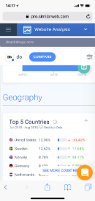

  WEBSITE TRAFFIC
CONVERSION TO SALES
By using market intelligence data we can calculate your potential sales increase, reach out to us for more details.
2%
conversion
rate to sales
€100
average shopping cart value
2.500
TOTAL VISITS OUTSIDE BENELUX
50
ESTIMATED INTERNATIONAL SALES
€5K
ESTIMATED MONTHLY SALES
€60K
ESTIMATED ANNUALISED SALES

Slide 7
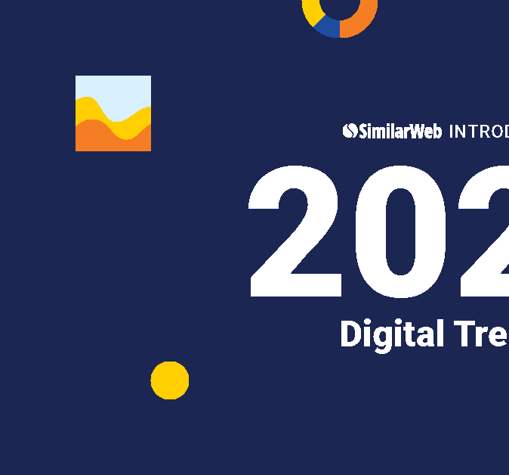
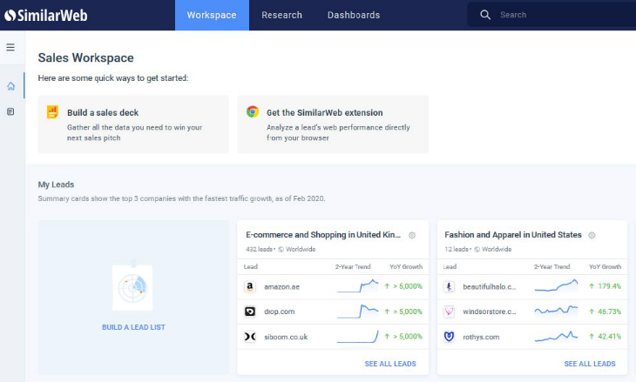
CONTACT OUR SALES SPECIALIST
Learn how your commercial teams can utilize market intelligence to help find, win and retain more business through a
consultative sales approach.

Slide 8


DHL Express’ B2C E-commerce Health Check
PUBLIC
A checklist that will help you to identify which elements of your
E-commerce website need further optimization:
Do you sell internationally? Do you state your shipping options on your home page and mentioned that you sell internationally? Do you offer an express delivery option? Are your shipping charges appropriate? Do you offer a Duties & Taxes Paid option? Are you sustainable and do you show it? | Do you offer an easy returns solution? Is your Website available in multiple languages? Do you apply currency conversion? Do you offer localized payment options? Are delivery notifications mentioned on your website?

Slide 9

Does the homepage clearly state that it’s open to international orders?
PUBLIC
It may seem obvious, but it’s good practice to be clear from the moment a Customer arrives on the site.
Our advice is to place a clearly visible banner on the home page, so foreign customers know right away that your goods are accessible to them.

Slide 10

35%
OF CONSUMERS PLACE A PREMIUM ON EXPERIENCE AND CONVENIENCE.
A growing number of consumers prioritize convenience over costs; 35% of online shoppers say they are happy to pay to get their items delivered WHEN and WHERE they want.

Slide 11

45% of consumers have abandoned a basket on a retailer / brand because delivery would take too long…
When making a luxury purchase, the exclusivity of a prestige delivery service appealed to 63% of consumers.
45%
LUXURY ITEMS REQUIRE
FAST AND ACCURATE DELIVERY
63%

Slide 12

START PLANNING
DECIDE UPON YOUR STRATEGY
If charges and service offerings are made clear, throughout the website, conversion rates will increase dramatically.
Make it clear you are open for international orders. Basket values often increase by more than 70% when an express shipping option is offered alongside standard
Offer local language, currency and payment options. 98% of online shoppers prefer to pay
in their local currency
70% of shoppers prefer to pay Duties and Taxes at the time of purchase. Retailers offering this are growing at twice the rate of those who don’t

Slide 13
THE ultimate
B2B E-COMMERCE
GUIDE
TRADITION IS OUT. DIGITAL IS IN.
DHL Express. Excellence. Simply Delivered.

Slide 14
What is B2B E-commerce?
PUBLIC
In general, B2B E-commerce, or business-to-business Electronic Commerce, describes online order transactions between businesses via an online sales portal.
Our definition of B2B E-commerce …
Business-2-Business E-commerce
[ biz-nis tuh biz-nis ee-kom-ers ] noun
“ A business buying from another Business, where the full transaction – including payments and shipping - is facilitated online via a transactional website, without the need to ‘become-a-customer’ first, login to a gated portal or speak to a sales-person.
Notes:
In general, B2B e-commerce is used to advance the performance of a company's sales efforts; because orders are processed digitally, buying efficiency is improved for wholesalers, manufacturers, distributors, and other types of B2B sellers.
Emerging e-commerce technologies are reducing the barrier to entry for traditionally B2B companies to remove the middleman and sell direct-to-consumer (B2B2C).

Slide 15
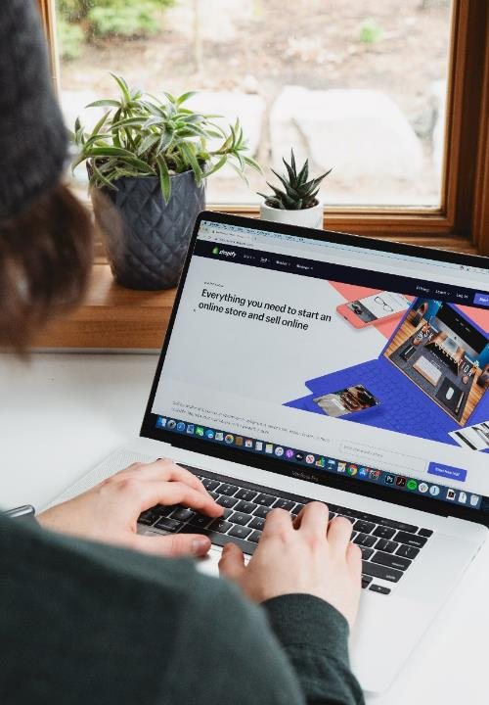

PUBLIC
B2C Customer Experiences have set the
tone for B2B CX transformation
B2B companies should start paying attention to the way they create customer experiences and learn from the “B2C Playbook”
However, the majority of B2B buyers still experience the same old "traditional" system that has always been there:
Instead of an online catalog they have to download a pdf
Instead of an option to "order online in three clicks", they have to call a sales person
80%
OF B2B BUYERS NOW EXPECT THE SAME
BUYING EXPERIENCE AS B2C CUSTOMERS
DHL Express | The Ultimate B2B E-commerce Guide | April 2021
Notes:
Whether you’re working in a business-to-consumer (B2C) or a business-to-business (B2B) company, companies should start paying attention to the way they create customer experiences.

Slide 16

The B2B E-commerce Revolution
Tradition is out. Digital is in.
PUBLIC
+18.2% | +75%
in 2019 alone, sales on B2B ecommerce sites and marketplaces jumped 18.2% to reach $12.3 trillion, outgrowing the B2C sector. Forrester, 2019 | 35.6% of B2B companies expect an increase of up to 75% in online sales from B2B buyers. Net Solutions, 2020
$20.9 tn | 12%
The B2B e-commerce market is projected to reach a value of $20.9 trillion by 2027 Globe Newswire, 2020 | B2B e-commerce was predicted to make up more than 12% of the overall B2B revenue by 2020. But that number is growing fast … Forrester, 2019
The global B2B E-commerce market (valued at USD $12.2 tn in 2019) is already bigger than the B2C Market.
[ Statista.com, 2019 ]

Slide 17

PUBLIC
A B2B Trend driven by B2B Buyers’ Behavior
Gartner¹ expects that by 2025…
80% of B2B sales interactions will occur in digital channels | 44% of millennials prefer no sales rep interaction in a B2B purchase setting | 33% of all buyers desire a seller-free sales experience.
AND BECAUSE OF THIS… 64% of B2B companies plan to increase Investments in their E-commerce websites ¹
Source: ¹ - The Future of Sales in 2025: A Gartner Trend Insight Report. ² - Digital Commerce 360, 2020
DHL Express | The Ultimate B2B E-commerce Guide | April 2021

Slide 18

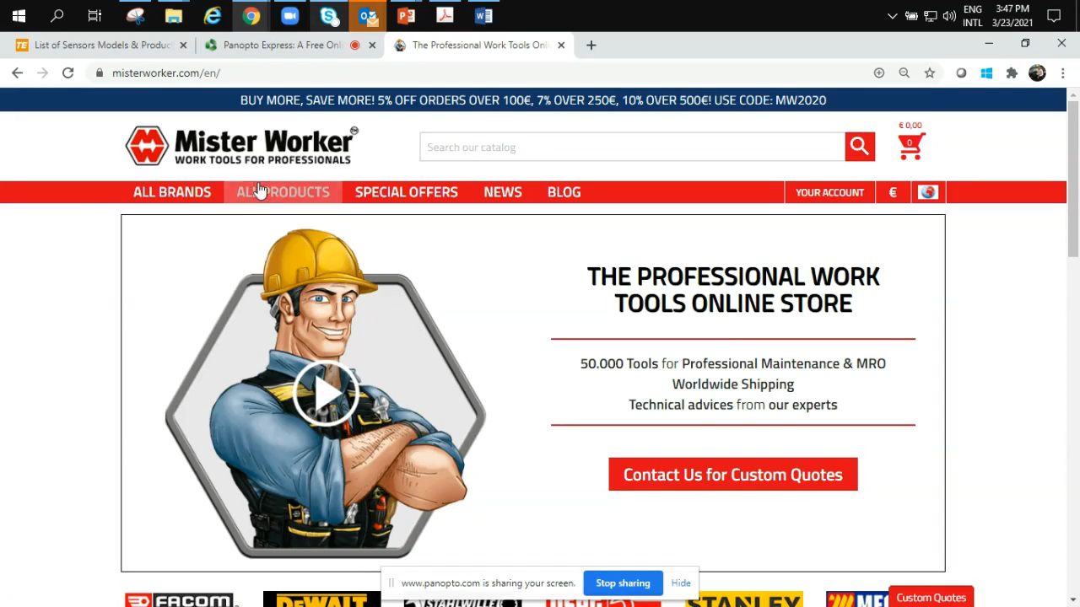
Can you buy 5 ‘DeWalt
Table Top Mitre Saws’ within 30 seconds?
Yes you can.
PUBLIC
A Real Life Example: MisterWorker.com
Mister Worker™ is an Italian B2B E-commerce store, active globally and selling worldwide.
It has a catalogue of over 50,000 products and, for the characteristics and quality of its service, it has been recognized by Forbes (France) among the most promising Italian start-ups.

Slide 19
Meet your new B2B customers:
The Millennials
PUBLIC
Millennials account for 73% of all B2B purchasing decisions¹. Growing up with the internet and mobile phones, they are digitally native and more technology oriented than their predecessors.
B2C customer experiences in their personal lives heavily influence what they expect from B2B transactions.
Research by Gartner found that 44% of millennials prefer no sales rep interaction at all in a B2B purchase setting
Source: Sana, “How to Meet Buyers’ Demand for (Better) B2B E-Commerce” - February 2019, Link
Notes:
Think about what features you value when placing a B2C order – speed, convenience, flexible delivery options…these are what your B2B customers are looking for when considering doing business with you.

Slide 20

Key Barriers and Challenges for E-commerce Growth
PUBLIC
Some barriers and challenges to B2B e-commerce growth were identified by supply chain experts & industry leaders during DHL’s research:
1. Digital First Mindset
Employees will be required to upskill in order to accommodate the changing business and supply chain landscape. A ‘digital first’ mindset is required to drive success.
2. Customs & Cross Border Shipping
Exchange rates, customs requirements, duties and taxes, and less developed infrastructures can be challenging to deal with – take time to understand the implications of cross-border shipping.
3. Agility
Large companies with well-established B2B platforms will find it challenging to compete with agile, start-up companies. They risk being left behind if they don’t react quickly to competition from these challengers – while not putting profitability at risk.
4. Pricing
B2B buyers are used to negotiating discounts for bulk or repeat purchases with sales reps.
B2B businesses will need to consider alternate ways to incentivize buyers – e.g. an easily implementable ‘buy more, pay less’ pricing strategy or bulk discounts.

Slide 21
SPINNING THE B2B E-COMMERCE FLYWHEEL
Get your B2B E-commerce flywheel spinning, and move from Good to Great
PUBLIC
BUILD/OPTIMIZE YOUR PLATFORM MIGRATE CUSTOMERS
PROMOTIONAL & LOYALTY PROGRAMS
DATA COLLECTION
E-COMMERCE AS VITAL PART OF YOUR BUSINESS MODEL
E-COMMERCE FLYWHEEL CONNECT WITH OTHERS
Ensure your E-commerce platform complements all your other sales channels
Only when a customer becomes complex or when a customer prefers personal contact, should an actual sales representative take over the account; an approach that allows the team to focus more on selling and less on order taking
Migrating your customers from offline to online channels: Communicate early and often
Ensure your online platform is user friendly with e.g. how-to guides and FAQs (= Health Check)
START HERE
Align business processes and teams to scale
Review your current organizational structure and re-align roles and resources
Roll out programs that spur loyalty, higher order values, and increased purchasing frequency
Produce data which can help your sales teams better understand your customers’ buying behaviour

Slide 22
DHL Express’ B2B E-commerce Health Check
PUBLIC
A checklist that will help you to identify which elements of your
E-commerce website need further optimization:
Similar to B2C
Different to B2C
Do you have an Easily Accessible B2B Webstore? Do you Sell Internationally and state clearly on your Home Page that you offer Worldwide Shipping? Is your website available in Multiple Languages? | Do you have Detailed Product Descriptions and Catalogs? Do you offer Online Interactive Support and Product Customization with easy interaction options? Do you offer Self-help Portals such as how-to videos? Do you have a simple and Powerful Search Engine on your website? Do you offer Multiple Payment options like credit card payments, extended payment and bank transfers?

Slide 23
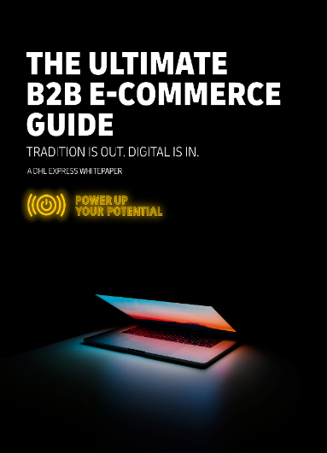


The Ultimate B2B E-Commerce Guide
Tradition is out. Digital is in.
PUBLIC
The pace of the B2B sector’s e-commerce transformation should not be underestimated:
Digitally-native buyers, combined with the ongoing effects of the pandemic, are pushing through rapid change in B2B supply chains.
B2B customers want flexible, convenient, and digitally-focused services more aligned with their B2C experiences.
Even B2B players already established within their sectors will need to invest to optimize their cross-border e-commerce channels
… and the pay-off in growth opportunities
is unlimited! Let’s discuss next steps…
Notes:
As international shipping specialists, we have the knowledge and global presence to help any B2B Company realize their cross-border E-commerce ambitions. We can support you to implement services into your B2B platform that will optimize efficiencies and boost customers’ satisfaction, such as tracking, order history, and Duty and Tax payments. And of course, we’ll be there for your last-mile logistics needs too.

Slide 24



your sustainability journey
DHL Express. Excellence. Simply Delivered.

Slide 25




Why it is - Now More Than Ever – important to focus on sustainability
We’re extremely passionate about sustainability at DHL. Not only are we fervent about driving sustainability within the logistics industry, but we’re also working hard to help our customers improve their credentials too.
1. PURCHASE DECISIONS
50%
of digital buyers state that environmental concerns impact their purchasing decisions
(Source: GlobalWebIndex)
2. CUSTOMER LOYALTY
88%
of customers are more likely to be loyal to a company which supports environmental issues
(Source: Cone)
3. WILLINGNESS TO PAY
77%
of buyers are willing to pay more for a product that is sustainable.
(Source: IBM)

Slide 26


What your customers are looking for
Using sustainability to create your competitive advantage
50% of buyers are (very) interested in an environmentally-friendly delivery method | 38% of consumers feel that retailers are doing a good job of using sustainable delivery practices 29% rated it as important and 19% as very important to have the seller recommend the most environmentally friendly delivery option
20% of buyers indicate they would pay more for a delivery from an environmentally friendly company This may not sound like a lot, but the experience of companies that offer premium delivery pricing says that it represents millions in incremental revenue. In addition, age plays an important part as Gen Z and Millennials (27%) more willing to pay a premium than 55+ (14%)
Source: Descartes Research Report: ‘Sustainability is Not a Challenge, It’s an Opportunity’ (2022)

Slide 27

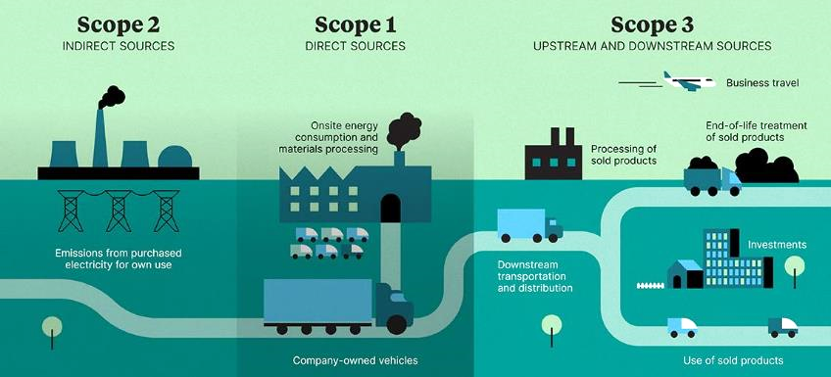


Some definitions
Scope 1, 2 and 3 Footprint
The Green House Gas Protocol Corporate Standard classifies a company’s GHG emissions into three 'scopes'
Scope 1 covers direct emissions from owned or controlled sources
Scope 2 covers indirect emissions from the generation of purchased electricity, heating etc. consumed by the reporting company
Scope 3 includes all other indirect emissions that occur in a company's value chain, including downstream transportation and distribution
THIS IS THE AREA WHERE WE CAN SUPPORT! STAY TUNED ...

Slide 28

Carbon Footprint Example
E-commerce Merchant: Home24.com
For most companies, the main drivers of carbon emissions lie primarily in Scope 3
SCOPE 3
The example of pure-play e-commerce company home24 shows that Scope 3 emissions - those that occur outside the organisation, e.g. in the supply chain - dominate the company’s carbon footprint. |  | The biggest Scope 3 emission comes from transport and distributions. Companies rely on a complex logistics and delivery network. Freight, delivery and packaging form the three main elements of an e-commerce company’s footprint.
Source: https://www.planetly.com/articles/sustainability-in-e-commerce-7-ways-your-brand-can-reduce-its-carbon-footprint

Slide 29



Companies are under increasing pressure to report and reduce scope 3 emissions – and soon it will become mandatory
The global regulatory landscape has been shifting towards non-financial disclosures.
Which means that companies have to report on their emissions besides only their financial results, and there is an increasing pressure on companies to report and reduce their scope 3 emissions
Selected regulations related to Scope 3 emissions
EU Taxonomy
The EU taxonomy is a classification system providing companies, investors and policymakers with appropriate definitions for which economic activities can be considered environmentally sustainable.
CSRD ¹
Broadens current NFRD rules to include all large companies (listed & not), listed small & med-sized enterprises and non-EU companies with generate net turnover more than €150m.
Japan Climate Disclosures
Strengthening Japan’s existing climate regulations, Japan’s financial watchdog has made companies on its prime blue chip market disclose greenhouse gas emissions and other climate-related disclosures.
March 2021
TBC
July 2020
April 2022
TBC
US Climate Disclosures
The US SEC has proposed a disclosure rule that will make it mandatory for their registrants (large, listed companies) to disclose their greenhouse gas emissions, including scope 3.
NFRD ²
mandatory scope 3
Outlines rules on disclosure of NFRD information, for listed and large public interest companies with more than 500 employees and either a balance sheet total of more than €20m or a net turnover of €40m.
1. Corporate Sustainability Reporting Directive. 2. Non-financial Reporting Directive.

Slide 30


Your Sustainability Health Check
Using sustainability to increase sales and create loyal customers
Laying the Foundation
Write your green mission statement and benchmark what others in your industry are doing Create your Green Team – and engage the right employees
83% of shoppers will seek out eco-friendly brands and products
Creating your Strategy
Use a tool or partner that can help to calculate your carbon and GHG emissions and complete an Eco-Assessment Measure your Scope 1, Scope 2 and Scope 3 Footprint and come up with a strategy to reduce CO₂e amongst all scopes: E.g. implement a Green Procurement Policy or use carbon reduced shipping solutions Use a framework to track progress
88% of customers are more likely to be loyal to a company which supports environmental issues
Sustainability in your marketing plan
Build sustainability in your marketing strategy Promote your commitments and accomplishments on your website and elevate your brand and improve your reputation using social media and other media
53% say sustainability is Important to them when shopping online
Power up your Sustainable Potential
Offer sustainable shipping options to your customers and communicate this clearly during the whole buying process Consider building in the costs for your sustainable shipping options in your shipping charges - and explain how much CO₂e will be reduced for each service Use sustainable packaging solutions
42% will consider to pay more for sustainable shipping options and 69% would choose to pay more for eco-friendly packaging
Sources: ‘CONE’ & Descartes: ‘Sustainability is Not a Challenge, It’s an Opportunity’ (2022)

Slide 31
Your Sustainability Health Check
Our Top Tips to accelerate your Sustainability Readiness
Laying the Foundation
Decide what sustainability means for your company because it could mean much more than you think Sustainability in business refers to a way of protecting the Earth’s resources for the long term. Carbon-reduction is probably the first thing that springs to mind. However, more and more of us are concluding that sustainability extends beyond economic and environmental issues and include governance and social equity At DHL Express we define sustainability quite simply as ESG: Environmental, Social and Governance
Creating your Strategy
Pursue ambitious sustainability targets that align with your business strategy, then set specific goals to achieve those targets No business would disagree about the importance of targets. However, when it comes to sustainability, targets can be random, cosmetic or simply too modest. If you want to make a real impact, your targets need to result in real change to your processes It doesn’t have to happen overnight. Make sure that targets fit with your business model
Sustainability in your marketing plan
Understand and respond to the external pressures on your industry and on your company to act in a sustainable way These days there is a lot of pressure from customers, governments, banks, suppliers and even employees to act in a sustainable way The obligation to pursue sustainable development is increasing. On the other hand, a greater awareness of the issues can make it easier for companies to change
Power up your Sustainable Potential
Make a good business case for sustainability and communicate it effectively to all your employees, customers and stakeholders Be serious about your sustainability strategy, explain it and advertise it. Employees, customers and investors need to know how and why your business is developing a sustainability program, and what the implications/benefits are for them Communication is a top priority, which includes messaging from the top, education and tracking progress Communicate what you are offering your customers as sustainable alternatives clearly during the whole customer journey (e.g., your sustainable shipping options)
Sources: Affirm, Consumer Trend Report, 2022; DHL, Online Shopper Report, 2022; CONE

Slide 32
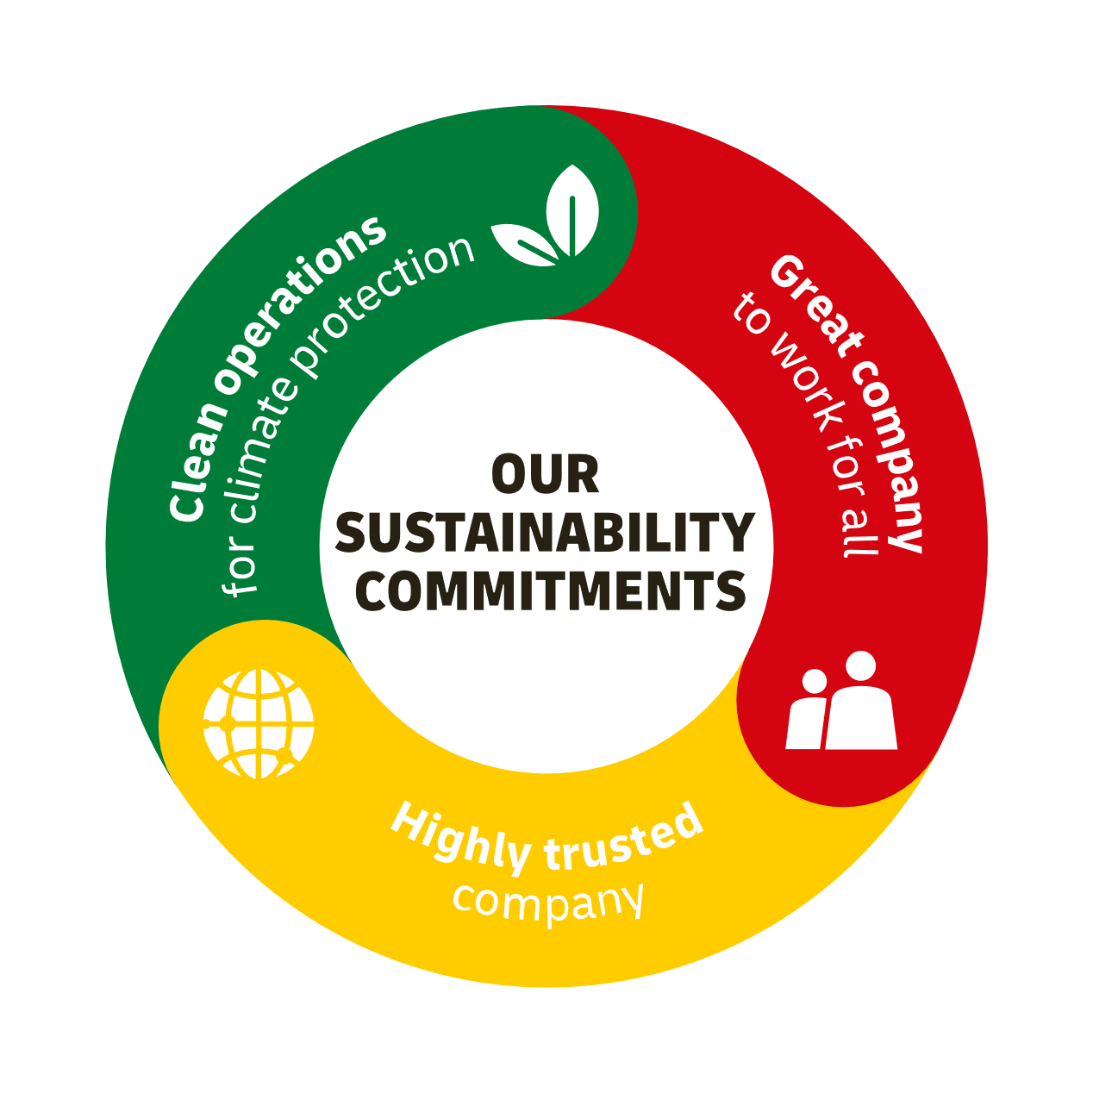







Our sustainability roadmap
We can’t create a lasting positive impact unless we follow a clear strategy.
Clean operations
for climate protection
Highly trusted
company
Green last mile & line-haul
Leader in sustainable aviation
Carbon neutral buildings by default
Most comprehensive portfolio of green products
Compliance as an integral part
of daily business
Effective governance set-up across the organization
Like-minded and compliant
suppliers and partners
Great company
to work for all
Attract & retain the best talent
Strong “Safety First” culture
Diverse & inclusive workplace
Lasting impact in communities through our Go programs with 1% of our net profit each year

Slide 33

We can help you shaping your sustainability roadmap
Your company can choose a reduction pathway which aligns with your climate targets and budget forecasts
Immediate 100% SAF procurement provides a fast-track reduction pathway of scope 3 emissions. You can also take a phased approach to SAF procurement like other companies are doing to align with company carbon reduction goals, e.g. net-zero in 2030 or 2050.
By phasing SAF over a longer timeframe you can select a pathway that fits within your CO₂e reduction and budgeting requirements.
Customers choose how much SAF to procure…
Indicative carbon reduction pathways based on SAF procurement trajectory
CONCEPTUAL
2050 target
…or spreading out carbon reduction and cost over a longer period of time
2030 target
Air Freight Scope 3 emissions
… going for a fast track reduction…
Immediate

Slide 34
We can help you shaping your sustainability roadmap
Most companies are choosing a gradual approach for their reduction pathway
You don’t need to reduce 100% of your emissions overnight. Choose a gradual approach that fits with your CO₂e reduction plans and with your budgeting requirements.
: CO2 Reduction via DHL Express : Scope 3 Footprint
CONCEPTUAL
Overall % CO₂e Reduction in your Scope 3 footprint
% CO₂e Reduction om Express shipping in year 1

Slide 35



THANK YOU

