Slide 1
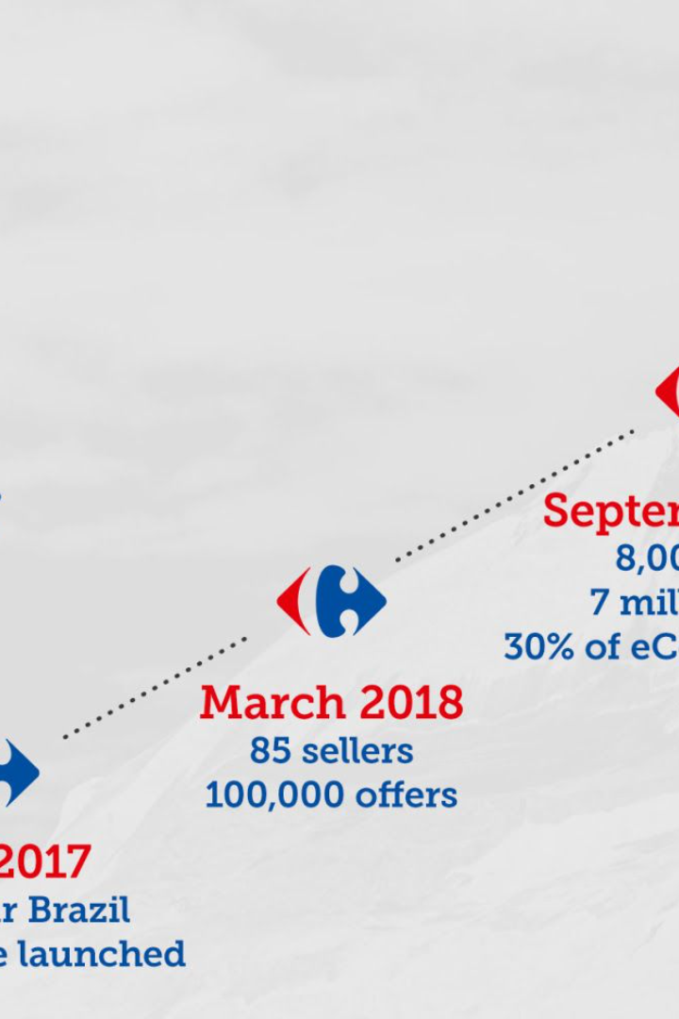

How artificial intelligence is helping Carrefour's ecommerce?
Let's find out how Carrefour is using AI in four different ways to help customers during their ecommerce shopping journey.
by Jean-Philippe Blerot - head of digital & ecommerce projects
built with AI (gama.app)

Slide 2
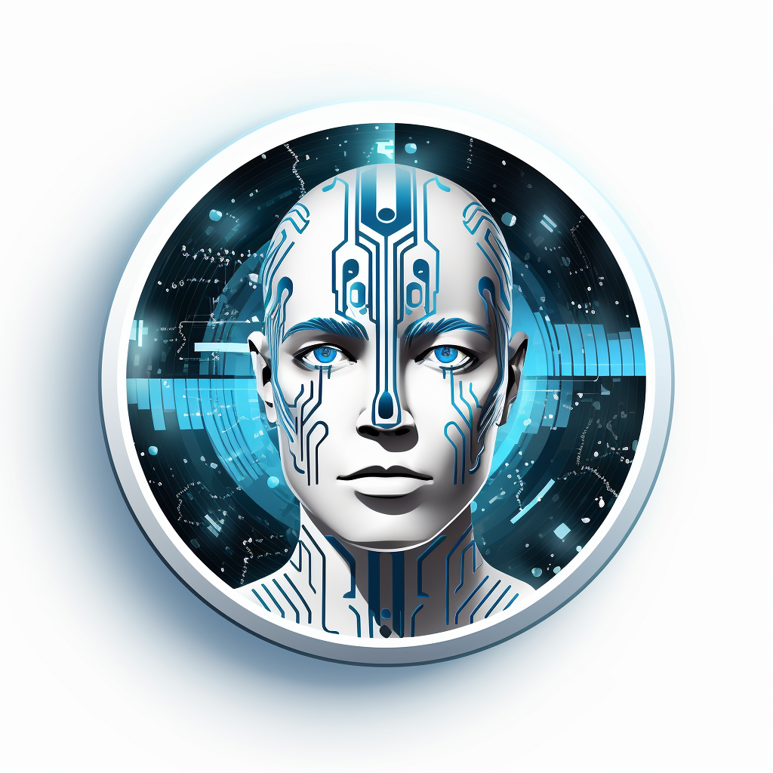
The customer journey with AI
A product description to optimize SEO
Helping and inspiring customers during their online journey
Product’s catalog
BOT - HOPLA
Posts
Customer service
Share products via posts on social networks
Answer customers' questions quickly and accurately

Slide 3
Selling means showcasing your products and instilling confidence
Standing out 🌟
Rich content 📝
Thousands of products online with full descriptions
High-quality information and explicit content for the customer
Improving search 🔍
Increase sales 💰
Descriptions are optimized for SEO (Google search) so that customers can easily find the product they are looking for.
An attractive and complete product description improves conversion and builds trust.

Slide 4
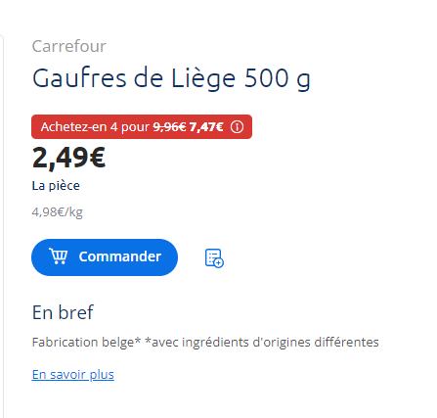
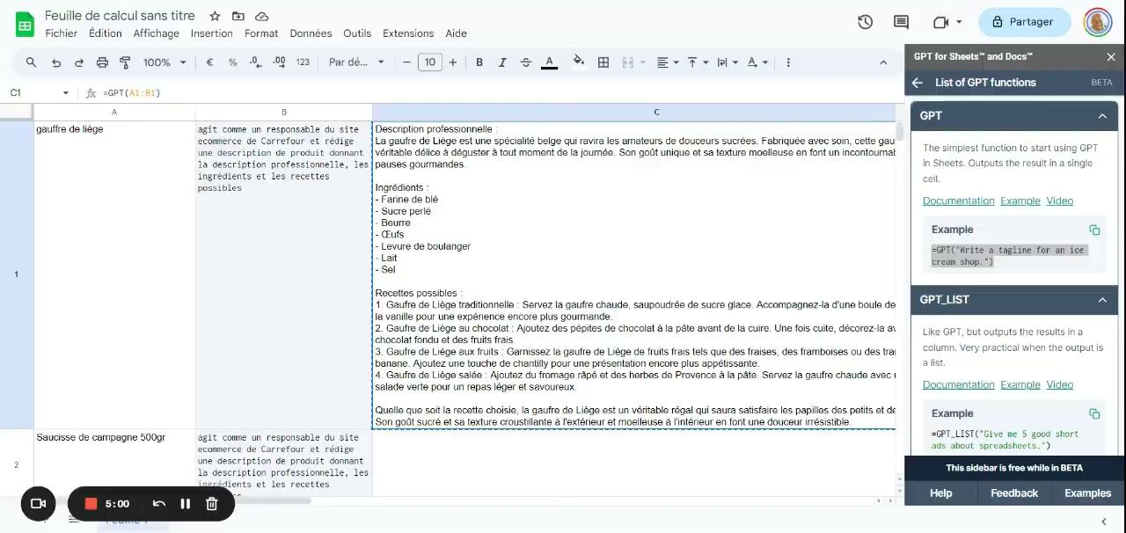
Optimized product description
product description
GPT optimizes product descriptions

Slide 5
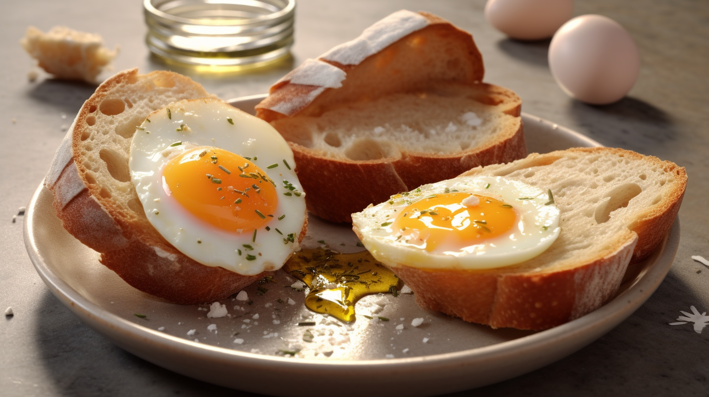
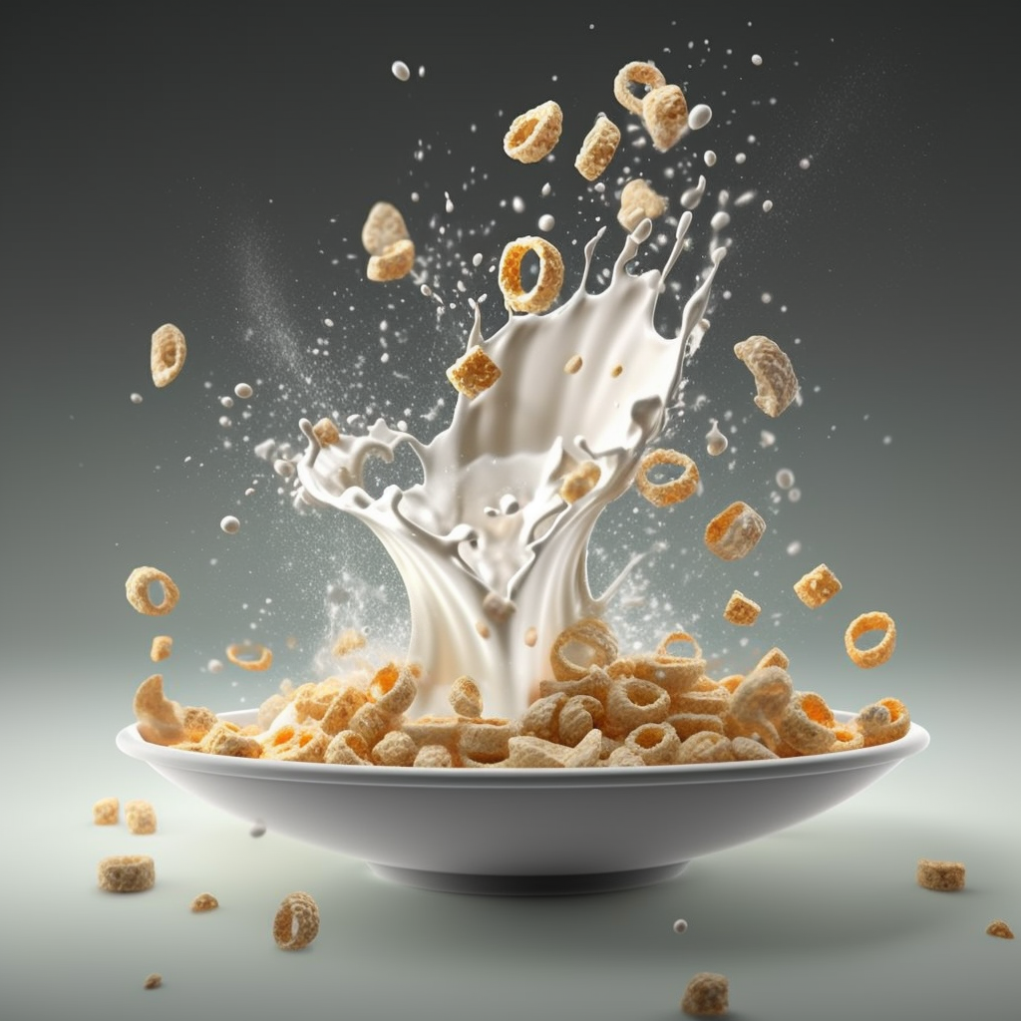
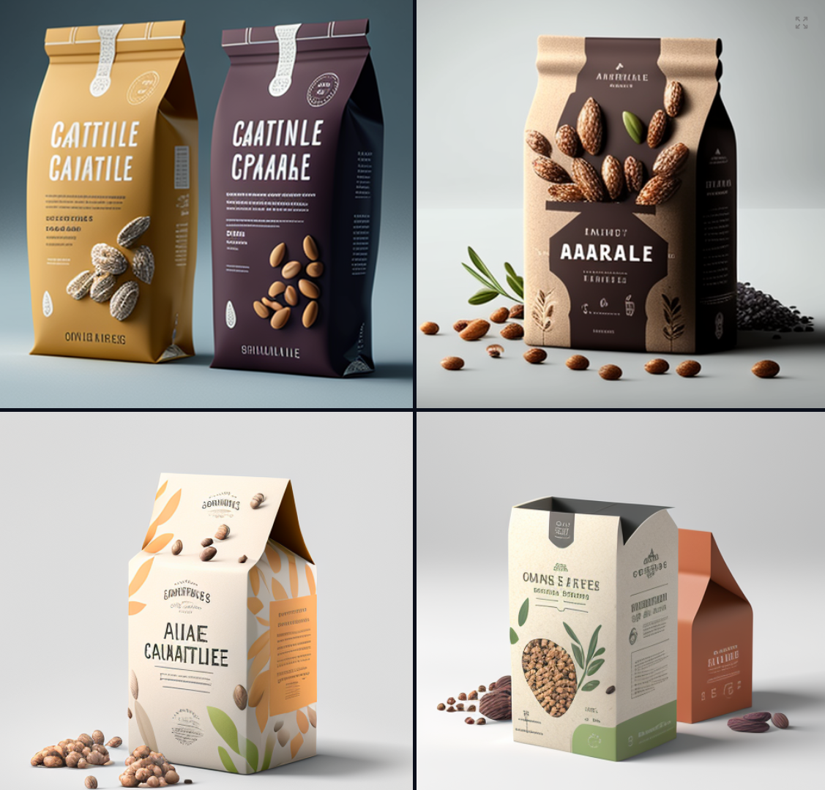
Images

Slide 6
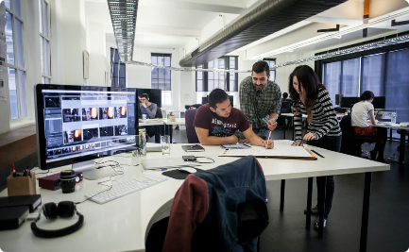
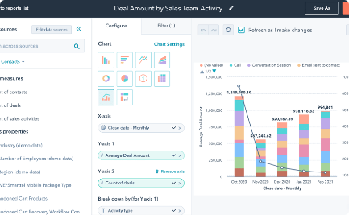
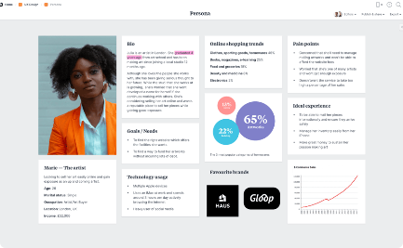
A marketing studio to create campaigns
Streamlined work👌
Various AIs 📊
For all média 🎯
An effective tool for creating digital campaigns
Créer des campagnes avec du texte, des images, des vidéo en quelques clics
Create campaigns with text, images and video in just a few clicks

Slide 7
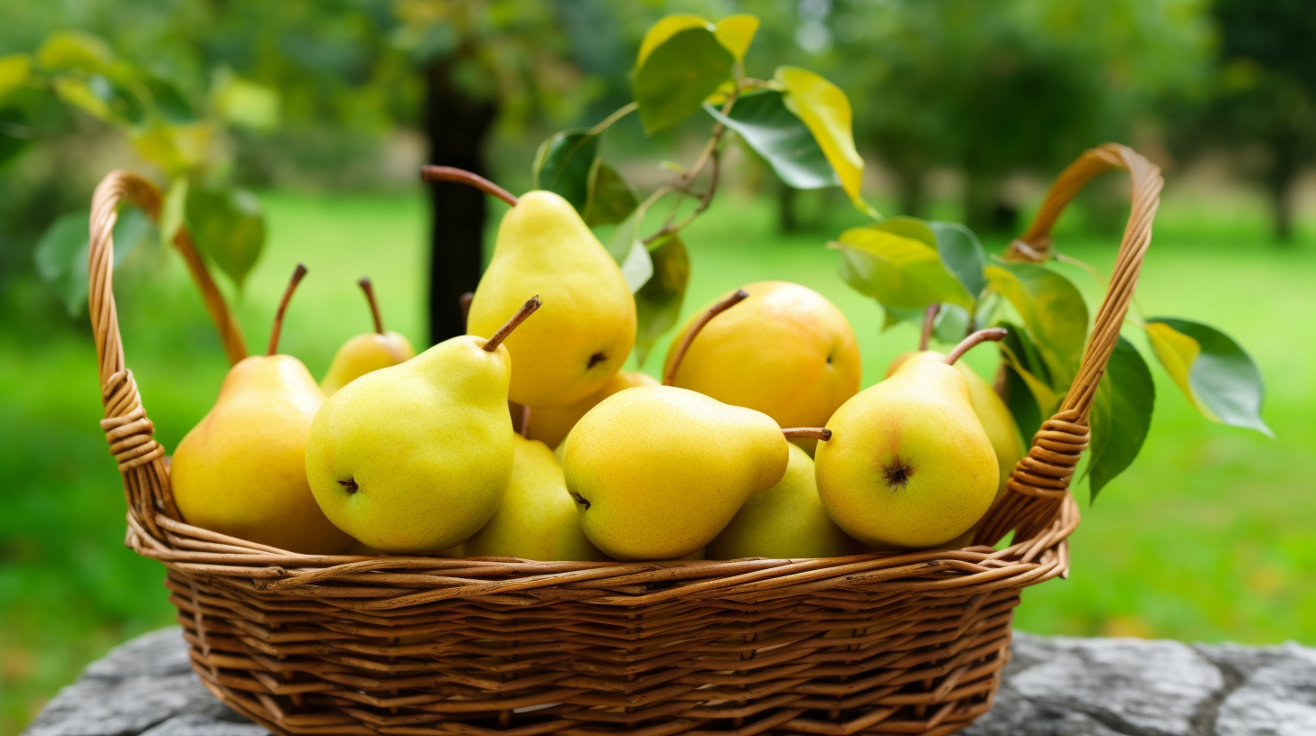
The tool that supports marketers
🍐 **New Arrival Alert!** 🍐
Your health is our priority at Carrefour Belgium, and we’re excited to introduce our latest offering: Fresh, Local Pears straight from the heart of Belgium!
🌱 **Why Choose Local and Healthy?** 🌱
✅ Freshness Guaranteed: Local produce is harvested at peak ripeness, ensuring you enjoy optimal taste and nutrition.
✅ Support Local: Our pears are sourced directly from trusted local producers in Belgium, giving back to our community.
✅ Eco-Friendly: Cut down on your carbon footprint by choosing local and sustainable.
🇧🇪 **Taste the Belgian Goodness** 🇧🇪
Indulge in the authentic flavors of Belgian-grown pears, now available exclusively at your nearest Carrefour Belgium store.
Don’t miss out on this nutritious addition to your daily meals. Shop local, eat healthy, and make a positive impact. 🌿
\#CarrefourBelgium #HealthyLiving #LocalProducers #Belgium #EatLocal
---
Feel free to share and let your friends know about the goodness that awaits them at Carrefour Belgium! 🤗

Slide 8

Hopla: the personal shopping assistant
1
Background
Leverage the latest in generative Artificial Intelligence technology to facilitate our customers' purchases and enhance their experience.
Deliver the product in 5 weeks and implement a conversational assistant based on OpenAI's GPT 4.
2
The approach
Provide recipes/ideas for meals that are economical, seasonal, healthy and adapted to their dietary preferences
Help them build their shopping cart
Offer an integrated experience in the customer journey: the user doesn't need to leave the site to take advantage of ChatGPT
3
The launch
Live since June 9
Tens of thousands of interactions in the first few weeks

Slide 9
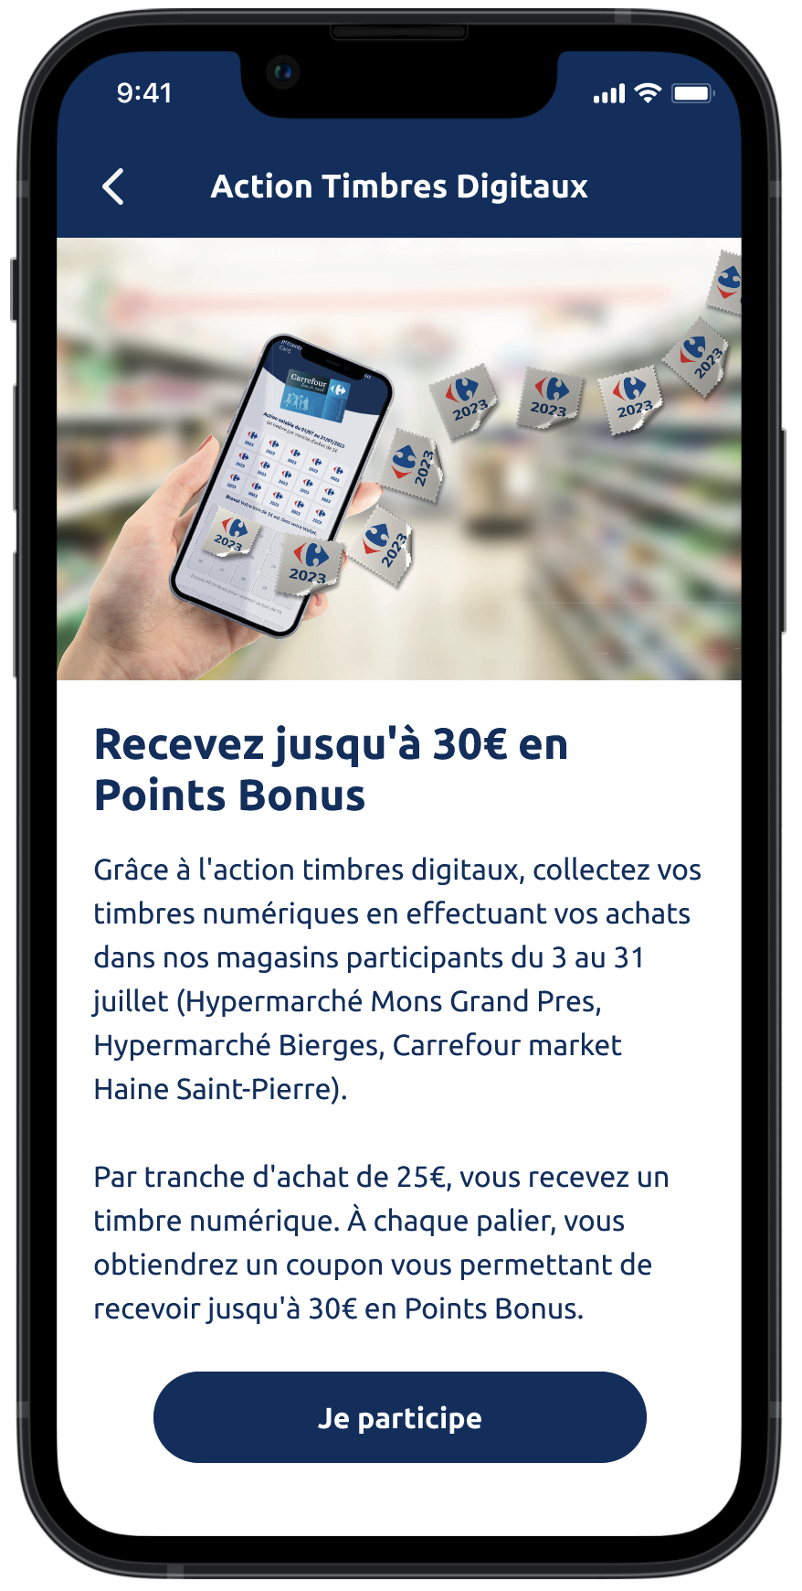
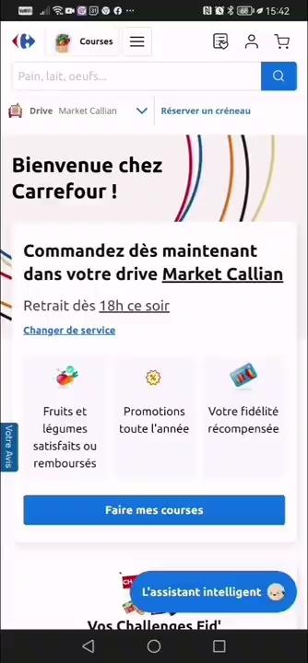
Meet Hopla: your personal assistant
In just a few seconds, you have your menu for the week according to your wishes.
1
24/7 Support
Hopla is available immediately, whenever you need it.
2
Efficient service
He's your assistant, there for you at the drop of a hat. It's there to save you time.
3
Personalized recommendations
Talk to him, tell him what you need, and he'll give you the answers you need based on your profile.

Slide 10
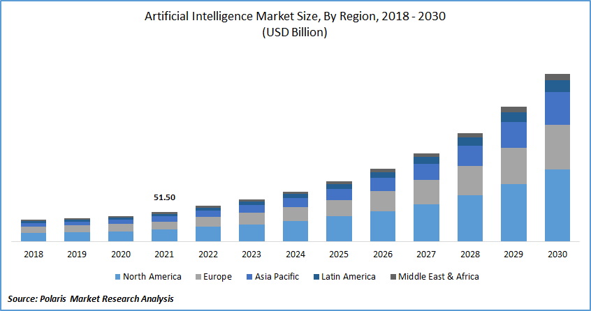
Tomorrow ?
List creation
Taking your diet into account
Interconnection with your sport
Enhanced personalization

Slide 11
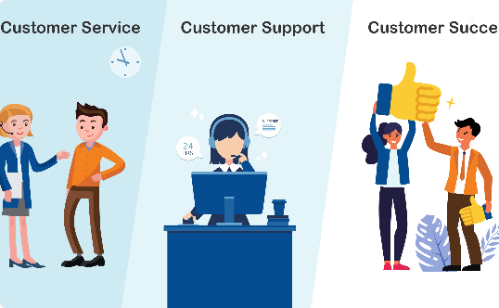
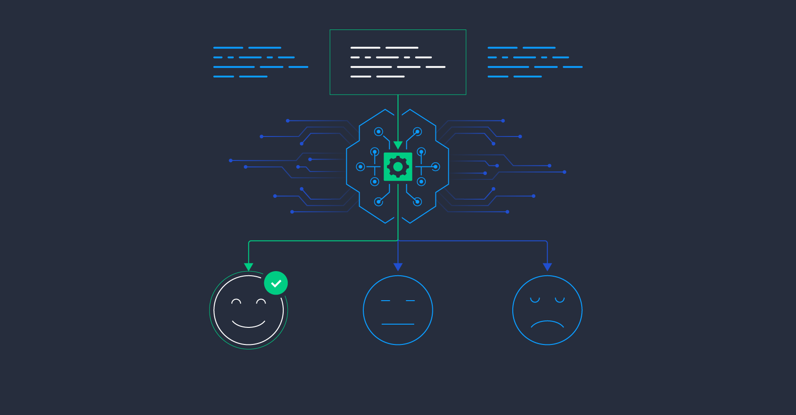
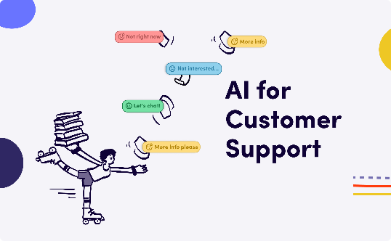
Our customer service team is here to help
Improve the experience
Boosting efficiency
Improving quality
An assistant that reads emails, gives the sender's sentiment, a proposed solution and a response
AI optimizes the work of both: new and experienced employees
AI makes it possible to analyze large quantities of data very quickly and guide the operator. We bring quality and confidence

Slide 12
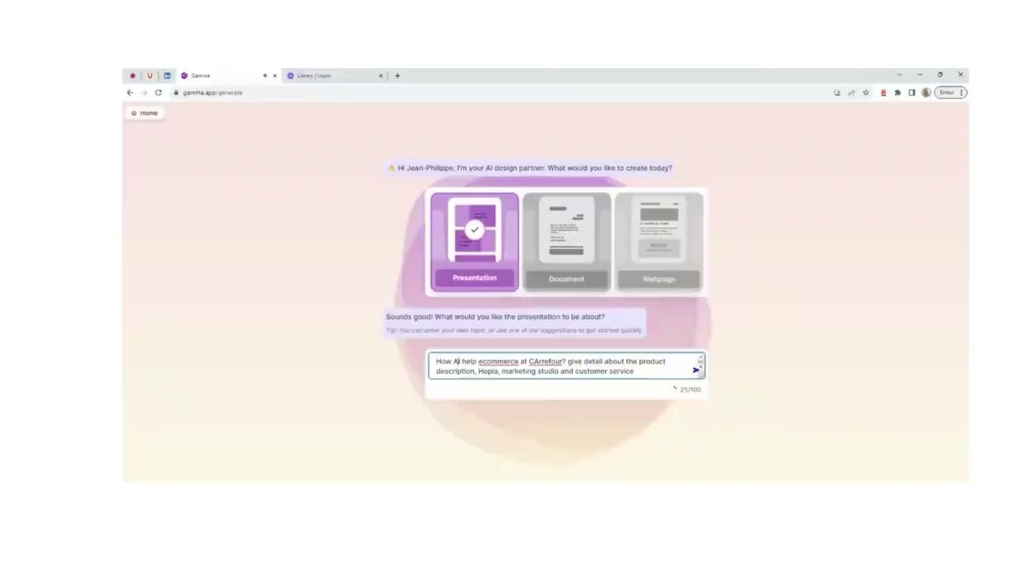
75% of this presentation was made possible by AI
1
Slide generation
A first draft was created via Gamma.app. Text, organization and templates were generated by the AI. The translation was proposed by the AI
2
Our logo and images
Mid journey generated in 10s the logo that accompanied us (top right) + the various images.
3
Video production
In front of you, an AI-generated video

Slide 13
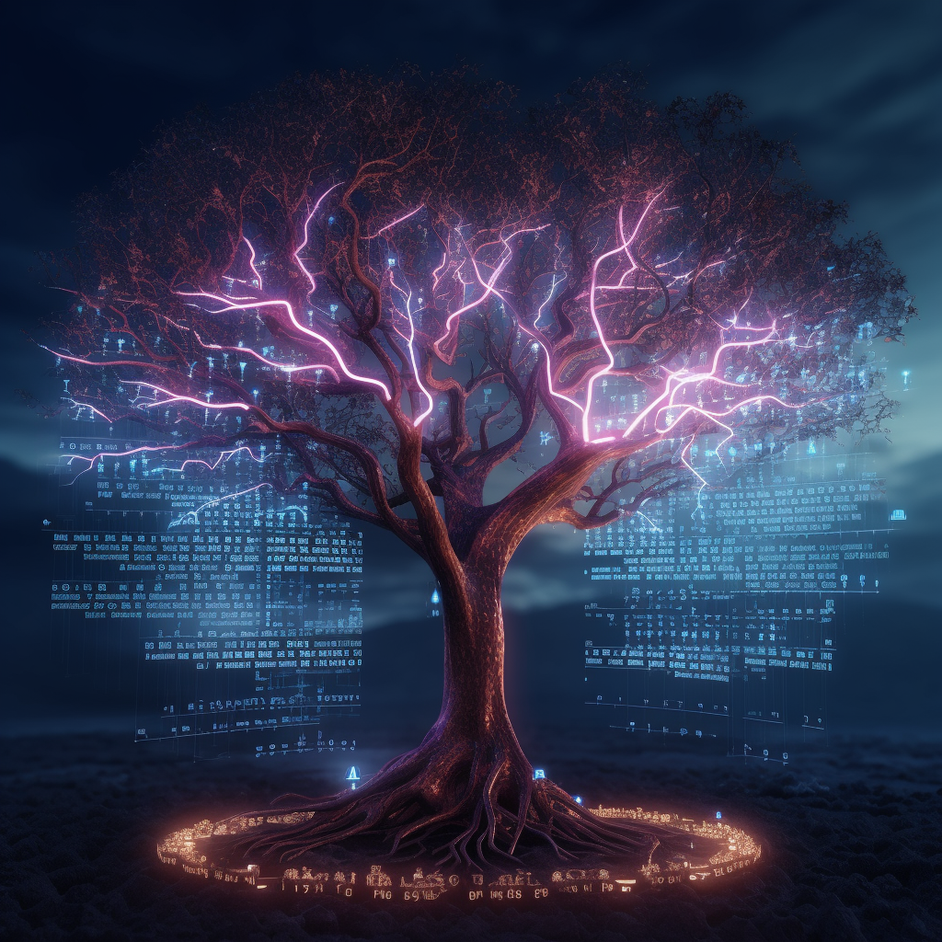

Conclusion
1
AI can improve ecommerce
2
Increase conversion rate
By offering a more efficient, personalized and fluid shopping experience.
By optimizing product descriptions and highlighting them in cutting-edge marketing campaigns.
3
Improving satisfaction and trust
AI provides fast, detailed and justified answers to the most pressing questions. Customers gain in confidence, and customer service becomes a sales and loyalty support. RGPD must surround AI

