Slide 1
Revolution in online payments.
BLIK success story
14th September 2023

Slide 2
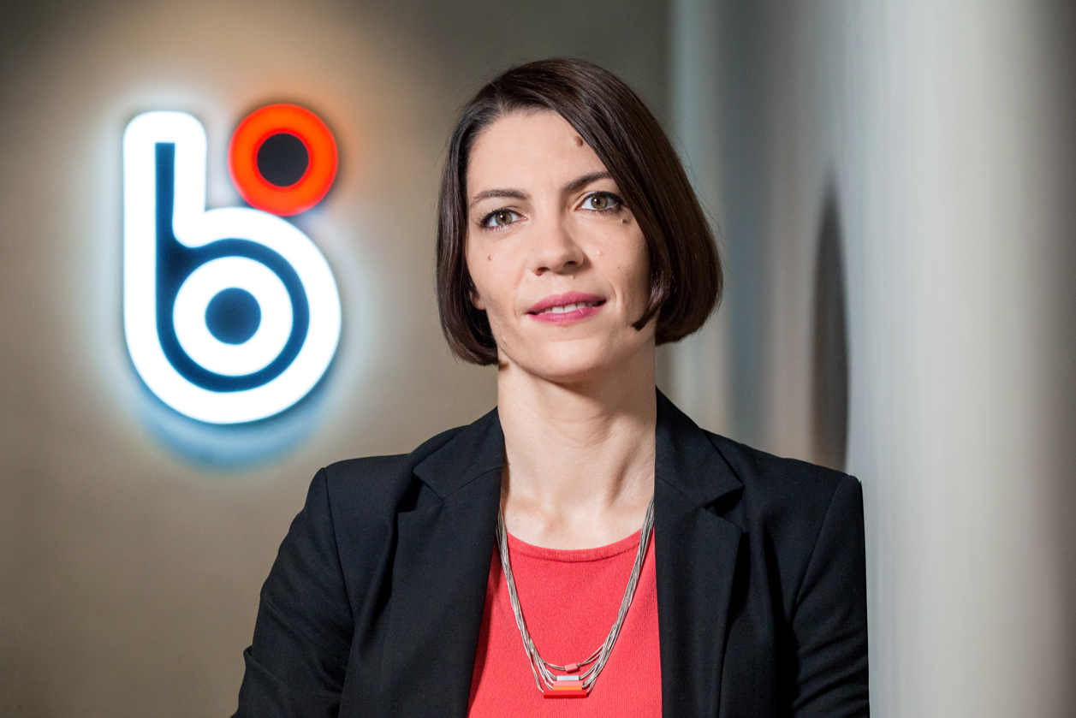
Hello
Innovative mobile payment system
We closely cooperate with e-commerce and acquirers with strong focus on user experience and conversion rate
Magdalena Kubisa – Business Development Director
blik.com

Slide 3
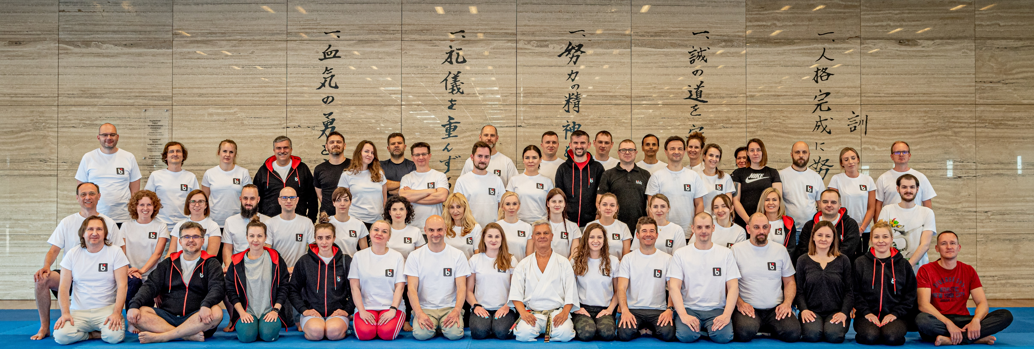
About our company
2015 launched onto the market. Six months later, BLIK has its first million users
mobile non-card payment system and payment scheme licensed and supervised by the National Bank of Poland
Joint venture of six biggest banks and Mastercard (since 2020) all with equal 14,3% stake; registered as limited company
+100 employees spanning from developers, sales, marketers, designers and more
EUR 46.2 million revenue in 2022 which translates to EUR 20.2 million net profit
1.2 billion transactions processed in 2022, higher than in the previous 2 years combined
blik.com
Picture of the BLIK team during team building session in the European Budo Centre 2022

Slide 4
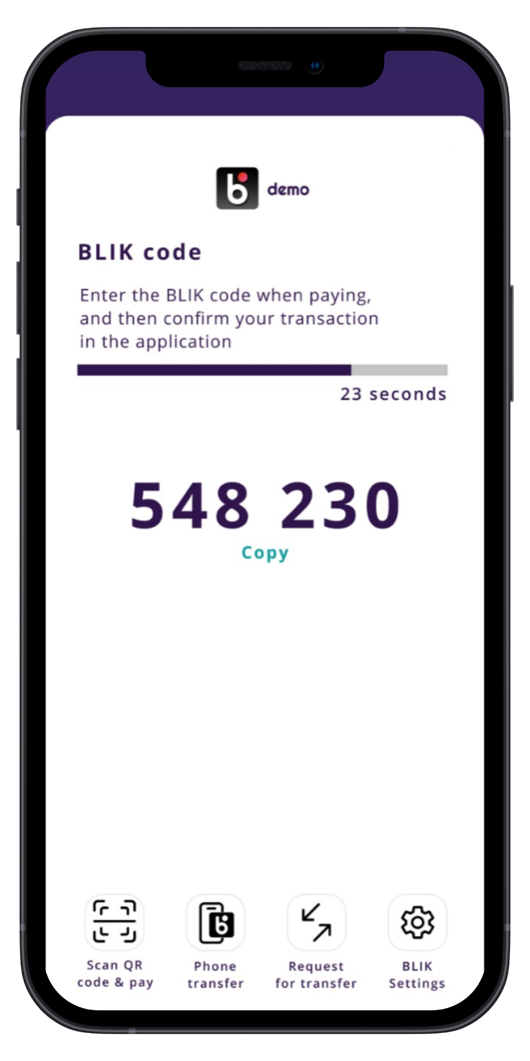
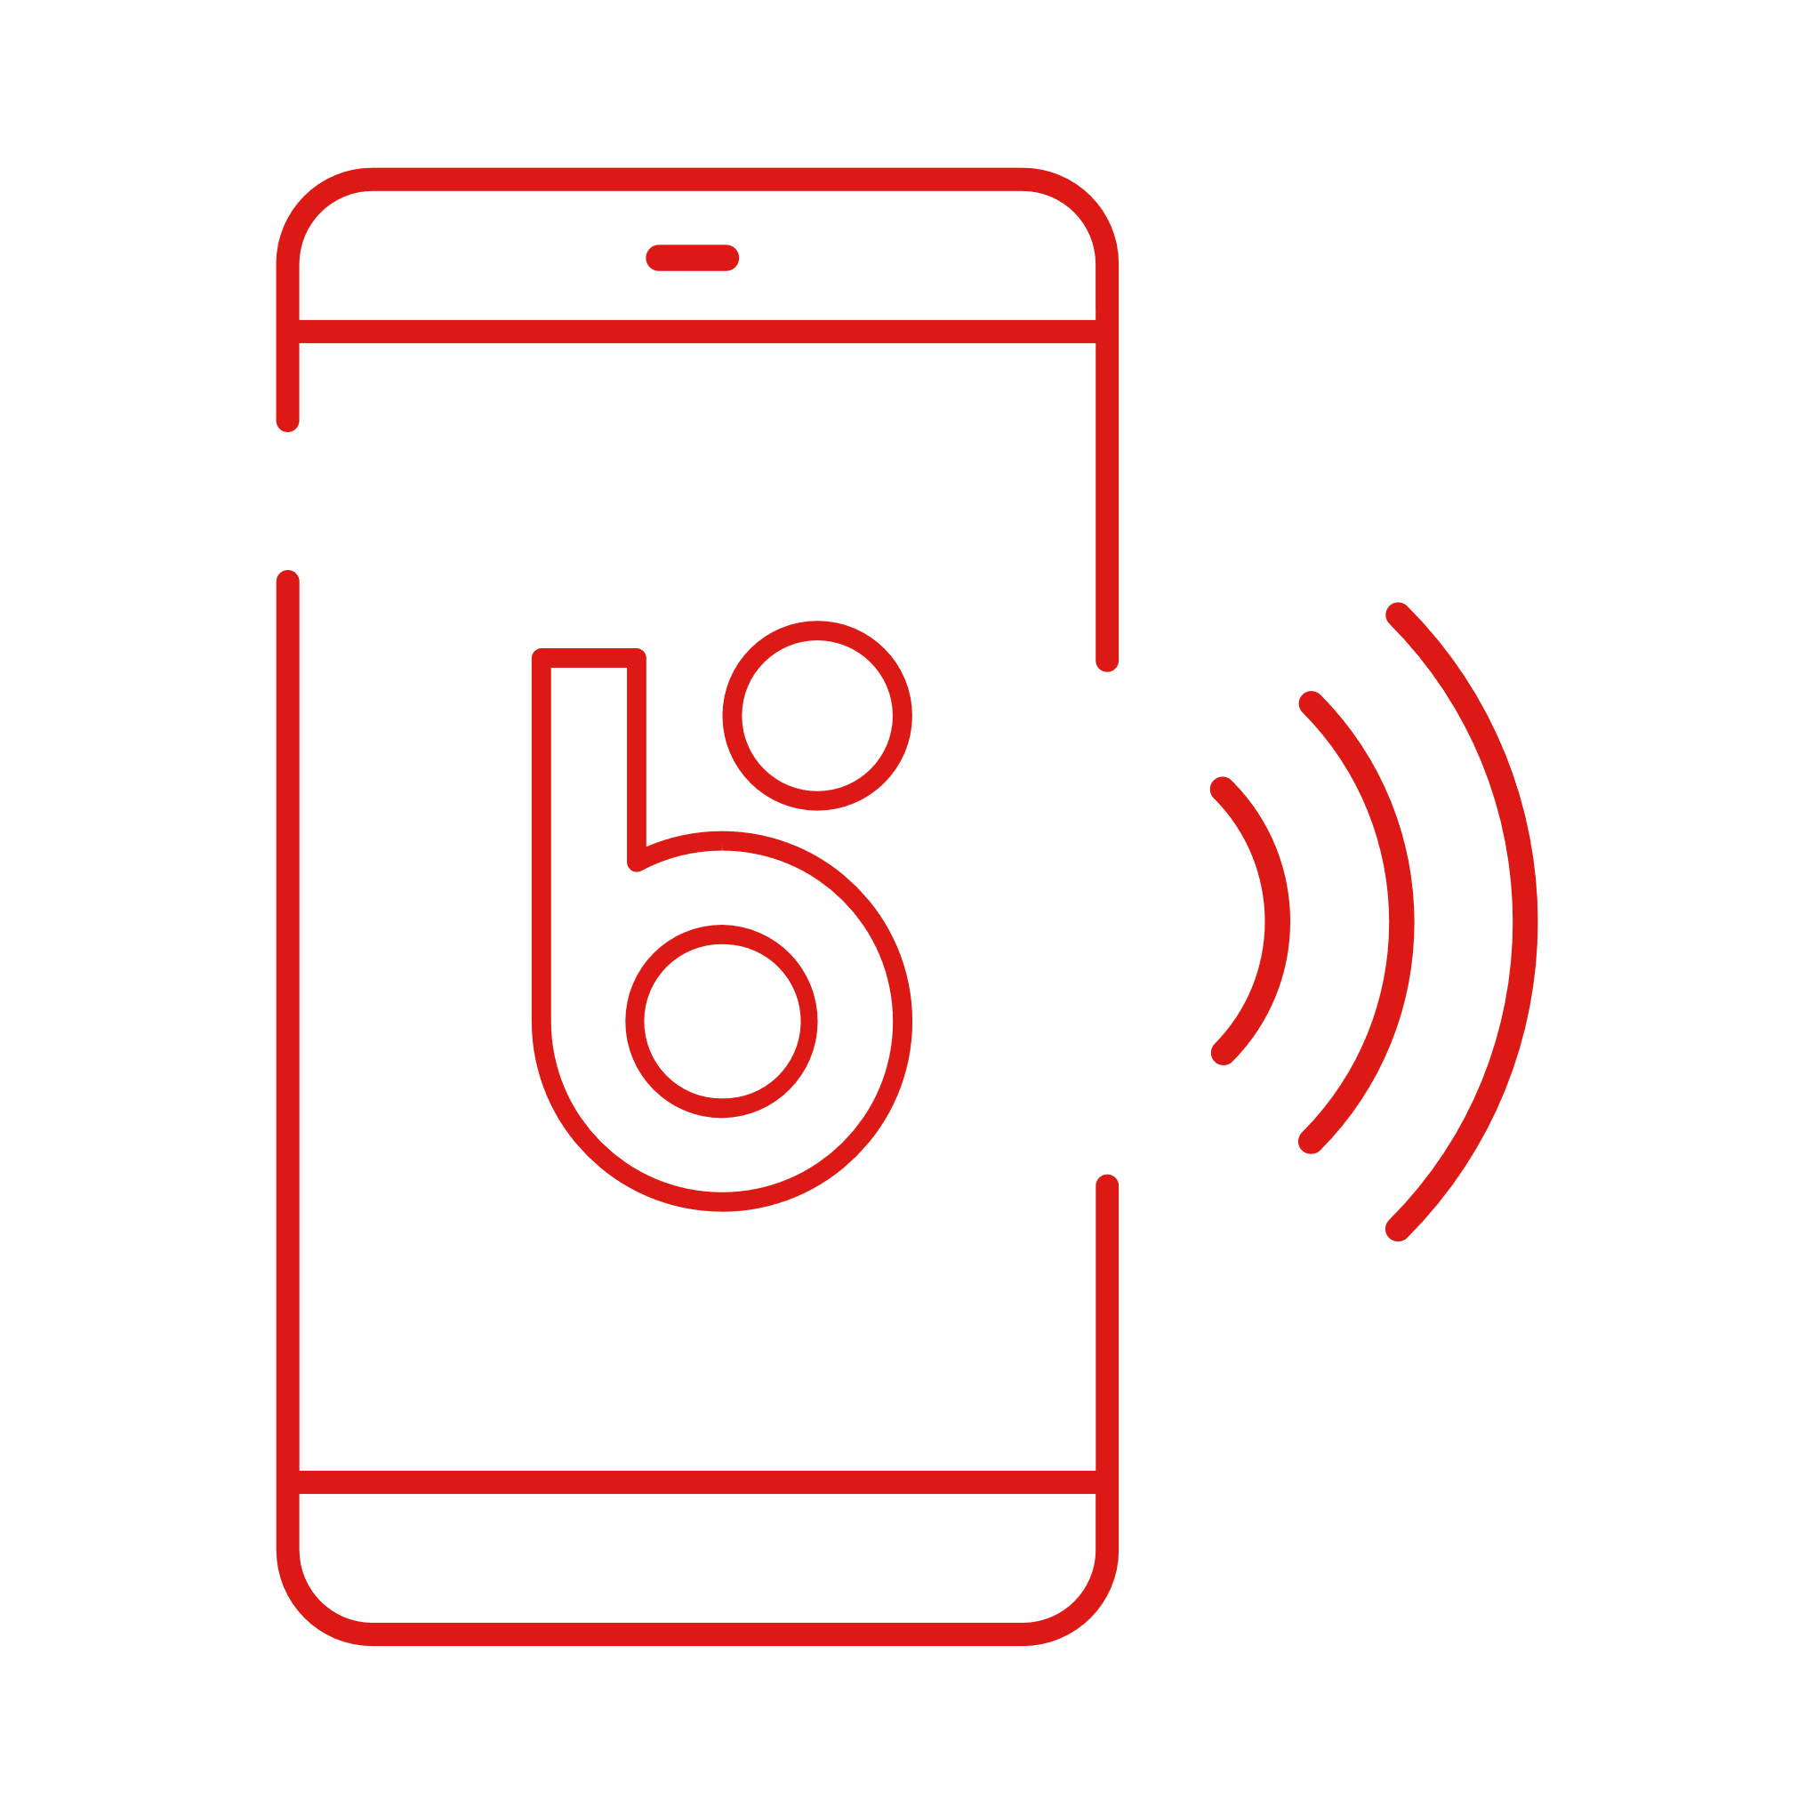
What is BLIK and why users love it
BLIK is a one-time 6-digit code, used for payment initiation at anytime & anywhere
Embedded seamlessly into existing mobile banking applications
Versatile for online & in-store payments, cash withdrawals, P2P payments and more
Instant
Easy
Universal
Secure
blik.com

Slide 5
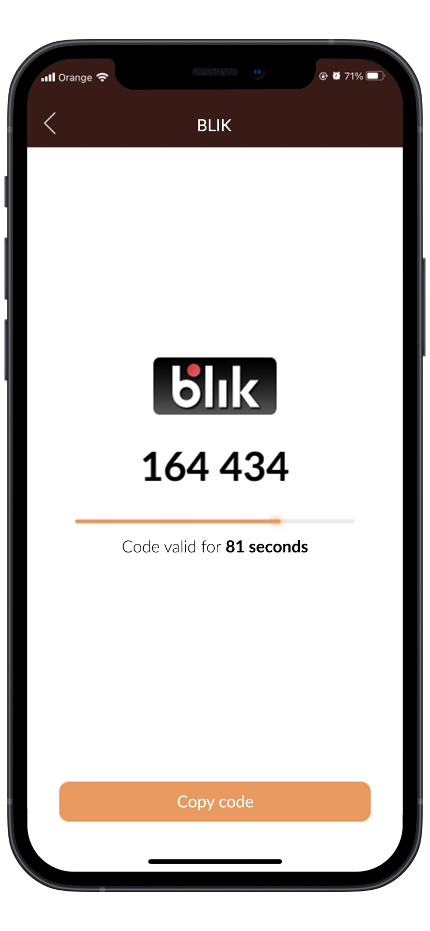
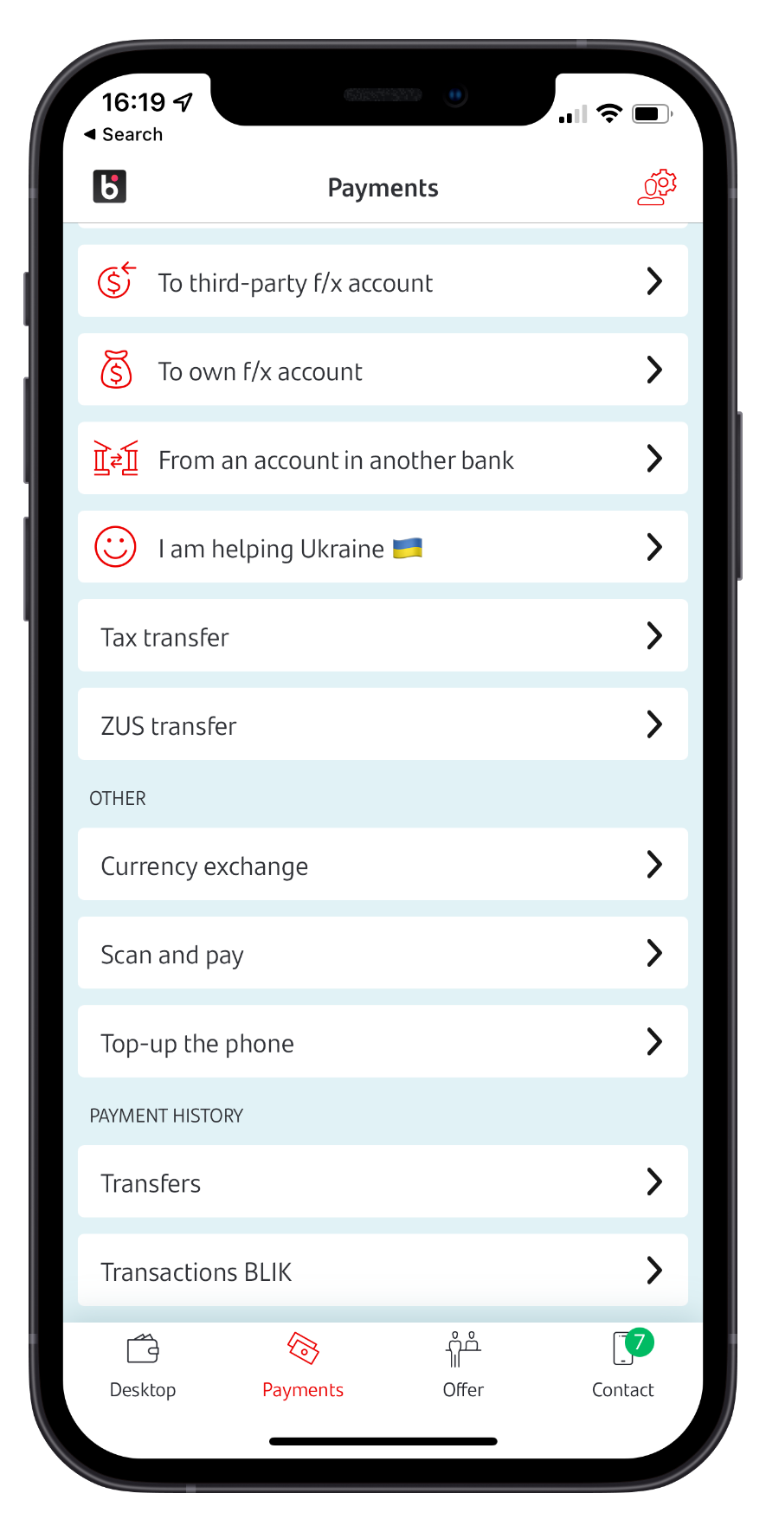
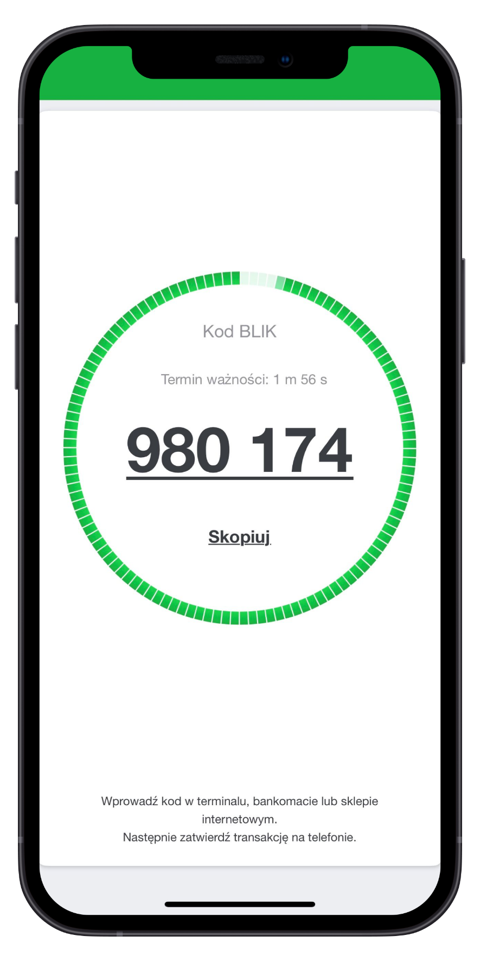
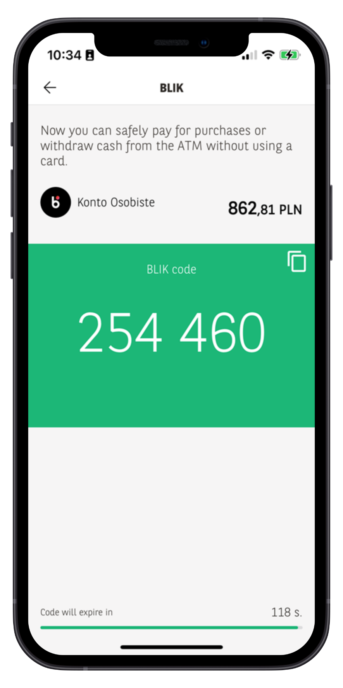
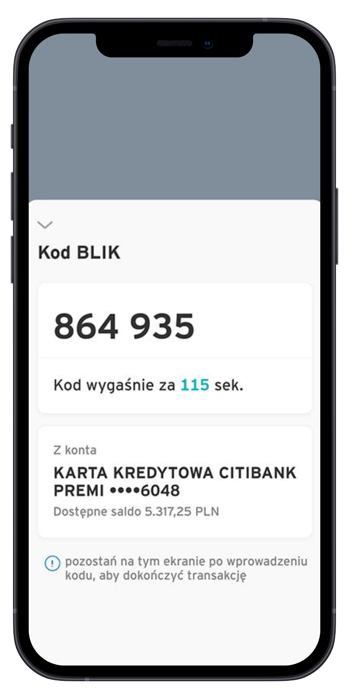
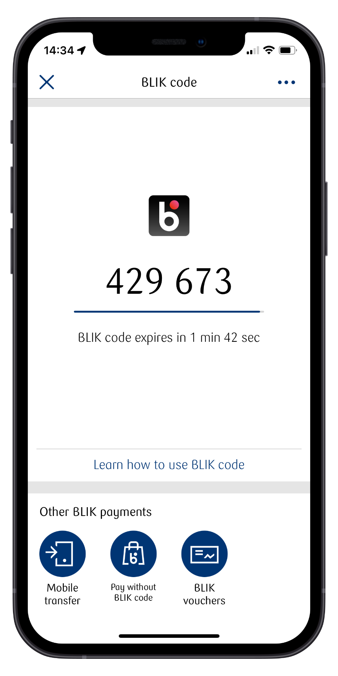
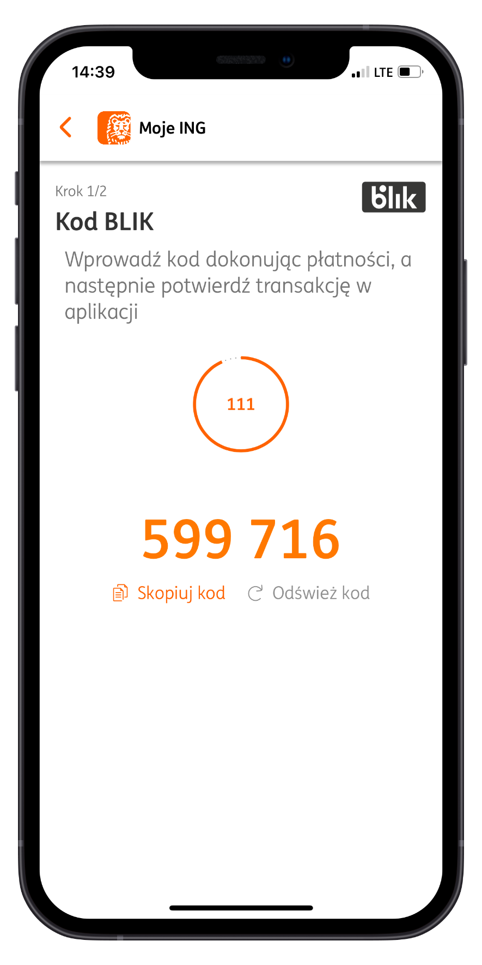
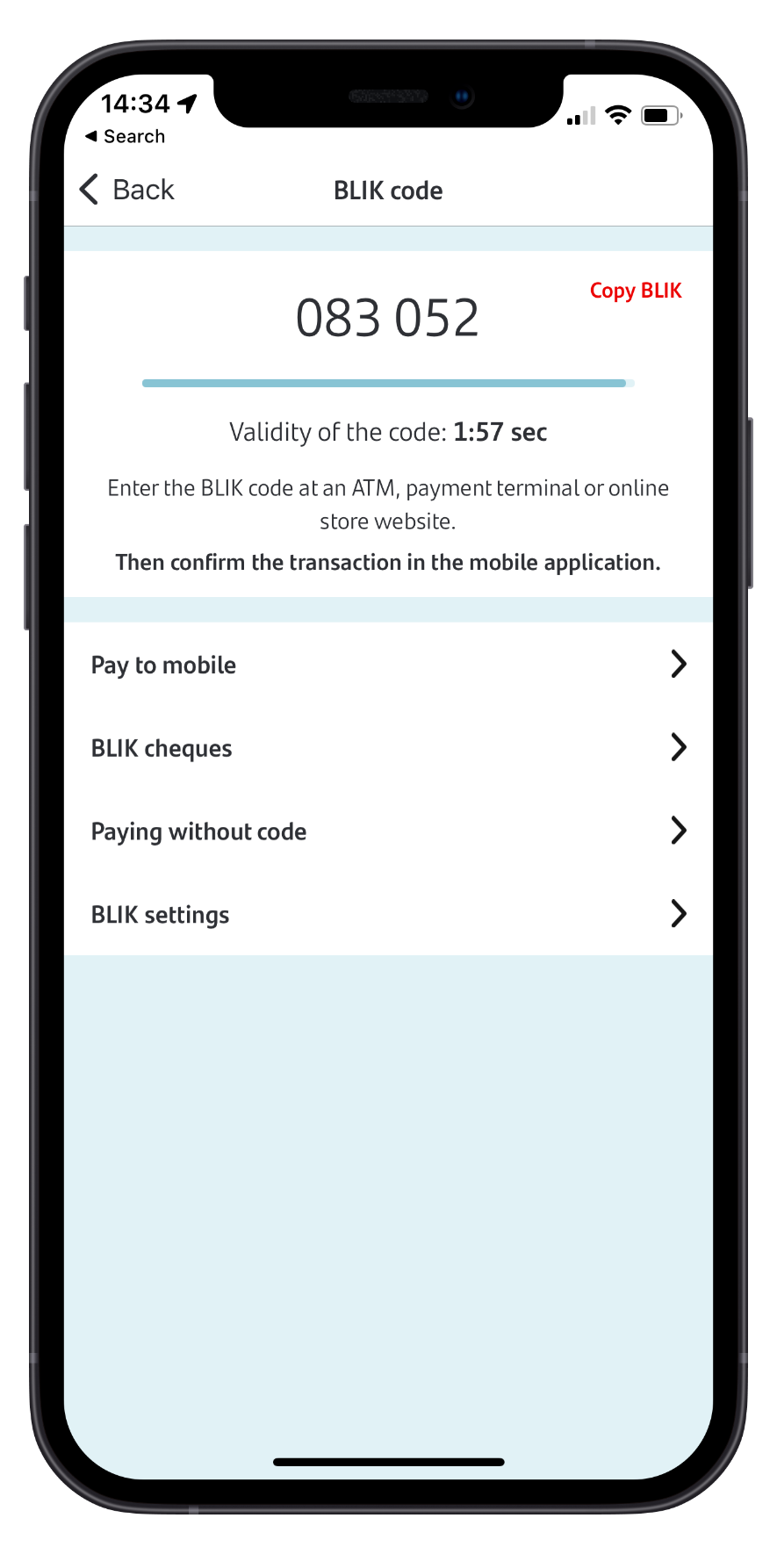
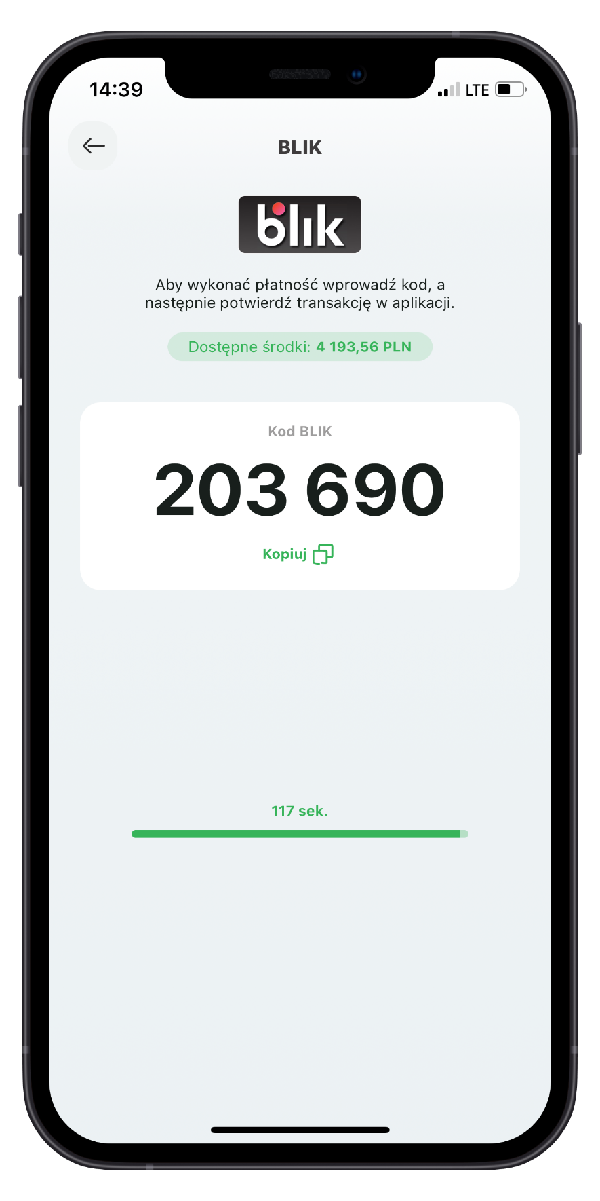
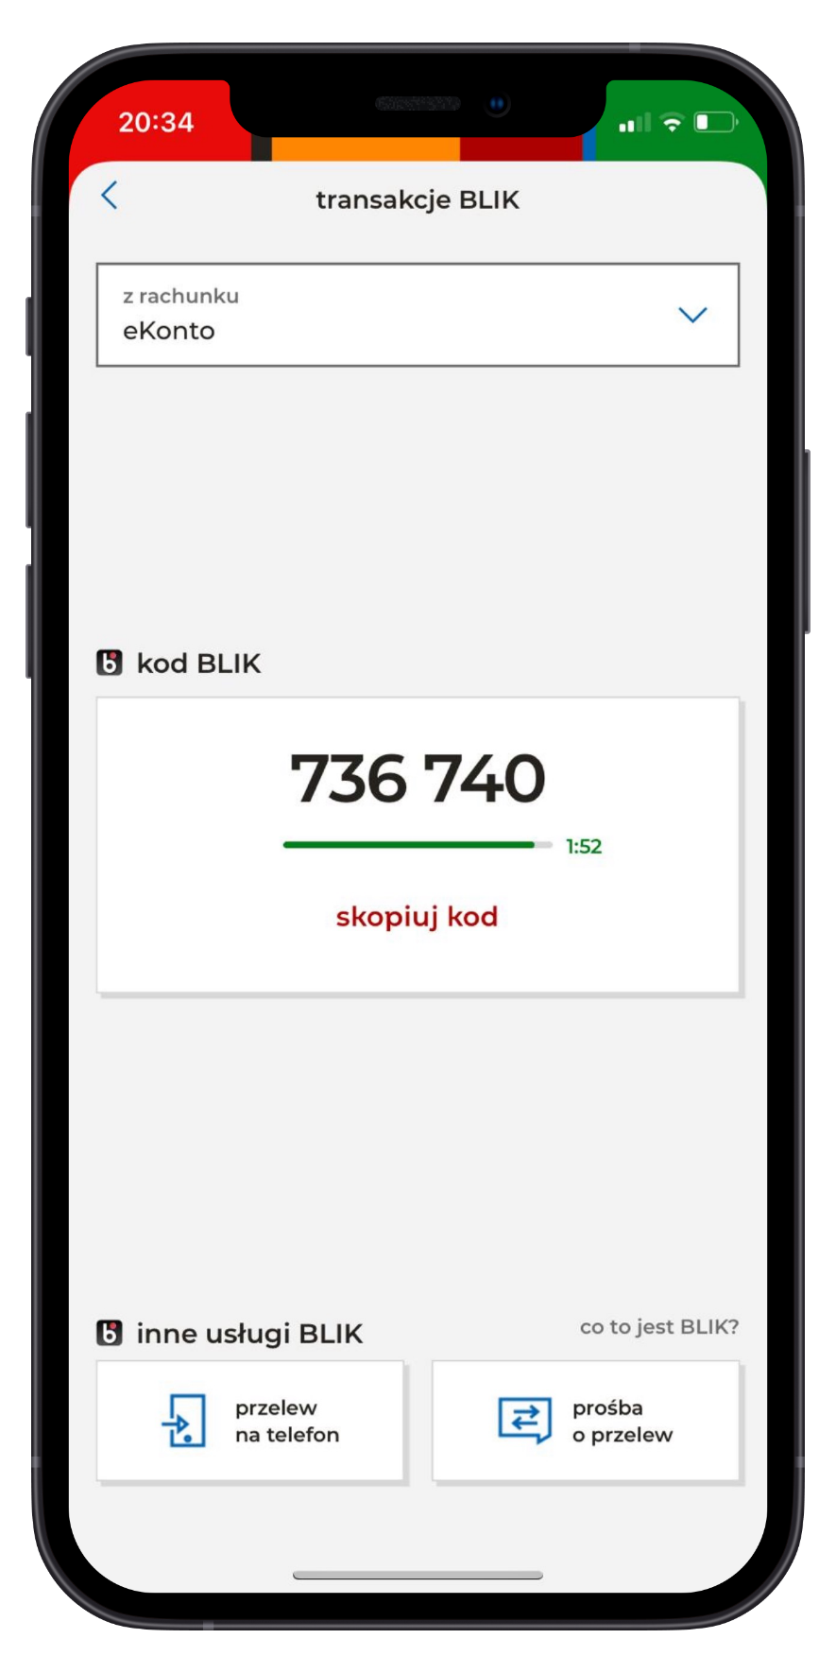
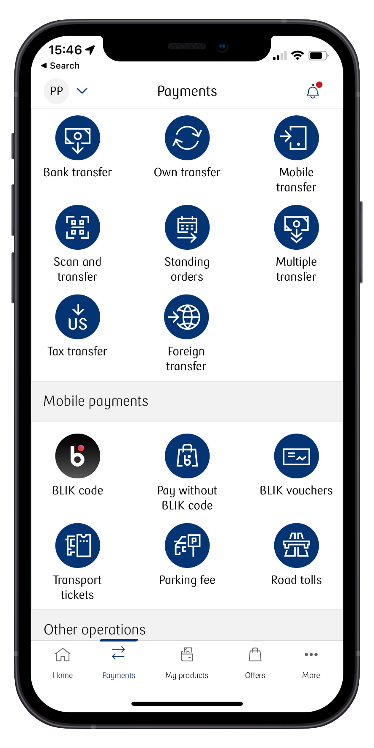

Slide 6
100%
coverage of retail customers

Slide 7
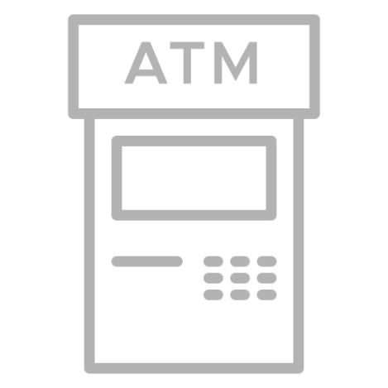
The most universal mobile payment method
You just need a banking app
Pay in-store offline – now also with contactless BLIK
Pay online
Send & request money using only mobile numbers
Withdraw cash
blik.com

Slide 8
BLIK flow in e-commerce
Basic flow with a 6-digit code
blik.com

Slide 9
BLIK flow in e-commerce
Saving a shop as trusted in a banking application
blik.com

Slide 10
BLIK flow in e-commerce
Payment without a BLIK code in a saved shop
blik.com

Slide 11
Our success story
blik.com

Slide 12
14,1 million active BLIK users
Poland – banking landscape
38,2 million Polish inhabitants
31,3 million adult population (88,5% banked)
21,3 million active users of online banking
23,5 million active users of mobile banking
blik.com
5
Notes:
Source for active users of online and mobile banking: Cashless.pl
https://www.cashless.pl/14200-bankowosc-internetowa-umowy-II-kw-2023
https://www.cashless.pl/14184-klienci-mobilni-II-kw-2023
41,5million Poland population (May 2022) including , but there are over 3 mln Ukrainian refugees due to the war.
According to the Research and Analysis Center of the Union of Polish Metropolises Paweł Adamowicz, almost 3 million 200 thousand Ukrainian citizens currently live in Poland.
31,3 milion adults (18+), banked 88,5% (27,7 milion)
Source: https://www.nbp.pl/systemplatniczy/zwyczaje_platnicze/zwyczaje_platnicze_Polakow_2020p.pdf
21 million active users of online banking (Q4 2021)
16 million active users of mobile banking (Q4 2021)
Source: https://www.zbp.pl/getmedia/ebf7bd37-fd02-47ad-95f0-514cc79709bc/Raport-Netbank_Q4-2021
11 million active BLIK users (as of 29.06.2022)
Context – looking at Poland
1. By online banking we mean all various digital channels through which you can access your online banking services. It includes:
bank’s website on your PC
Bank’s website on your smartphone -> RWD (responsive web design browsers)
Mobile banking app
All possible digital access points to your bank services
2. A user who logs in to his/her online banking platform at least once a month

Slide 13
Accepted virtually everywhere
100%
100%
90%
At all POS terminals in stores
In all e-commerce checkouts
Almost in all ATMs
blik.com

Slide 14
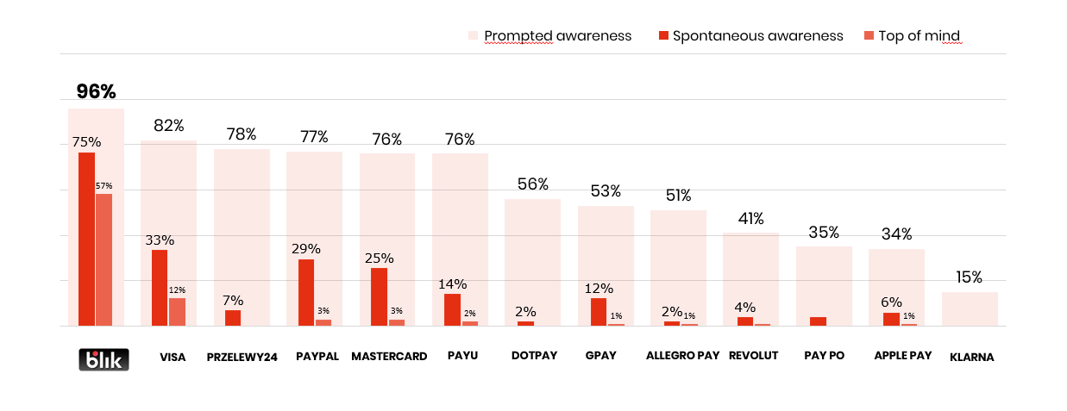
Users love the BLIK experience
BLIK – a leader in awareness among payment brands
blik.com
Source: KANTAR POLAND, Q2 2023, CAWI N=1624, smartphone owners, mobile applications users on smartphone [including banking applications]

Slide 15
BLIK is the dominant online payment method in Poland
x 3,2
100% of Polish
e-commerce acceptance
Up to 78% market share in e-commerce
59% transactions in banking apps are done via BLIK
1st
place in TOP brands in payments (2021)
(in millions of digital transactions including only e-commerce in Poland)
Source: National Bank of Poland, BLIK
blik.com

Slide 16
Number of transactions in 2022 was higher than in the previous 2 years combined
2,8 billion transactions processed in 8 years
Total 351 million transactions
between 2015 - 2019
1.18 billion transactions
between 2020-2021
1.23 billion
blik.com

Slide 17
Global acquirers and merchants already accept BLIK
blik.com

Slide 18
Case studies
blik.com

Slide 19
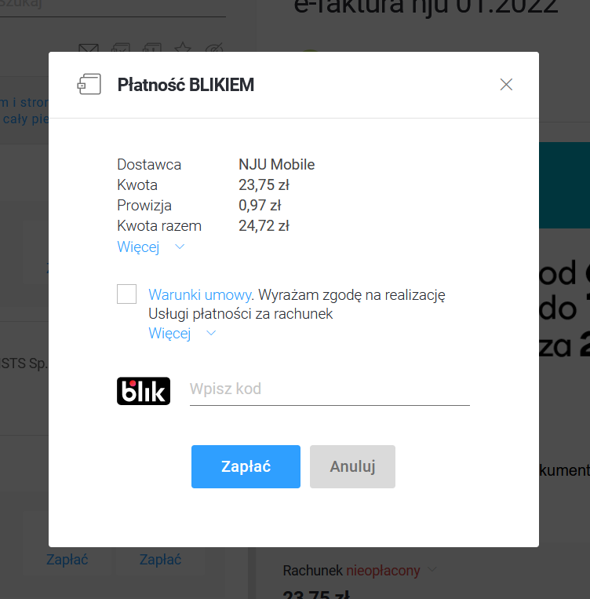
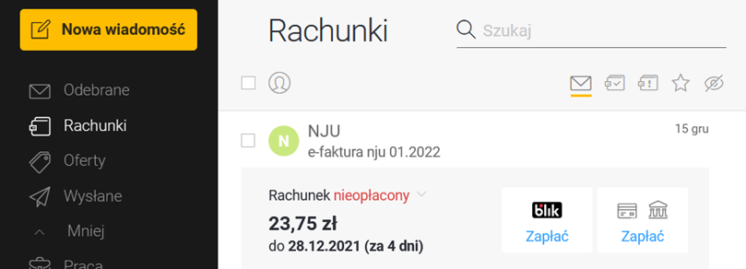
Interia’s Mail Service with BLIK implementation
Billing email list with highlighted BLIK payment
Overview of bill payments with highlighted BLIK implementation
blik.com

Slide 20
BLIK effect
+21%
conversion increase
+81%
growth q2/q1 2021
number of BLIK transactions
+35%
Increase in total number of transactions
-24%
abandoned carts
+24%
growth q2/q1 2021
number of paying users
93%
users use BLIK again
blik.com

Slide 21
BLIK brings benefits to all participants of the system
Stronger primary relationship with users, BLIK supports mobile activation of users
Increased conversion rate at checkout, BLIK provides simple, fast and secure payment with up to 98% success rate because of superior UX
Improved convenience and ease of use, as BLIK is fully embedded into banking app user experience is aligned with all familiar banking features known to users
blik.com

Slide 22
Mobile payments’ time is now
blik.com

Slide 23
Mobile payments’ time is now
Universal, standardized payment option – easy to use and safe
Increased conversion rate at checkout with up to 98% success rate because of superior UX
Further stimulation of e-commerce growth and the reduction of share of cash in transactions
Availability of fintech-like functionality in the mobile banking channels and mobile activation of users
blik.com

Slide 24
BLIK International
After achieving remarkable success in Poland, BLIK targets expansion into new markets.
Slovakia and Romania are the countries in which BLIK commenced its European expansion.
Slovakia
In May 2023 BLIK has acquired 100% of shares in the Slovakian payment company Viamo. We plan to introduce BLIK eCommerce functionality to the Slovakian market this year.
Romania
BLIK has announced the set-up of its new subsidiary BLIK Romania in March 2023. The process of authorization to operate a payment system is ongoing.
Euro area
The company aims to be able to offer BLIK Euro to many banks from the euro area countries, demonstrating a commitment to openness and willingness to expand.
blik.com

Slide 25
Let’s bring BLIK experience to your customers
blik.com

Slide 26
Thank you for your attention
Magdalena Kubisa
Business Development Director
magdalena.kubisa@blik.com

