Slide 1
Amazon in Belgium, Europe and beyond – growing e-commerce together!
EU CBEC forum
September 13 2023

Slide 2
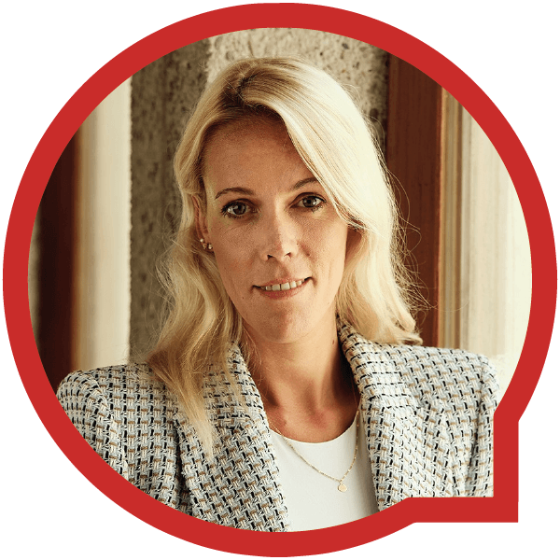
Your Amazon presenter
Belgian
KU Leuven Alumni
8-year Amazonian
Customer obsessed ;)
Eva Faict
Amazon.com.be Country Manager
Notes:
Let me start with a few words about my background. I’m a native of Belgium, born in Ghent, and attended the university in Brussels. I’ve been working at Amazon for 8 years, and what a fulfilling journey it has been! From my very first day, I was impressed by Amazon’s culture and customer-centricity. I kept thinking, “how great would it be to bring Amazon to Belgium?” Fast forward seven years, and I had the privilege of launching amazon.com.be and leading its implementation here, in my home country.

Slide 3
What We Do - Amazon
Our Mission:
To be earth’s most customer-centric company
Where people can find and discover anything they want to buy
Deliver to everyone on the planet
Convenience
Selection
Price
Notes:
We work every day to earn and keep customers’ trust. Our philosophy is simple: work backwards from what customers want – big selection of safe and authentic products, convenience, and low prices – and constantly innovate to make our store better, for both our buying customers and our selling partners. Customer Trust is the one key driving principle at Amazon, the core of Amazon's value. Amazon is striving to be the world’s most customer centric company, earning customer trust is difficult and losing it is extremely easy. Amazon is known for its customer obsession, and a critical part of that is earning and maintaining our customers’ trust, which is why we are so focused on creating a trustworthy shopping experience each and every day. Today, we and our millions of selling partners serve hundreds of millions of customers worldwide. Our customers expect that when they purchase an item in our store, sold either by Amazon or by one of our third-party selling partners, they will receive an authentic and safe product.

Slide 4
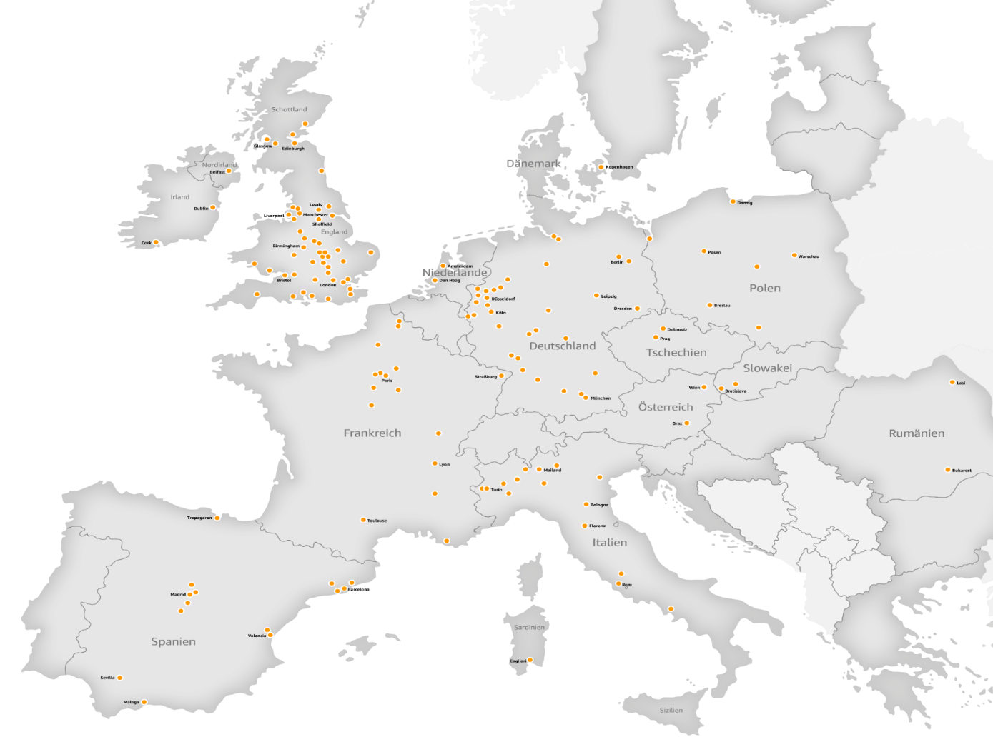
Amazon in Europe AS OF 2022
9
Dedicated storefronts
€150bn
Invested since 2010
150k⁺
Employees across
21 EU member states
250
Fulfillment/Delivery/Sortation Centers across Europe
900k⁺
Independent sellers, authors, content creators, delivery and IT providers
185k
Small and medium businesses selling on Amazon
Notes:
We are a big contributor to the European Economy and are a big employer in the EU. In spite of a sometimes-challenging political climate, Amazon is proud of our growing business in Europe. Amazon is dedicated to the EU. Over the last decade alone (2010 to 2020), we’ve committed more than €100 billion to grow Amazon across the EU and the UK. If you take in to account our cumulative investments in Europe plus our overall GDP contribution, the total is estimated to be more than €200 billion on a pan-European basis since 2010. Those investments have also established Amazon as a major European employer. We now employ over 200k people in permanent roles across Europe, in our offices, in one of our 70 fullfilment centers and other supporting locations. In 2021, we created 65k new permanent jobs across our EU businesses, 850k jobs indirectly in our supply chain and at 3P business selling on our marketplace. Amazon works with more than 900,000 independent small and medium sized partners in Europe, including sellers, App developers, Kindle book authors, and delivery providers. Of these, around 185,000 are Selling Partners selling on Amazon’s Stores.

Slide 5
Amazon in Belgium – the road so far
1994: Belgian customers can shop in English from the US
2003: Belgian customers can shop in French from Amazon.fr
2017: Belgian customers can shop in Dutch from Amazon.de
2020: Belgian customers can shop in Dutch from Amazon.nl
2021: Launch of AMZL in Belgium, to facilitate faster transports
October 18th 2022: Launch www.amazon.com.be
Amazon in Belgium is growing!
Notes:
For years now, our customers in Wallonia and Flanders have been shopping on our Amazon websites across the border. It started in 1994 when Belgian customers could shop in English from the US store and later other international stores followed. We improved the experience in the past 20 years for Belgian customers as they could start shopping on Amazon.fr, Amazon.de and Amazon.nl in the local languages French, German and Dutch. And finally, last year on October 18th, we launched Amazon.com.be where Belgian customers are able to shop in French, Flemish or English, covering 99% of population. This tailored shopping experience for our Belgian customers includes the best of our own retail selection and millions of products from small and medium businesses. Today, we have about 100 employees working in our Brussels office & about 50 employees work in our last mile delivery center in Antwerp. On top of this, 150 Belgian employees are working for international Amazon subsidiaries and we have 200 drivers working for our delivery partners. Partners!

Slide 6
Opportunity is huge
First and foremost, it provides SMBs with a level playing field
Second, it addresses a growing customer shopping trend
Numbers:
2022: total online turnover Belgium - 14.7 billion euros (+22 % yoy)
2022: 8.5 million Belgians shopped online in 2022 (74% population)
2022: retail e-commerce sales >5.7 trillion U.S. dollars worldwide
SMBs (>60% of everything we sell in our online stores) in 2021: >2.2 billion products - combined export sales >€14.5 billion in 2021 (10% increase yoy)
Notes:
This brings me to the second part of my talk as we want to be a partner for companies’ digitalization to further support their business growth, and ultimately contributing to the growth of our country’s economy. When I joined Amazon 8 years ago, I witnessed firsthand the huge opportunity a marketplace can represent for companies and more particularly for entrepreneurs, small and medium-sized businesses, start-ups and craftsmen:
First and foremost, it provides SMBs with a level playing field. Traditionally, smaller businesses struggled to compete with larger, established companies due to limited resources, financial constraints, and a lack of brand recognition. But the advent of e-commerce has transformed and revolutionized this landscape. Today, with an online presence, an SMB can reach a global audience, regardless of their physical size or location. This newfound accessibility enables them to showcase their products and services to a much larger market, expanding their reach beyond the confines of their local community.
Second, it addresses a growing customer shopping trend. Let me share a few striking numbers with you. In 2022, the total online turnover in Belgium was 14.7 billion euros, a 22 percent year-on-year growth. According to BeCommerce, at least 8.5 million Belgians shopped online in 2022, meaning that 74% of the Belgium population actually bought products online! When you consider those few numbers, the actual playing field for our local businesses is just enormous. And this is only for Belgium! In 2022, retail e-commerce sales were estimated to exceed 5.7 trillion U.S. dollars worldwide, and this figure is expected to reach new heights in the coming years.
SMBs are the backbone of the European economy and the heart of our business model. Behind every sale is a seller with a business – SMBs continue to account for more than 60% of everything we sell in our online stores.
In 2021, they sold more than 2.2 billion products in our stores and their combined export sales were more than €14.5 billion in 2021 – a 10% increase on export volumes for the previous year.

Slide 7
Amazon growth enabler
E-commerce yet to be fully embraced: only 30% of Belgium SMBs recorded online sales in 2021
Marketplaces (eg.Amazon.com.be) give access to millions of potential customers around the world = growth lever
20+year relationship with tens of thousands of European selling partners (>50% of everything that is sold on Amazon)
2022: invested >€8 billion across Europe to further enable these companies to sell on Amazon
Notes:
But while e-commerce is undoubtedly developing in Belgium and all over the world, this growth has yet to be fully embraced by small and medium-sized Belgium companies. According to a 2021 Eurostat study, only 30% of Belgium SMBs recorded online sales in 2021. A marketplace such as Amazon.com.be, which gives access in a few clicks to millions of potential customers around the world, represents an invaluable growth lever for these companies and we intend to be a long-term partner for them. And we have the experience to do so!
I am very proud to be part of a company that has a 20+year relationship with tens of thousands of European selling partners of all sizes, most of whom are SMBs. Supporting them is a fundamental part of our work and today they represent more than half of everything that is sold on Amazon.
When I say that supporting the growth of SMBs is a fundamental part of our work, I mean it. In 2021 alone, we invested over €3.4 billion across Europe to further enable these companies to sell on Amazon and access hundreds of millions of customer accounts, generate sales in our stores and succeed while delivering value and a great shopping experience to our customers. These investments are at every stage of an entrepreneur’s journey including logistics (we doubled our fulfilment capacity), services and tools that help to analyze and optimize a business.

Slide 8
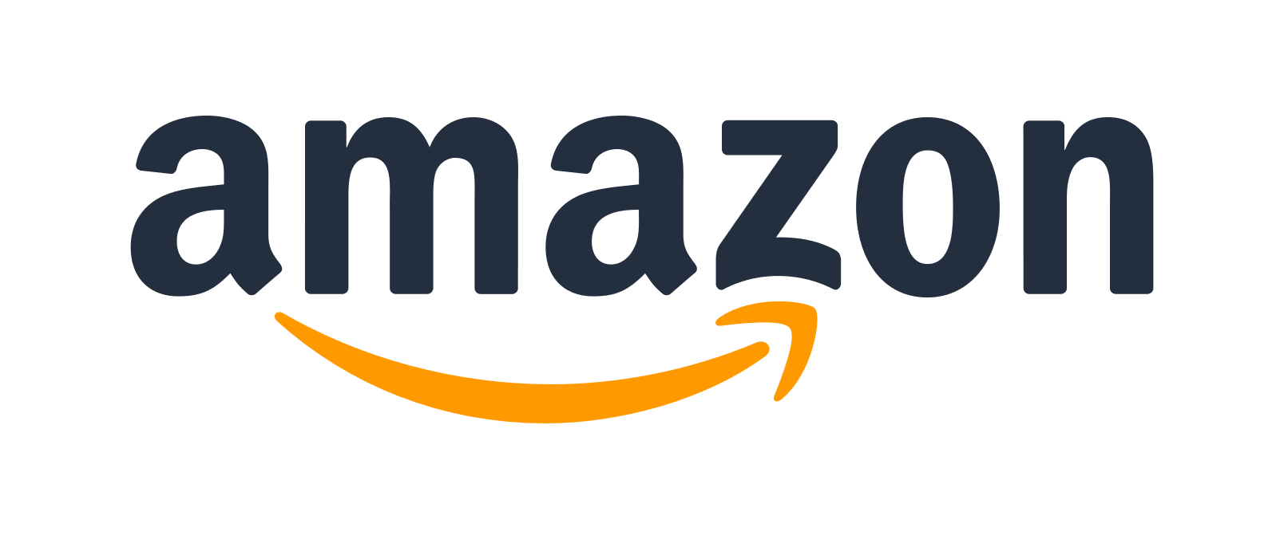
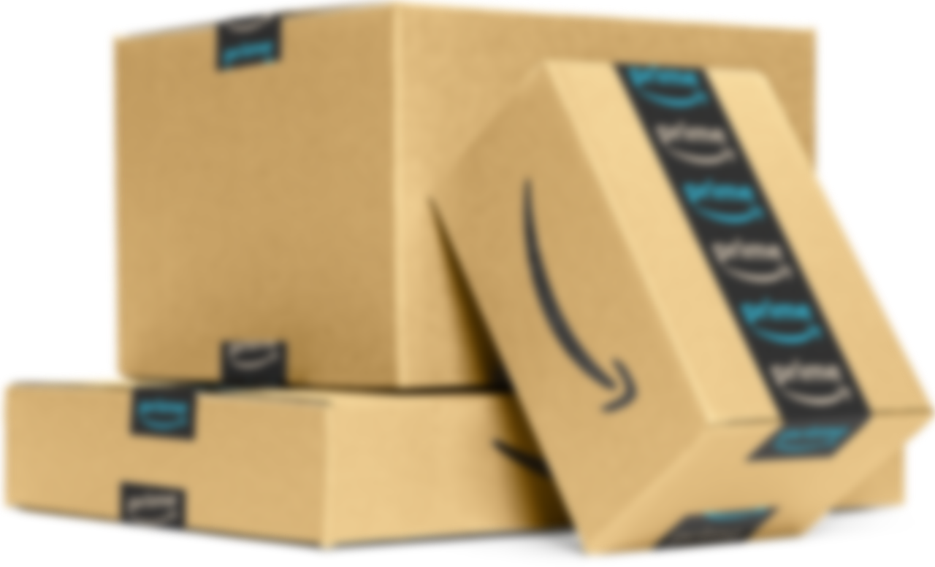
Fulfillment Options
FBA - Fulfilled By Amazon
Selling Partner sends stock to Amazon Fulfillment Centre
Amazon distributes the stock
Customer places an order
Amazon
Picks & Packs order
Amazon ships order with “Next Day promise”
Customer receives order next day
Your products are eligible for
FBA makes it easier to sell across Europe
On average, selling partners who use the FBA service see their sales increase by
36%*
Customers benefit from Amazon’s trusted customer service and returns
Our services let your business scale quickly
*This figure is based on per-channel data analysis from Q4 2019 to Q4 2020 (excluding Q2 2020 in light of the impact of COVID-19). It is provided for general reference only. It does not reflect data updated in real time and is not specific to an ASIN or product category. Actual results may vary depending on a wide range of factors including, but not limited to, seasonality, selling price, or the existing shipping solution. Amazon does not guarantee any results for your company if you use FBA.
Amazon Confidential, © 2023, Amazon.com or its affiliates. All rights reserved
Notes:
The Amazon Marketplace is undoubtedly a great accelerator for small businesses that don't always have the means, time or skills to take the digital plunge and embark on the e-commerce adventure. It allows them to benefit from Amazon's know-how in terms of logistics, sales and marketing so they can focus on their core business.
Take the example of the "Fulfilled by Amazon" service. It helps companies develop their business internationally by accessing Amazon's international logistics resources and the millions of Prime customers who benefit from fast and free delivery options. They can also rely on a recognized customer service available in the language of the countries where they want to sell. With the Fulfilled by Amazon service, we store, pick, pack and ship their inventory throughout Europe when customers order their products. Finally, their products also become eligible for Amazon Prime, giving them access to millions of Amazon's most loyal and active customers.
And we want to further support the international expansion of the companies that sell on Amazon. That is why we recently launched what we call the European Expansion Accelerator. With just 2 clicks, sellers can now sell across all EU Marketplaces! And it is quite easy to use. With that program, selling partners can access one page in Seller Central, discover the stores they are not yet selling in and just click to expand. Their account registration, set-up, translations, listing, shipping setup, product eligibility checks and catalogue customizations will be executed automatically within three business days.

Slide 9
Traffic Generation
Advertising
Notes:
As I said earlier, e-commerce has provided SMBs with a level playing field. While international expansion is definitely one of e-commerce’s key perk, it has brought so many more valuable room for acceleration to SMBs:
E-commerce offers cost-effective marketing strategies. Traditional advertising methods, such as print media or television, can be prohibitively expensive for smaller businesses with limited budgets. However, digital marketing tools, such as social media advertising, search engine optimization, and email marketing, offer cost-effective alternatives. These tools allow to target specific demographics, create personalized campaigns, ensuring that their marketing efforts are both efficient and effective. By leveraging these digital marketing strategies, companies can increase their brand visibility, attract new customers, and ultimately grow their sales.

Slide 10
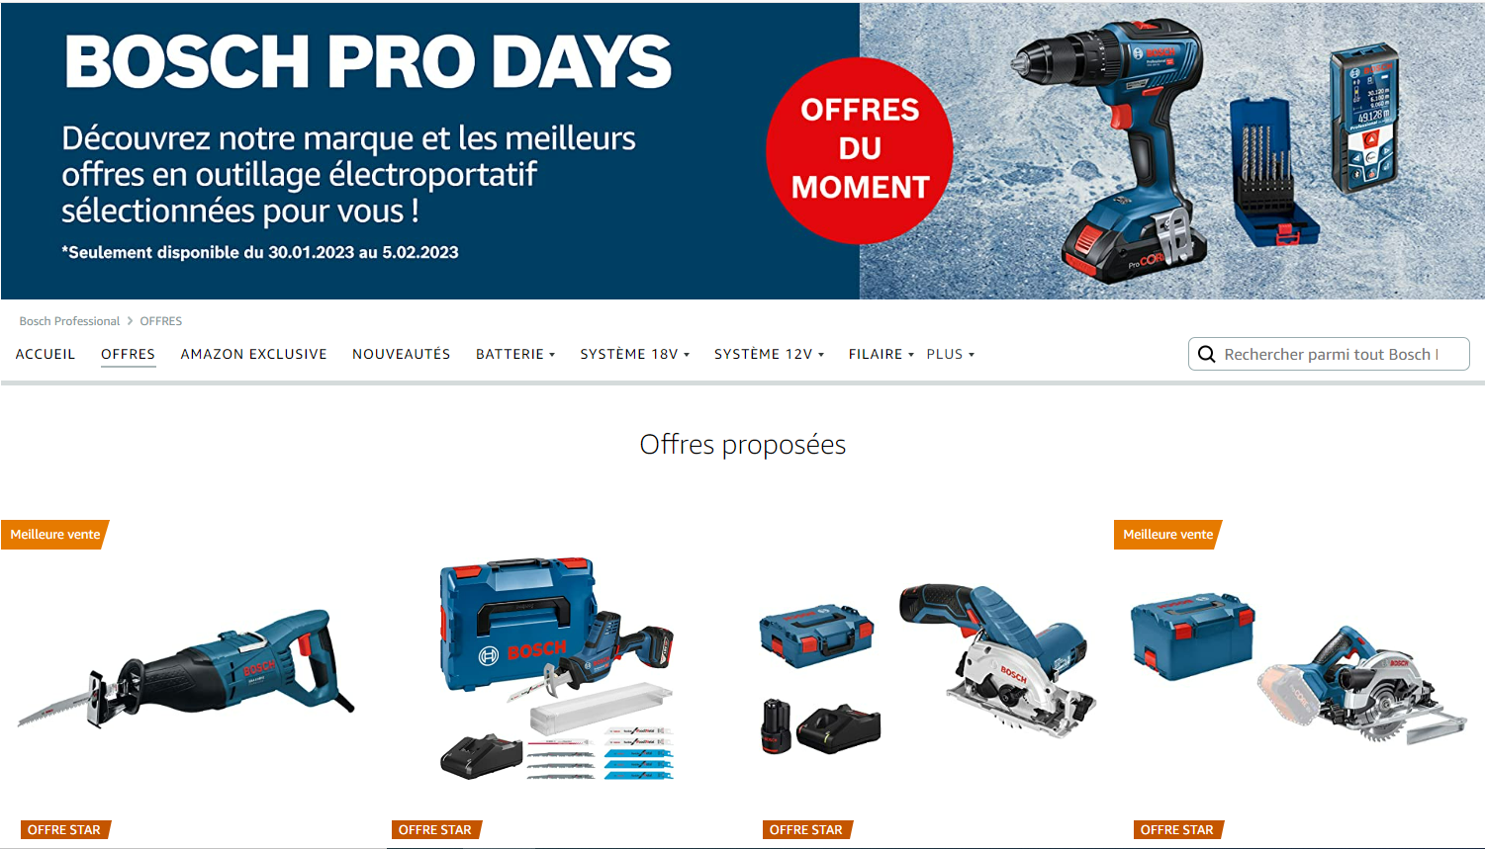
Grow your brand on Amazon
AMAZON STOREFRONTS
Allows you to present your brand in a more personalized way
Allows you to create an immersive selling experience
Allows shoppers to discover your full range of products
Helps generate more traffic from search pages and detail pages
Amazon Confidential, © 2023, Amazon.com or its affiliates. All rights reserved
Notes:
E-commerce also provides invaluable data and analytics. Online platforms generate a wealth of data, ranging from customer preferences and purchasing habits to website traffic and conversion rates. By harnessing this data, companies can gain valuable insights into their target market, identify trends, and make data-driven decisions to optimize their business strategies. This wealth of information levels the playing field for SMBs, as they can now access the same analytical tools and insights that were previously available only to larger corporations. Armed with this knowledge, companies can refine their offerings, improve their customer experience, and tailor their marketing efforts, ultimately driving growth and profitability.

Slide 11
Supporting SMBs – It pays off!
In 2022 more than 125,000 European SMEs sold more than 1.2 billion products to Amazon customers worldwide.
more than 2,200 sales every minute.
Total sales in Amazon stores by EU SMEs exceeded €30 billion in 2022.
To date, more than 30,000 EU SMEs passed the €100,000 sales threshold by selling in Amazon stores and around 6,200 have achieved more than €1 million.
Many of those sales outside of home country borders
More than 70% of all European small and medium enterprises on Amazon are now active participants in the European Single Market and regularly sell products to customers in another Member State.
Notes:
As a company we go the extra mile to enable our sellers to expand their reach and give them the chance to export to consumers in other countries of the European Union. Especially the regulatory framework at the European level needs to be further adapted so that consumers can enjoy the diverse offer that is available Europe-wide. Seamless and frictionless trade within the EU is therefore the answer.
This year the Single Market is 30 years old. The Single Market is described by the European Commission as one of the EU’s greatest achievements, leading to economic growth and making everyday life for European businesses and consumers easier. At Amazon, we share this sentiment. It is clear that the deeper the integration of the European Single Market, the more effective the results for Europe. Amazon takes great pride in being a Single Market Champion. We not only act as an EU integrator, but also as a trustworthy hub for global imports. Beyond retail, our cloud solutions allow for seamless integration of EU-wide businesses, and Prime Video contributes to EU-wide publication of local video productions. But many obstacles to the Single Market remain. The Single Market needs increased ambitions to lower the costs of growth for everyone, but especially for resource-limited businesses - we can do this through objective implementation and enforcement of Single Market rules.
Trade barriers is just one concrete example of frustration we hear our selling partners are facing every day. There are many examples of this, from complex customs rules to payments legislation, but one stands out in particular. Today companies have to maintain foreign VAT registrations in every EU country where they are sending or holding stock. We know that merchants selling online want to hold their stock in multiple Member States in order to be as close as possible to consumers. We need to make it simpler for them to do business.
The solution? The European Commission has proposed legislation that would create a single EU VAT ID, allowing companies to register VAT only once and fulfil their tax obligations in all EU countries through a single online portal. This measure is crucial for SMEs as it removes administrative obstacles related to VAT payments and enables the expansion of their businesses throughout the EU. It needs to be prioritized.

Slide 12
Seamless and frictionless trade within the EU
Single Market is 30 years old – one of EU’s greatest achievements
Amazon:
Single Market Champion
Hub for global imports
Cloud solutions - integration of EU-wide businesses
Prime Video - EU-wide publication of local video productions
The Single Market needs increased ambitions to lower the costs of growth for everyone
Notes:
As a company we go the extra mile to enable our sellers to expand their reach and give them the chance to export to consumers in other countries of the European Union. Especially the regulatory framework at the European level needs to be further adapted so that consumers can enjoy the diverse offer that is available Europe-wide. Seamless and frictionless trade within the EU is therefore the answer.
This year the Single Market is 30 years old. The Single Market is described by the European Commission as one of the EU’s greatest achievements, leading to economic growth and making everyday life for European businesses and consumers easier. At Amazon, we share this sentiment. It is clear that the deeper the integration of the European Single Market, the more effective the results for Europe. Amazon takes great pride in being a Single Market Champion. We not only act as an EU integrator, but also as a trustworthy hub for global imports. Beyond retail, our cloud solutions allow for seamless integration of EU-wide businesses, and Prime Video contributes to EU-wide publication of local video productions. But many obstacles to the Single Market remain. The Single Market needs increased ambitions to lower the costs of growth for everyone, but especially for resource-limited businesses - we can do this through objective implementation and enforcement of Single Market rules.
Trade barriers is just one concrete example of frustration we hear our selling partners are facing every day. There are many examples of this, from complex customs rules to payments legislation, but one stands out in particular. Today companies have to maintain foreign VAT registrations in every EU country where they are sending or holding stock. We know that merchants selling online want to hold their stock in multiple Member States in order to be as close as possible to consumers. We need to make it simpler for them to do business.
The solution? The European Commission has proposed legislation that would create a single EU VAT ID, allowing companies to register VAT only once and fulfil their tax obligations in all EU countries through a single online portal. This measure is crucial for SMEs as it removes administrative obstacles related to VAT payments and enables the expansion of their businesses throughout the EU. It needs to be prioritized.

Slide 13
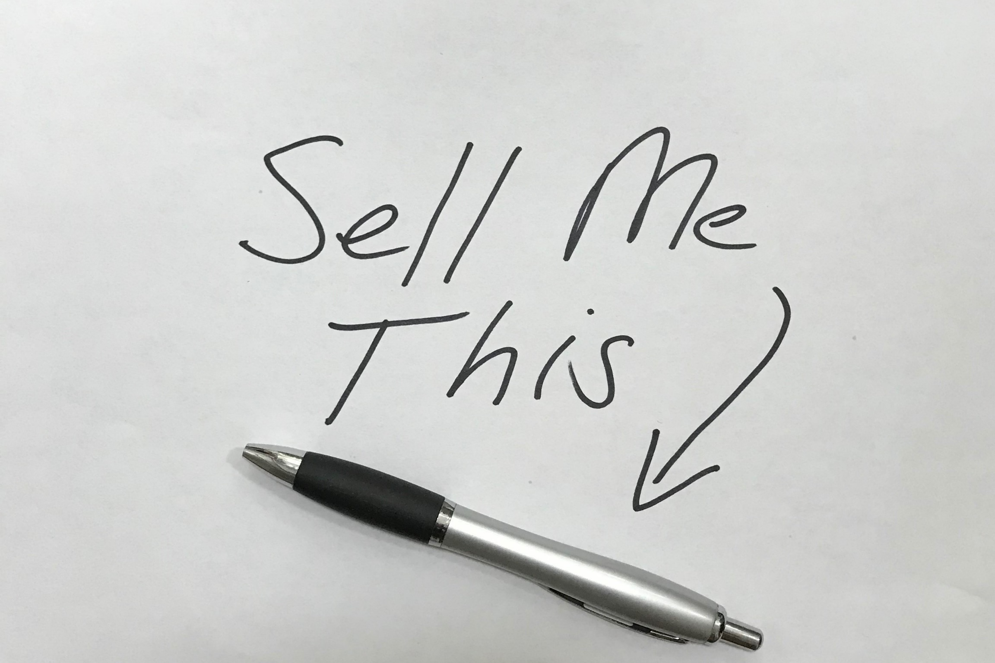
VAT registrations
single EU VAT ID
Notes:
Trade barriers is just one concrete example of frustration we hear our selling partners are facing every day. There are many examples of this, from complex customs rules to payments legislation, but one stands out in particular. Today companies have to maintain foreign VAT registrations in every EU country where they are sending or holding stock. We know that merchants selling online want to hold their stock in multiple Member States in order to be as close as possible to consumers. We need to make it simpler for them to do business.
Now imagine for a minute, that I am a Belgian seller who is eager to sell a pen on Amazon.com.be, and make it accessible to an international audience. I’d want to be certain that I can sell on amazon.com.be, but also be sure that I can easily sell my pen across the border, given that I am in Europe after all. However, I find that I might have to go through a lengthy administrative process, navigate different tax codes, and comply with various regulations just to sell my pen in a different country. Administrative burden should not stop me from showcasing my great pens across borders, and scaling my pen business in the EU. We support these sellers by making available big business tools to small players without the investments, and offer several compliance support services, like VAT calculation services. Such tools are valuable for companies which must grapple with costly, time consuming and often prohibitive VAT registrations in each EU country where they store inventory and from which they sell to local customers, spending around € 8,000 per country per year in compliance costs. I would need to sell a lot of pens to overcome that kind of overhead cost.
The solution? The European Commission has proposed legislation that would create a single EU VAT ID, allowing companies to register VAT only once and fulfil their tax obligations in all EU countries through a single online portal. This measure is crucial for SMEs as it removes administrative obstacles related to VAT payments and enables the expansion of their businesses throughout the EU. It needs to be prioritized.

Slide 14
Success story: Loop Earplugs
Notes:
Going back to our Belgian store. We launched Amazon.com.be just about 11 months ago and we are determined to make the Amazon Belgium Marketplace the place for our local SMBs to grow. Today, over 1,000 Belgian small and medium size businesses have chosen to sell on Amazon, and have set-up their businesses to sell on one or more of the 21 stores across the world, diversifying their sales channels and reaching hundreds of millions of customers. I am proud to see Belgium brands like Barbecook, Kipling, Serax, Loop Earplugs or Valley of Tea selling on Amazon, especially on the Brands of Belgium boutique.
Let’s talk quickly about Loop Earplugs, one of the SMBs we work with, which to me is a great example of how a well-thought out product, designed locally can become an international hit. Loop Earplugs has developed plugs made for noise sensitivity. Loop Earplugs, a successful seller which makes reusable, noise-reducing earplugs that help to avoid sensory overload by reducing annoying or loud sounds. They look and feel good. . It is smart! Perfect for concert-goers who want to listen to music at a lower volume or think about your snoring partner for 5 minutes. These earplugs will just change your nights! Loop Earplugs have been on Amazon since the inception of the company. They also sell through their own website but the bulk of the business is done through Amazon. And thanks to Amazon’s platform, the Belgian company has grown from a two-man operation to a company with more than 70 employees, in just a few years. They sell internationally, especially in the US where they became bestselling earplug! The co-founder acknowledged the many moving parts to deal with as a start-up, and mentioned how it’s better to leave the shipping of products to a specialist like Amazon. We’re always looking to make the lives of our sellers easier. We’re aware, however, that there’s always constant room for improvement. If I have learned one thing from the expansion of our store, it’s that with business success and scale come broad responsibility - our ways of working are continuously evolving and improving, in order to stay on top of new challenges.

Slide 15
1.2 million SMEs in Belgium
History moves forward. And our history has become digital.
The Internet has permanently transformed: societies, economies, access to culture and consumer habits
1.2 million small and medium-sized businesses with unique know-how that are just waiting to shine
We innovate every day to optimize the shopping experience and provide our businesses with new services to help them sell better
Notes:
So it is clear that with or without us, history moves forward. And our history has become digital. In just a few decades, the Internet has permanently transformed our societies, our economies, our access to culture and, of course, our consumer habits. Belgium has more than 1.2 million nuggets that could transform the Belgium economy. 1.2 million small and medium-sized businesses with unique know-how that are just waiting to shine. But too few have seized the opportunities of digital technology to develop their activities, increase their notoriety and extend their selling area from local to national, Europe and why not the whole world. Lack of knowledge, lack of resources... Whatever the reasons, we can put an end to it. By freeing our companies from technological, marketing and logistical constraints, we open the doors to the world by giving them access to millions of customers who are eager to discover the unique know-how of our regions, our companies, our entrepreneurs, our craftsmen... This is the credo of Amazon in the world and in Belgium. That's why we innovate every day to optimize the shopping experience and provide our businesses with new services to help them sell better. And that's why we created the Brands of Belgium store, a store dedicated to Belgium creators and know-how.

Slide 16
Integrating sustainability
We support digitalization while decarbonizing our business
Explore how e-commerce enables more sustainable production and consumption patterns
Amazon Sustainability Accelerator:
12-week training program
Create more sustainable consumer products
Navigate the challenges of starting and scaling a sustainable business
Example: “Yokuu”, a startup that produces waterless, probiotic-based, and planet-friendly cleaning products
Notes:
We have this commitment to support Belgium SMBs digitalization, and we are doing it while decarbonizing our business. This is very important to me and brings me to the final part of my talk. It’s key to explore how e-commerce can enable more sustainable production and consumption patterns. As a business, Amazon works hard to bring other players up.
For instance, we help founders of start-ups via Amazon Sustainability Accelerator, a 12-week training program designed to help them create more sustainable consumer products and navigate the challenges of starting and scaling a sustainable business. The program includes expert-led workshops, mentorship, and access to a network of like-minded founders. A quick example: a small Belgian company called “Yokuu”, a startup that produces waterless, probiotic-based, and planet-friendly cleaning products, recently launched on Amazon. They became one of the winners of the Sustainability Accelerator, and their business has been thriving and rapidly expanding ever since, selling in markets internationally.

Slide 17
Amazon‘s commitment to a sustainable future
100 %
Renewable energy by 2025 (85% in 2022)
Commitment to reach net-zero carbon emmissions by 2040
Co-founded in 2019
>300 signatories
50 %
Of our deliveries net zero CO2 emission by 2030
100 %
Net zero CO2 emissions by 2040
2020: world’s largest corporate purchaser of renewable energy
2021: more than 100 million packages delivered globally using zero-emission vehicles
2022: 120 million packages by electric vehicles
Next 5 years: invest over €1 billion to further electrify and decarbonize our transportation network across Europe
Notes:
The journey to become more sustainable is not simple or straightforward for any organization. For a company of the size and broad scope of Amazon, it’s a big challenge. But at Amazon, we don’t shy away from big challenges. We innovate and create. We don’t have all the answers today, but we believe in the need to act now. In 2019, we co-founded The Climate Pledge and made a commitment to achieve net-zero carbon by 2040—10 years ahead of the Paris Agreement. We invited others to join us and there are now more than 300 businesses and organizations across 51 industries and 29 countries that have signed the Pledge, which means we are collectively coming at the climate crisis from nearly every sector and nearly every angle.
As part of our efforts to decarbonize our business, we became the world’s largest corporate purchaser of renewable energy in 2020, and last year, we reached 85% renewable energy across our business. We continue to expand our use of zero-emission transportation such as electric delivery vans, cargo bikes, and on-foot deliveries. In 2021, more than 100 million packages were delivered to our customers’ doorsteps globally using zero-emission vehicles. We now have thousands of electric vehicles in Europe and delivered 120 million packages by electric vehicles in 2022. Over the next five years we are to invest over €1 billion to further electrify and decarbonize our transportation network across Europe, delivering packages to customers more sustainably.

Slide 18
Integrating sustainability
Amazon.com.be: launched offering micro-mobility deliveries via e-cargo bikes in Brussels
Lowering Emissions by Accelerating Forest finance (LEAF) Coalition - protect the world’s tropical rainforests
I invite you to join the Climate Pledge:
https://www.theclimatepledge.com/
Notes:
For the first time, we launched a new store in Belgium offering micro-mobility deliveries via e-cargo bikes in the Pentagon of Brussels. As we work to decarbonize our delivery network, we also help SMBs who use our fulfilment services to reduce their carbon emissions.
We are also investing in nature-based solutions, and last year, we helped to create the Lowering Emissions by Accelerating Forest finance (LEAF) Coalition—a global initiative of governments and leading companies that has already mobilized $1 billion to protect the world’s tropical rainforests. We will continue to act boldly to address climate change and to invest in solutions to help meet our commitment to reach net-zero carbon across our operations by 2040. It is a collective effort and I therefore invite you to join the Climate Pledge, a cause that lies close to my heart.
Let put our efforts together to support our businesses growth and work together on the environmental front. We have the power to unlock all those challenges together, so let’s go!

Slide 19
Thank you!
Come visit our booth today and tomorrow!
Eva Faict
Amazon.com.be Country Manager
Notes:
I have talked about Amazon’s ambition to become a springboard for companies and a lever for growth nationally and internationally. How we are going at this in a sustainable way and our desire to scale this further. The final key message I want to add to this, is that this is a journey we must all take together as one topic reinforces the other, same as one company can reinforce the other.
My colleagues will be here today and tomorrow in the expo area to tell you more about the services Amazon can provide to both SMBs and larger corporations to continue growing and facilitating their e-commerce business. Do not hesitate to pay them a visit and see what this could mean for you.
Thank you all for your attention!

